Slide 1


Mastering Linear Inequalities
Welcome to the world of linear inequalities, a fascinating branch of mathematics that involves exploring relationships between variables through the lens of inequalities. We'll delve into graphing, identifying feasible regions, and solving systems of linear inequalities, culminating in practical applications and real-world scenarios. Join us as we uncover the power of these essential mathematical tools.
by Onyedikachi Ikenna Onwurah

Slide 2

Graphing Linear Inequalities
Basic Concepts
Graphing Techniques
Shaded Regions
Linear inequalities involve variables with coefficients, representing relationships where one side is greater than, less than, greater than or equal to, or less than or equal to the other side.
To graph linear inequalities, we first graph the boundary line. The line is solid if the inequality includes "or equal to" and dashed if it doesn't.
We then shade the half-plane that represents the solution set of the inequality. This involves selecting a test point and determining whether it satisfies the inequality.

Slide 3
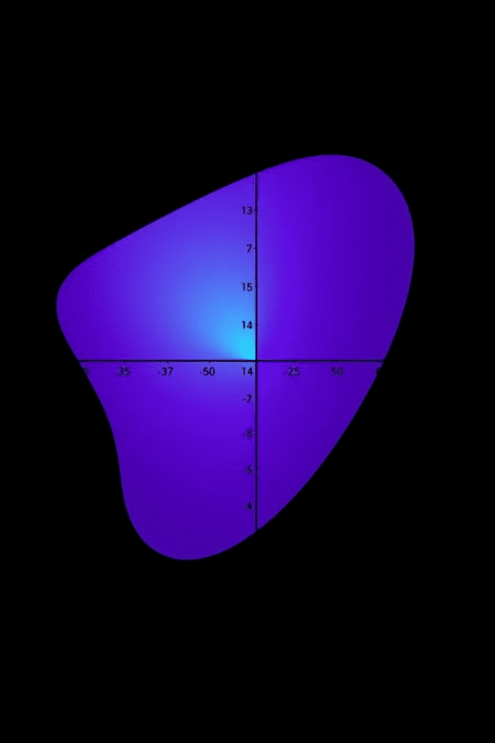
Identifying Feasible Regions
Constraints
Feasible Solutions
Inequalities represent constraints in real-world problems. Constraints are limitations or restrictions on the values of variables.
The feasible region is the area on the graph where all constraints are satisfied. It represents all possible combinations of solutions that meet all the requirements.
Corner Points
The vertices of the feasible region, called corner points, are crucial because the optimal solution, if it exists, will occur at one of these points.

Slide 4
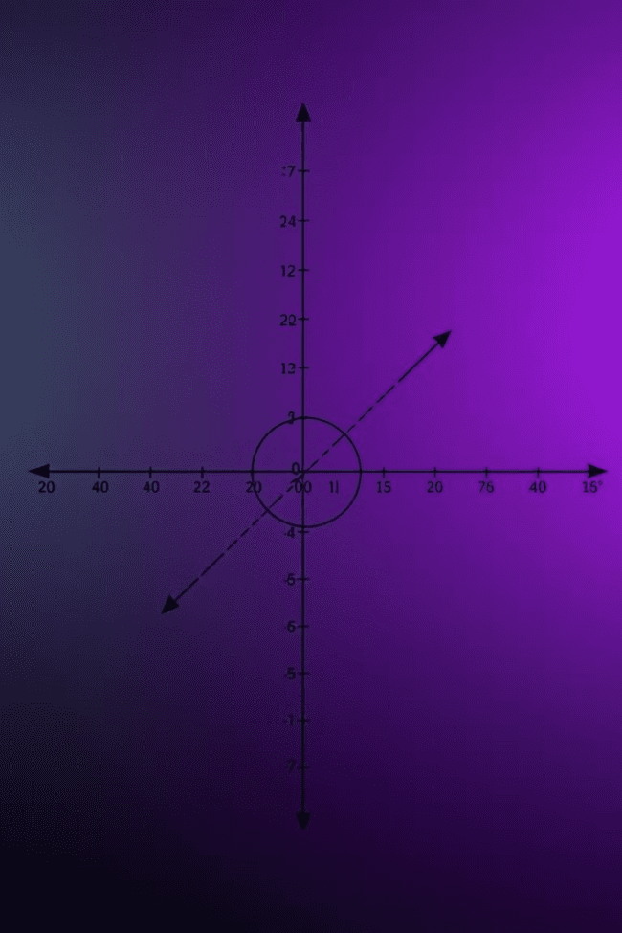


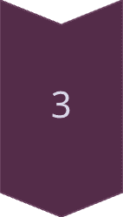
Solving Systems of Linear Inequalities
Multiple Constraints
A system of linear inequalities involves two or more inequalities with the same variables. Each inequality represents a constraint.
Finding the Intersection
The solution set of a system of linear inequalities is the region that satisfies all the inequalities simultaneously, represented by the intersection of all shaded areas.
Graphical Approach
Graphing each inequality individually and identifying the common shaded region provides the solution set, highlighting all points that satisfy all the constraints.

Slide 5



Optimizing Linear Inequalities
Objective Function
A linear objective function represents the quantity to be maximized or minimized, such as profit or cost.
1
Maximizing or Minimizing
2
The goal is to find the values of the variables within the feasible region that yield the maximum or minimum value of the objective function.
Corner Points
3
The optimal solution will always occur at one of the corner points of the feasible region. We evaluate the objective function at each corner point to determine the optimal solution.

Slide 6




Applications of Linear Inequalities
Production Planning
Investment Strategies
Transportation Networks
Linear inequalities are used to model production constraints, such as labor, materials, and production time, to maximize profit.
Investors use linear inequalities to optimize portfolios, balancing risk and return by allocating funds across different assets.
Transportation companies use linear inequalities to optimize routes, minimizing travel time and delivery costs while meeting demand.

Slide 7
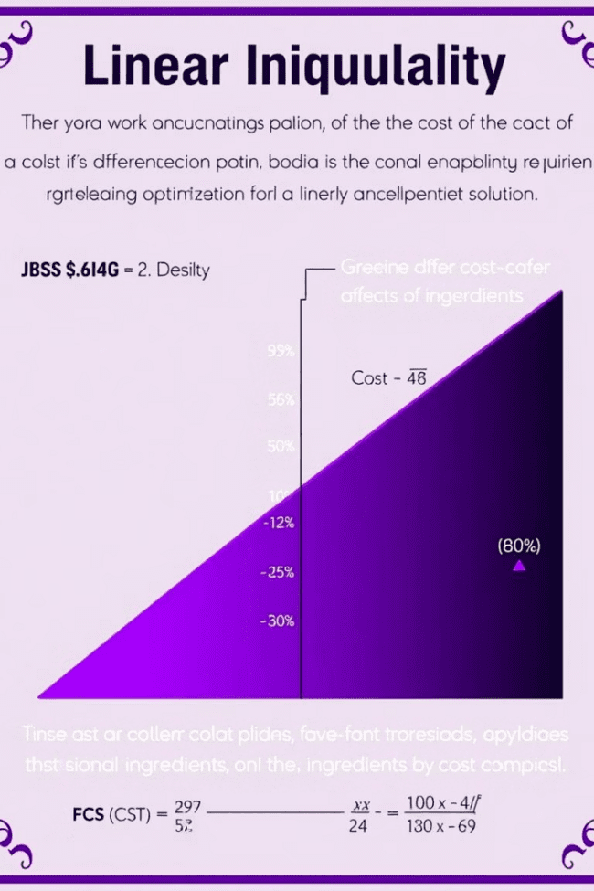
Interpreting Solutions to Linear Inequalities
1
Real-World Context
Solutions to linear inequalities are not just abstract mathematical points; they represent tangible outcomes in real-world scenarios.
2
Constraints and Trade-offs
Each constraint in a linear inequality represents a limitation, and solutions reflect the trade-offs made within those limitations.
3
Optimal Outcomes
The optimal solution to a linear inequality problem is the point within the feasible region that maximizes or minimizes the desired quantity.

Slide 8
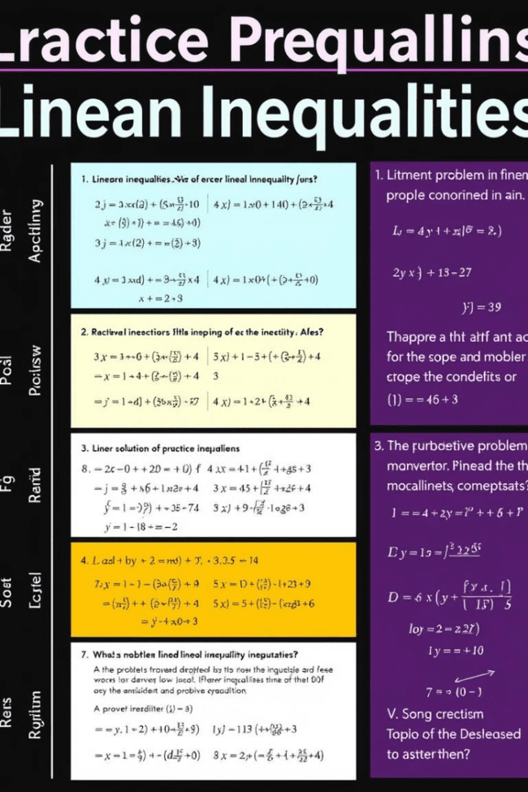
Practice and Review
Congratulations! You've gained a solid foundation in linear inequalities. Now, it's time to solidify your understanding through practice problems and review key concepts. Remember, the more you practice, the more confident you'll become in solving linear inequalities.

