Slide 1


Exploring the Fundamentals of Calculus: Limits and Continuity
Welcome to this presentation on Limits and Continuity, two fundamental concepts in Calculus. We'll delve into understanding what limits represent, their properties, and how to evaluate them. We'll then explore continuity, its types, and the implications of continuity in real-world applications.
by Onyedikachi Ikenna Onwurah

Slide 2
What is a Limit?
A Fundamental Concept
Graphical Representation
A limit in calculus represents the value that a function approaches as its input approaches a specific value. This concept helps us understand the behavior of functions around specific points, even if the function is not defined at that point.
Think of it like a target on a graph. As you get closer to the target, the output of the function gets closer to a specific value. The limit is that specific value the function approaches, even if it doesn't actually reach it.

Slide 3
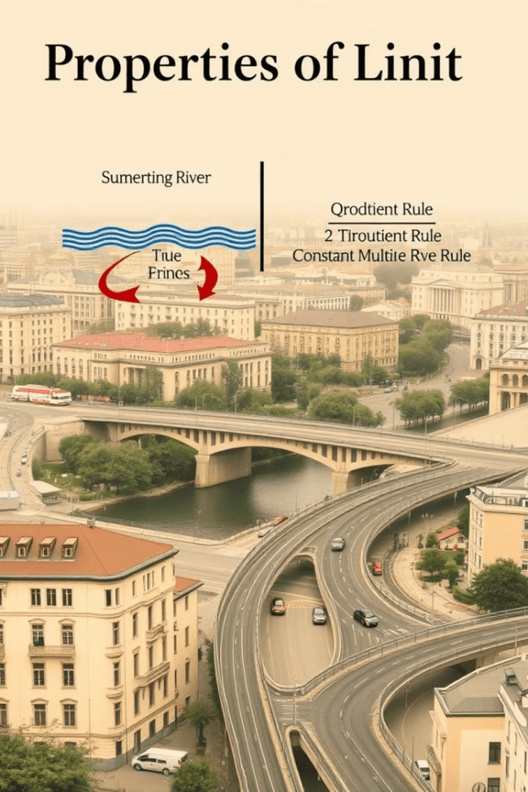
Properties of Limits
1
Sum Rule
2
Product Rule
The limit of the sum of two functions is the sum of the limits of those functions.
The limit of the product of two functions is the product of the limits of those functions.
3
Quotient Rule
4
Constant Multiple Rule
The limit of the quotient of two functions is the quotient of the limits of those functions, as long as the limit of the denominator is not zero.
The limit of a constant multiple of a function is the constant multiple of the limit of the function.

Slide 4
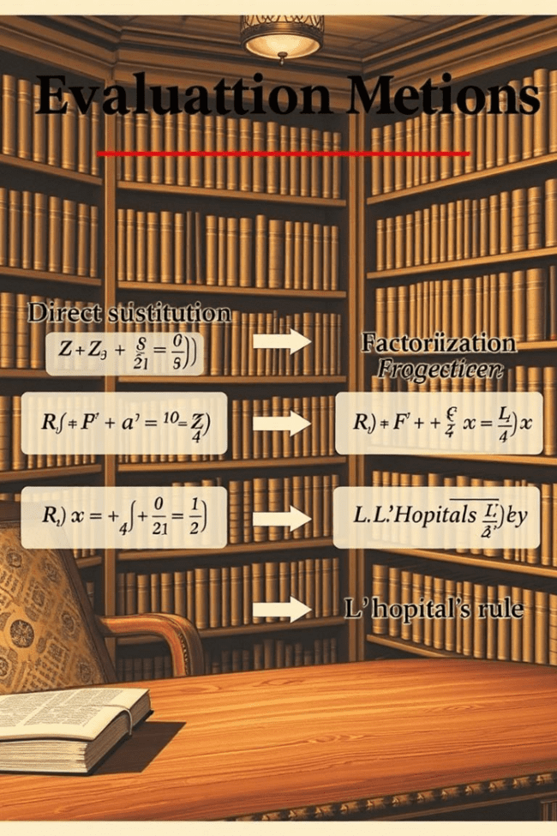
Techniques for Evaluating Limits
Direct Substitution
Factorization and Simplification
If the function is continuous at the point, simply substitute the value to find the limit.
Factor the numerator and denominator to eliminate any common factors, simplifying the expression.
Rationalization
L'Hopital's Rule
Multiply the numerator and denominator by the conjugate of the expression to simplify the function.
If the limit leads to an indeterminate form, take the derivative of both the numerator and denominator and evaluate the limit again.

Slide 5



One-Sided Limits
Left-Hand Limit
Right-Hand Limit
The limit as x approaches a value from the left side.
The limit as x approaches a value from the right side.

Slide 6

Continuity
1
A function is continuous at a point if the limit as x approaches that point exists and is equal to the value of the function at that point.
2
Continuity is important because it allows us to predict the behavior of functions around specific points. It also plays a crucial role in many areas of mathematics, including calculus, differential equations, and topology.
3
In the real world, continuity is often used to model physical phenomena. For example, the position of a moving object can be modeled by a continuous function.

Slide 7
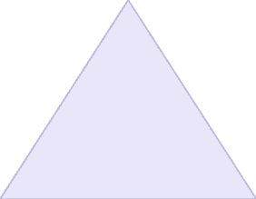
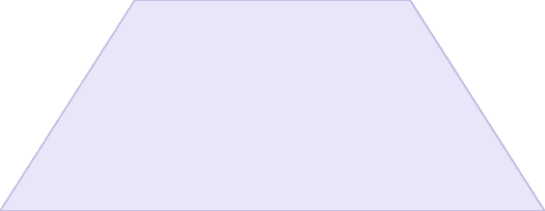
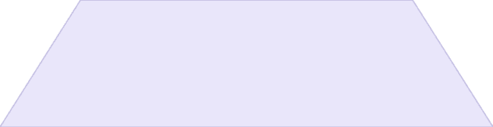
Types of Discontinuities
Jump Discontinuities
1
The function jumps from one value to another.
Removable Discontinuities
2
A hole in the graph, which can be "filled" by redefining the function at that point.
Infinite Discontinuities
3
The function approaches infinity or negative infinity as x approaches the point of discontinuity.

Slide 8
Intermediate Value Theorem
Key Concept
1
If a function is continuous on a closed interval, then it must take on every value between its minimum and maximum values on that interval.
Applications
2
This theorem is used in various fields, including finding roots of equations, proving the existence of solutions, and understanding the behavior of continuous functions.

Slide 9

Limits and Continuity in Real World Applications
1
2
Physics
Engineering
Understanding motion, velocity, and acceleration.
Designing structures, optimizing processes, and analyzing materials.
3
4
Economics
Computer Science
Modeling economic growth, demand, and supply.
Developing algorithms, simulating systems, and creating visual effects.

