Slide 1

Unlocking the Mystery: The Magic of Onto Functions in Mathematics

Slide 2




Introduction to Onto Functions
In this presentation, we will explore
, a fascinating concept in mathematics. An onto function is one where every element in the is mapped by at least one element in the . Let's unlock the mystery behind this magical
concept!

Slide 3
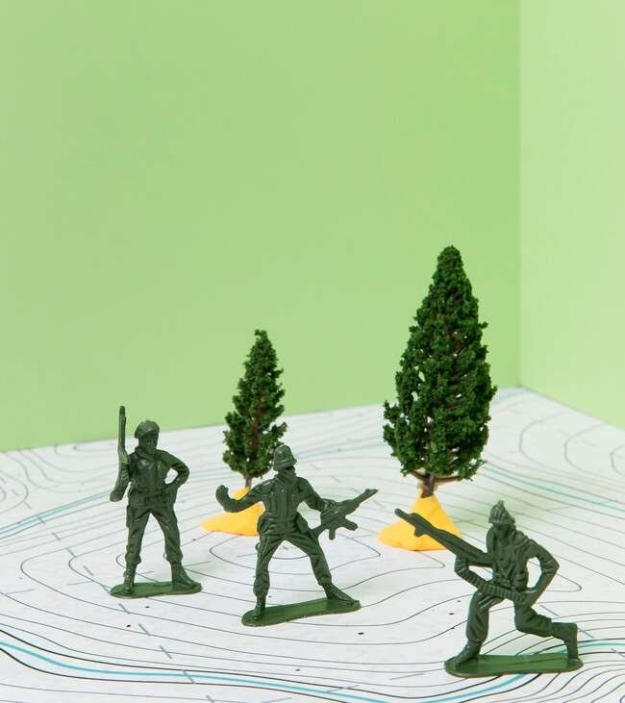





What is an Onto Function?
An
, or
, ensures that every
possible output is achieved. This means for every element in the
, there exists at least one corresponding element in the
. Understanding this concept opens up new
perspectives in mathematical functions.

Slide 4




Visualizing Onto Functions
Imagine a in the
where every point is touched by at least
one point from the . This visualization helps in grasping the essence of onto functions. It's like a dance where every partner ﬁnds a match!

Slide 5

Real-World Applications
Onto functions are not just theoretical; they have
! From computer science to economics, understanding how to model
relationships ensures that every outcome is accounted for. This is crucial for effective decision-making.

Slide 6



Identifying Onto
Functions
To determine if a function is onto, we can check if every element in the is covered. This involves
analyzing the and
ensuring it matches every element in the target set. Let's explore some methods to identify them!

Slide 7



Common Misconceptions
Many confuse onto functions with
. Remember, an onto function can have multiple inputs mapping to the same output,
while a one-to-one function must map each input to a unique output. Clarifying these terms enhances our understanding.

Slide 8

Interactive Examples
Engaging with
can solidify our understanding of onto functions. By experimenting with different sets and mappings, we can visually see how onto functions operate. Let's dive into some hands-on activities to explore this further!

Slide 9

Conclusion: The Magic Unlocked
In conclusion, the magic of lies in their ability to connect every element of a codomain to the domain. By grasping this concept, we can enhance our mathematical skills and apply this knowledge to various ﬁelds. Keep exploring and unlocking more mysteries!

Slide 10
Thanks!
Do you have any questions? youremail@email.com
+91 620 000 838
www.yourwebsite.com @yourusername

