Slide 1


Shapes and Geometry Basics
Geometry is the fundamental branch of mathematics that explores the properties and relationships of shapes, angles, and spatial dimensions. From the simplest circles and triangles to the intricate polygons and 3D forms, the study of geometry underpins our understanding of the world around us, from the natural world to the built environment. In this presentation, we'll dive into the basics of geometric shapes, their characteristics, and how they can be applied in various practical contexts.
by Onyedikachi Ikenna Onwurah

Slide 2
Introduction to Geometric Shapes
2D Shapes
3D Shapes
Compound Shapes
The most fundamental geometric shapes are those that exist in a two-dimensional plane, such as circles, triangles, squares, and rectangles. These shapes are defined by their number of sides and the relationships between their angles and sides.
Three-dimensional shapes, also known as solids, occupy space and have depth, width, and height. Common examples include cubes, spheres, pyramids, and cylinders. These shapes are crucial in understanding and modeling the physical world around us.
More complex shapes can be created by combining or transforming basic geometric shapes. These compound shapes, such as polygons and curved surfaces, are essential in architecture, engineering, and design, allowing for the creation of intricate and innovative structures.

Slide 3
Properties of Circles
1
Continuous Curve
2
Radius and Diameter
A circle is defined as the set of all points in a plane that are equidistant from a given point, called the center. This continuous, curved line has no beginning or end, making it a unique and elegant geometric shape.
The radius of a circle is the distance from the center to the edge, while the diameter is the distance between two points on the edge, passing through the center. These measurements are fundamental in understanding and calculating the properties of a circle.
3
Circumference
4
Area
The circumference of a circle is the distance around the outside of the shape, which is calculated using the formula 2πr, where r is the radius. This measurement is crucial in many real-world applications, such as bike tire sizing and pipe diameters.
The area of a circle is the space enclosed within the circular shape, which is calculated using the formula πr^2, where r is the radius. This property is essential in fields like architecture, engineering, and physics, where the efficient use of space is paramount.

Slide 4
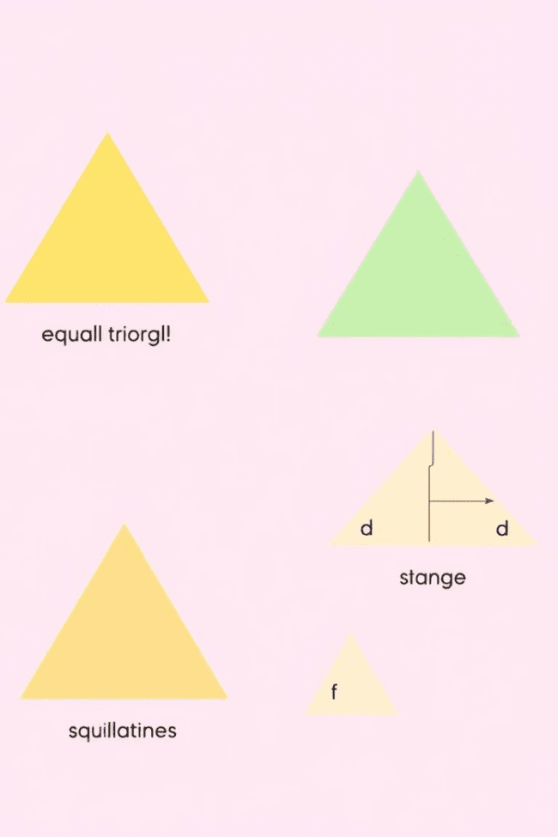
Understanding Triangles
1
Equilateral Triangle
An equilateral triangle is a three-sided polygon with all sides and angles equal. This symmetric shape is often used in architecture, engineering, and design for its structural stability and aesthetically pleasing properties.
2
Isosceles Triangle
An isosceles triangle has two sides of equal length, resulting in two equal angles. This shape is commonly found in nature, such as in the wings of certain birds, and is also used in various constructions and designs.
3
Scalene Triangle
A scalene triangle is a three-sided polygon with no equal sides or angles. This asymmetric shape is often used in engineering and design applications where a more dynamic or irregular form is desired.

Slide 5
Characteristics of Quadrilaterals
Squares and Rectangles
Rhombus and Parallelogram
Trapezoid
Squares and rectangles are four-sided shapes with opposite sides of equal length. Squares have all four sides and angles equal, while rectangles have two sets of parallel sides of equal length. These shapes are widely used in architecture, engineering, and design due to their structural stability and efficient use of space.
A trapezoid is a four-sided shape with at least one pair of parallel sides. This asymmetric shape is commonly found in roofing, furniture design, and various architectural elements, where it can be used to create dynamic and eye-catching structures.
A rhombus is a four-sided shape with all sides of equal length, while a parallelogram has opposite sides of equal length and parallel. These shapes are often used in the design of buildings, vehicles, and various products, as their unique properties can create visually interesting and functional designs.

Slide 6
Exploring Polygons
Regular Polygons
Irregular Polygons
Polygon Properties
Regular polygons are shapes with an equal number of sides and angles, such as pentagons, hexagons, and octagons. These symmetrical shapes are widely used in architecture, design, and nature, as they offer structural stability and visual appeal.
Irregular polygons are shapes with an unequal number of sides and angles, such as heptagons, nonagons, and decagons. These more complex shapes are often used in modern architecture, product design, and abstract art, where they can create dynamic and visually interesting compositions.
Regardless of their shape, all polygons share certain properties, such as the relationship between the number of sides and the sum of the interior angles. Understanding these properties is essential for various mathematical and practical applications, from calculating areas to designing efficient structures.

Slide 7



Symmetry in Geometric Shapes
Reflectional Symmetry
Rotational Symmetry
Bilateral Symmetry
Shapes with reflectional symmetry can be divided into two or more identical halves by a line or plane of reflection. This type of symmetry is commonly found in nature, such as in butterfly wings and snowflakes, as well as in architectural and design elements.
Shapes with rotational symmetry can be rotated around a central point by a certain angle and still appear unchanged. Regular polygons, such as squares and hexagons, are prime examples of shapes with rotational symmetry, which is often used in decorative and industrial designs.
Bilateral symmetry, also known as mirror symmetry, occurs when a shape can be divided into two equal halves along a central axis. This type of symmetry is prevalent in nature, such as in the human body and many animal species, and is also widely used in architectural and design compositions.

Slide 8
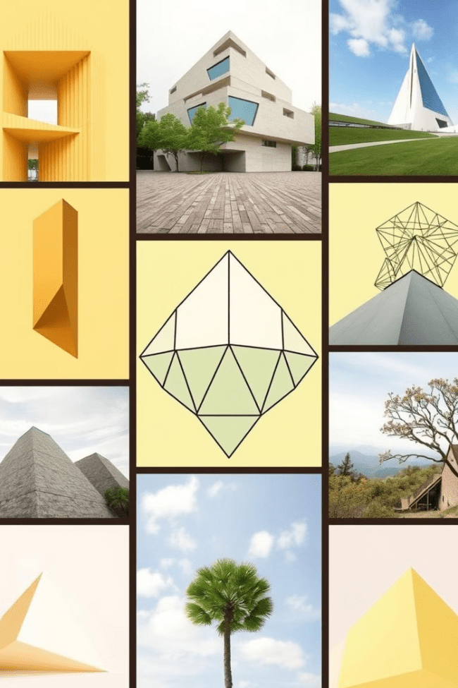



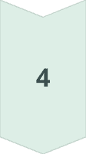
Practical Applications of Geometry
Architecture
Geometric shapes and principles are fundamental in the design and construction of buildings, bridges, and other structures, ensuring stability, efficiency, and aesthetic appeal.
Engineering
Engineers rely heavily on geometric concepts to design and analyze everything from mechanical systems to electronic components, ensuring optimal performance and safety.
Design
Geometric shapes and patterns are widely used in product design, packaging, and visual arts, as they can create visually striking and functionally effective compositions.
Nature
The natural world is filled with a diverse array of geometric shapes and patterns, from the hexagonal structure of beehives to the spiral arrangements of seashells, showcasing the prevalence and importance of geometry in the natural environment.

