Slide 1

Unlocking the Mysteries: A Journey into the World of Complex Numbers

Slide 2








Introduction to Complex
Numbers
Welcome to the fascinating world of
! In this presentation, we will explore their and
. From the
to their role in various ﬁelds, prepare to embark on a that
unveils the beauty of
.

Slide 3





What Are Complex
Numbers?
Complex numbers consist of a
and an
bi, where 'i' is the
, expressed as a +
. They
allow us to solve equations that have no real solutions, opening doors to a
in mathematics and
beyond.

Slide 4




The Imaginary Unit
The 'i' is deﬁned as the square root of -1. This seemingly
revolutionizes mathematics by allowing us to
express and perform operations that were previously impossible, leading to in various ﬁelds.

Slide 5








Visualizing Complex Numbers
Complex numbers can be visualized on the
where the x-axis represents the
,
and the y-axis represents the
. This graphical representation helps us understand their and
, making complex concepts more .

Slide 6
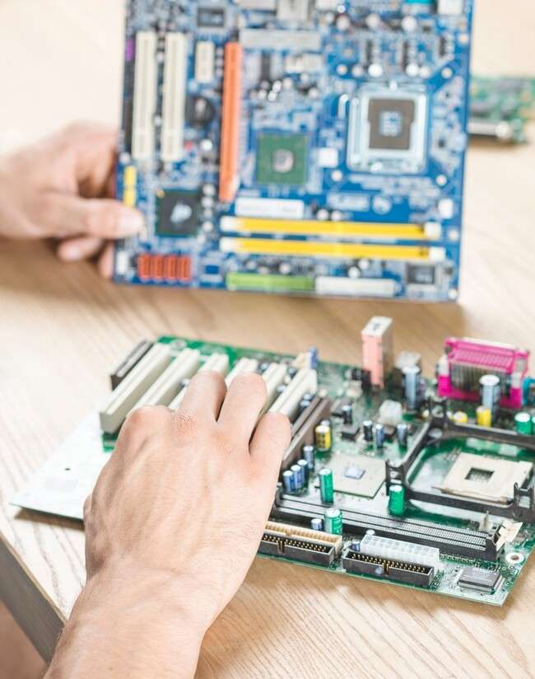




Applications in Engineering
play a crucial role in engineering, particularly in
. They are used in
control systems, and circuit analysis, providing engineers with powerful tools to analyze and design complex systems efﬁciently.
,

Slide 7





Complex Numbers in Physics
In physics, are
essential in quantum mechanics and wave theory. They help describe and
phenomena such as
and , allowing
scientists to model and predict the behavior of particles and waves
effectively.

Slide 8





Unlocking New Perspectives
The study of
unlocks new perspectives in mathematics and science. By embracing the , we can tackle problems in ways that
transcend traditional methods, fostering and
various disciplines.
in

Slide 9


Conclusion: The Journey Continues
As we conclude our exploration of , remember that this journey is just the beginning. Their
are vast, and their applications are ever-expanding.
Embrace the they offer and continue your quest for knowledge in this captivating realm.

Slide 10
Thanks!
Do you have any questions? youremail@email.com
+91 620 000 838
www.yourwebsite.com @yourusername

