Slide 1
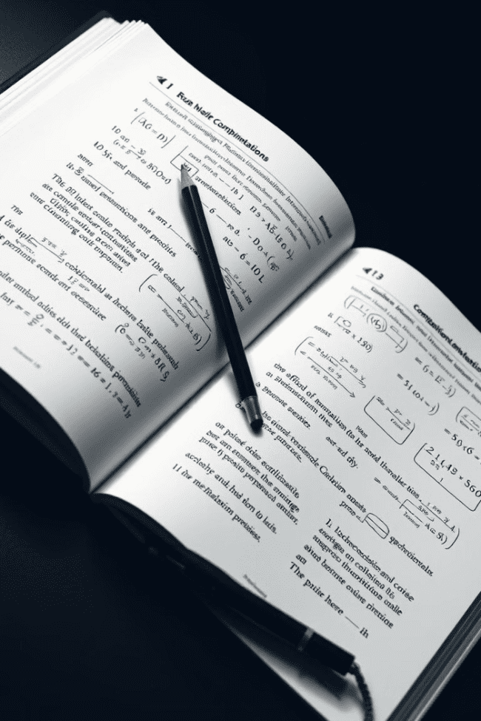
Combinations and Permutations
This presentation will explore the concepts of combinations and permutations, their applications, and how they relate to the binomial theorem.
IO
by IKENNA ONYI

Slide 2
Introduction
In mathematics, **combinations** and **permutations** are ways to arrange or select objects from a set. Combinations refer to the selection of items from a set without regard to their order, whereas permutations refer to the arrangement of items in a specific order.
These concepts are essential in various fields, including probability, statistics, computer science, and cryptography. Understanding them is crucial for solving problems involving selection, arrangement, and probability.

Slide 3

Fundamental Counting Principle
1
The Basics
2
Example
The fundamental counting principle states that if there are *m* ways to do one event and *n* ways to do another event, then there are *m* * n* ways to do both events.
If you have 3 shirts and 2 pairs of pants, you have 3 * 2 = 6 different outfit combinations.

Slide 4

Permutations
Definition
Formula
Example
A permutation is an arrangement of objects in a specific order. The order of the objects matters.
The number of permutations of *n* objects taken *r* at a time is given by: nPr = n! / (n - r)!
The number of ways to arrange 5 books on a shelf is 5! = 120.

Slide 5




Permutations with Repetition
Definition
Permutations with repetition allow for the same object to be chosen multiple times. For example, in a combination lock, you can choose the same number multiple times.
Formula
The number of permutations with repetition of *n* objects taken *r* at a time is given by: n^r
Example
A 3-digit combination lock has 10^3 = 1000 possible combinations.

Slide 6

Combinations
1
Definition
A combination is a selection of objects from a set where the order doesn't matter. It's about choosing a group, not arranging them.
2
Formula
The number of combinations of *n* objects taken *r* at a time is given by: nCr = n! / (r! * (n - r)!)
3
Example
The number of ways to choose 3 apples from a bag of 5 is 5C3 = 10.

Slide 7




Combinations with Repetition
Definition
Formula
Example
Combinations with repetition allow for the same object to be selected multiple times. For example, you can choose multiple candies of the same type from a store.
The number of combinations with repetition of *n* objects taken *r* at a time is given by: (n + r - 1)Cr
If you want to choose 3 candies from a store with 5 types, you have (5 + 3 - 1)C3 = 35 combinations.

Slide 8



Binomial Theorem
The Theorem
1
The binomial theorem expands (x + y)^n for any positive integer *n*. It uses combinations to calculate the coefficients.
Formula
2
(x + y)^n = nC0 * x^n * y^0 + nC1 * x^(n-1) * y^1 + ... + nCn * x^0 * y^n
Example
3
(x + y)^2 = 2C0 * x^2 * y^0 + 2C1 * x^1 * y^1 + 2C2 * x^0 * y^2 = x^2 + 2xy + y^2

Slide 9
Applications of Combinations and Permutations
Probability
1
Combinations and permutations are used to calculate probabilities in various situations. For instance, finding the probability of drawing a specific card from a deck.
Computer Science
2
In computer science, combinations and permutations are used for algorithms like sorting and searching. They are also crucial in cryptography for generating codes and ciphers.
Statistics
3
Combinations and permutations are applied in statistics for analyzing data and conducting experiments, particularly for calculating sample sizes and confidence intervals.

Slide 10
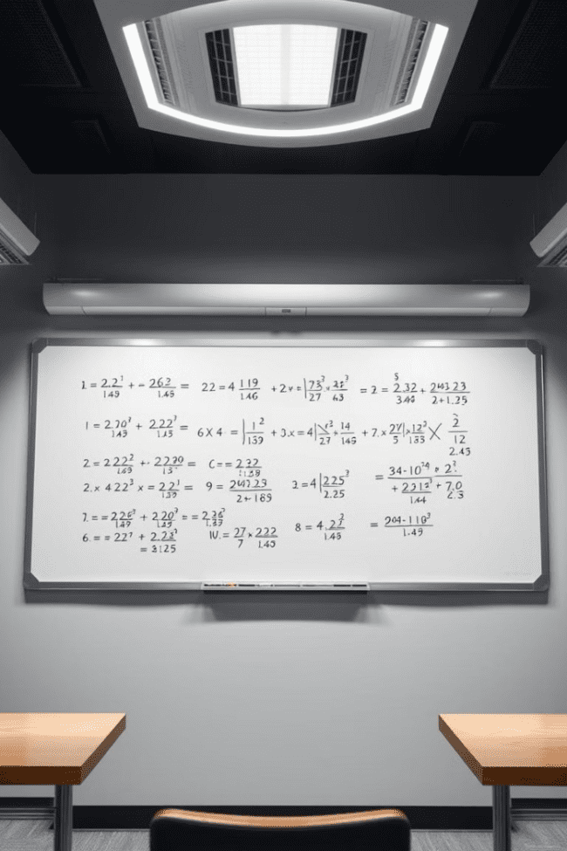
Practice Problems
1
Coin Toss
How many different outcomes are possible if you toss a coin 4 times?
2
Committee Selection
In how many ways can a committee of 3 be chosen from a group of 8 people?
3
Password Generation
How many 6-character passwords can be created using letters and numbers if repetition is allowed?

