Slide 1



Factors and Multiples
Factors and multiples are fundamental concepts in mathematics that are essential for understanding and working with numbers. In this presentation, we will explore the definitions, relationships, and practical applications of these important mathematical ideas.
by Onwurah Onyedikachi

Slide 2

What are Factors?
1
Definition of Factors
2
Examples of Factors
Factors are the numbers that divide evenly into another number without leaving a remainder. In other words, they are the integers that can be multiplied together to get a specific number.
For example, the factors of 12 are 1, 2, 3, 4, 6, and 12, because these are the numbers that can be multiplied together to get 12 (1 x 12, 2 x 6, 3 x 4).
3
Importance of Factors
Identifying the factors of a number is important for understanding its divisibility, prime factorization, and various mathematical operations.

Slide 3

Finding Factors of a Number
1
Step 1: Start with 1
The first factor of any number is always 1, as 1 divides evenly into any integer.
2
Step 2: Divide by Integers
Divide the number by the integers, starting from 2, until you reach the square root of the number. All the numbers that divide evenly are factors.
3
Step 3: Include the Number Itself
The final factor is the number itself, as every number is divisible by itself.

Slide 4
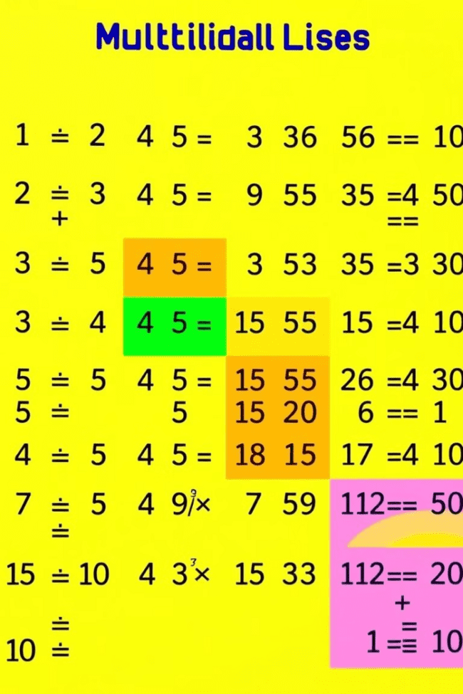
What are Multiples?
Definition of Multiples
Examples of Multiples
Multiples are the numbers that can be obtained by multiplying a given number by an integer. In other words, multiples are the products of a number and any whole number.
For example, the multiples of 5 are 5, 10, 15, 20, 25, and so on, as these are the numbers that can be obtained by multiplying 5 by 1, 2, 3, 4, and 5, respectively.
Importance of Multiples
Multiples are essential in various mathematical operations, such as finding common multiples, least common multiples, and understanding divisibility rules.

Slide 5

Finding Multiples of a Number
1
Step 1: Start with the Number
The first multiple of a number is the number itself.
2
Step 2: Multiply by Integers
Multiply the number by the integers, starting from 2, to find the subsequent multiples.
3
Step 3: Continue the Pattern
Keep multiplying the number by the next integer to generate more multiples.

Slide 6
Relationship between Factors and Multiples
Factors
Multiples
Relationship
The factors of a number are the integers that divide the number evenly, without a remainder.
The multiples of a number are the numbers that can be obtained by multiplying the number by an integer.
Factors and multiples are closely related. The factors of a number are the numbers that divide it, while the multiples of a number are the numbers that it divides.
For example, the factors of 12 are 1, 2, 3, 4, 6, and 12.
For example, the multiples of 5 are 5, 10, 15, 20, 25, and so on.

Slide 7





Practical Applications of Factors and Multiples
Mathematical Operations
Time and Date Calculations
Financial Applications
Scientific Applications
Factors and multiples are essential for performing basic mathematical operations, such as division, factorization, and finding common factors or multiples.
Factors and multiples are used in various financial calculations, such as interest rates, loan repayment schedules, and investment strategies.
In the sciences, factors and multiples are used in areas like physics, chemistry, and biology, where they help describe and analyze phenomena at various scales.
Understanding factors and multiples can help with calculating dates, schedules, and time intervals, especially when dealing with concepts like common factors and multiples.

Slide 8




Exercises and Examples
Find the Factors
Find the factors of the number 24.
Find the Multiples
Find the first five multiples of the number 7.
Identify Common Factors
Find the common factors between the numbers 12 and 18.

Slide 9
Recap and Key Takeaways
Factors are the numbers that divide evenly into another number, while multiples are the numbers that can be obtained by multiplying a given number by an integer.
To find the factors of a number, start with 1, divide by integers up to the square root of the number, and include the number itself.
To find the multiples of a number, start with the number itself and multiply by the integers.
Factors and multiples are closely related, as the factors of a number are the numbers that divide it, while the multiples of a number are the numbers that it divides.
Factors and multiples have practical applications in various fields, including mathematics, finance, science, and more.

