Slide 1
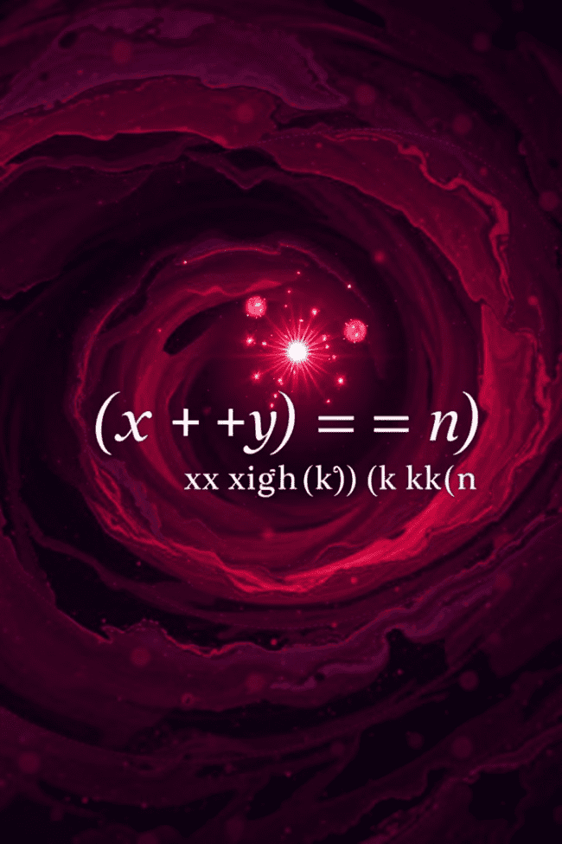

Unveiling the Power of the Binomial Theorem
Welcome to our exploration of the Binomial Theorem! This fascinating mathematical tool unlocks the secrets of expanding powers of binomials, enabling us to delve into intricate patterns and solve various problems. From understanding probability to analyzing complex data, the Binomial Theorem plays a crucial role in diverse fields. Join us as we unravel its power, exploring its origins, applications, and limitations.
by ONYEDIKACHI ONWURAH

Slide 2

Introduction to the Binomial Theorem
Understanding Binomials
Unlocking Patterns
A binomial is a polynomial with two terms, for example, (x + y). The Binomial Theorem provides a systematic way to expand expressions like (x + y)^n, where n is a non-negative integer.
The theorem reveals a pattern in the coefficients of these expansions, allowing us to calculate each term without individually multiplying the entire expression. This simplifies complex calculations and reveals hidden relationships.

Slide 3
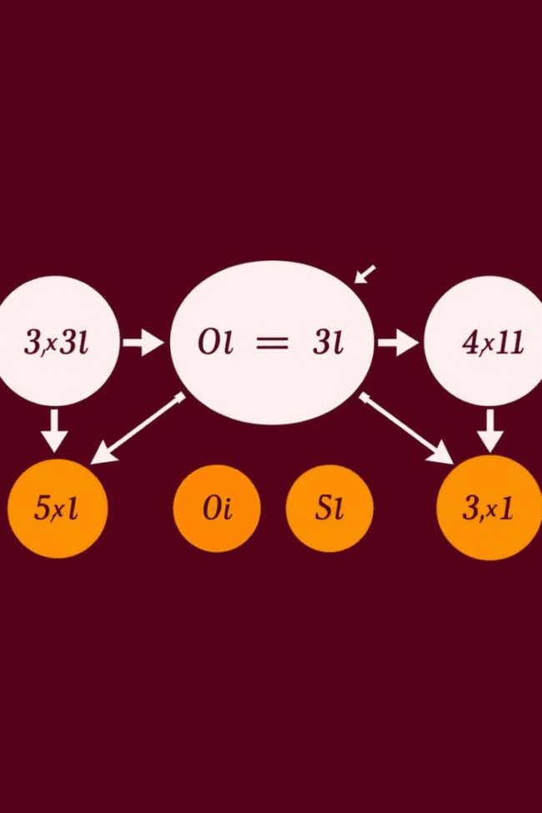
Binomial Expansion and Coefficients
1
Expansion of (x + y)^n
2
Binomial Coefficients
When we expand (x + y)^n, we get a sum of terms with specific powers of x and y. The coefficients of these terms are called binomial coefficients, determined by the Binomial Theorem.
Binomial coefficients are represented by the symbol "n choose k," which is the number of ways to select k items from a set of n items. This notation, nCk, represents the coefficient of x^(n-k) * y^k in the expansion of (x + y)^n.

Slide 4



Pascal's Triangle and Binomial Coefficients
A Visual Pattern
Pascal's Triangle, a triangular array of numbers, offers a visual representation of binomial coefficients. Each number is the sum of the two numbers directly above it.
1
Connecting the Dots
2
The numbers in each row of Pascal's Triangle correspond to the coefficients of the expansion of (x + y)^n, where n is the row number.
Unveiling the Formula
3
Pascal's Triangle helps us understand the formula for binomial coefficients, nCk = n! / (k! * (n-k)!), which enables precise calculation.

Slide 5
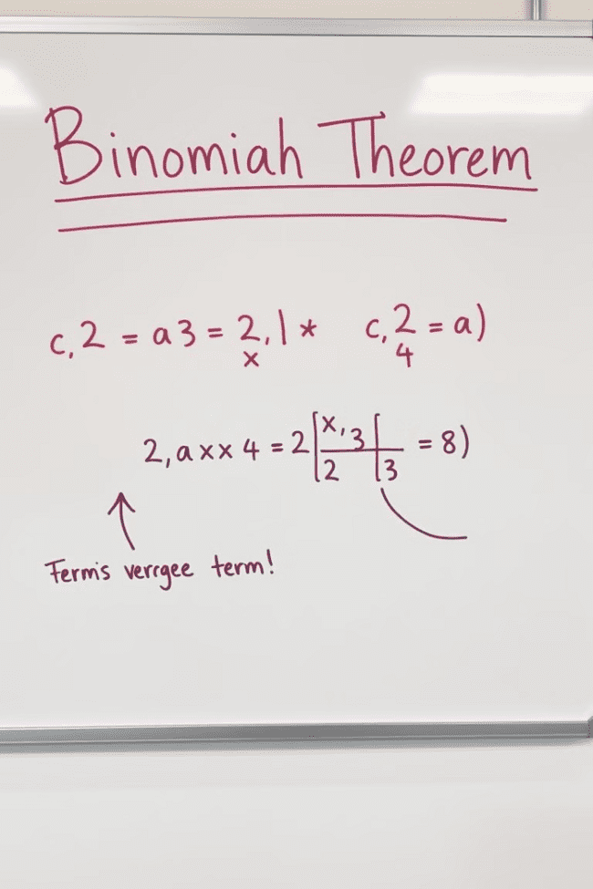
Binomial Theorem Formula
(x + y)^n = nC0 * x^n * y^0 + nC1 * x^(n-1) * y^1 + nC2 * x^(n-2) * y^2 + ... + nCn * x^0 * y^n

Slide 6
Proof of the Binomial Theorem
Inductive Reasoning
1
We prove the Binomial Theorem using mathematical induction, demonstrating the formula holds true for the base case (n=1) and then proving that if it holds for n, it also holds for n+1.
Combinatorial Arguments
2
Another approach uses combinatorial arguments, proving that the coefficients in the expansion correspond to selecting k items from a set of n items, validating the formula.
Expanding the Formula
3
We expand the left side of the equation using the distributive property and simplify the terms to match the right side, demonstrating the formula's validity.

Slide 7




Applications of the Binomial Theorem
Probability
The Binomial Theorem is fundamental in probability theory, allowing us to calculate probabilities of events in situations with a fixed number of trials and independent outcomes.
Statistics
It plays a critical role in statistical analysis, helping us understand the distribution of data and estimate probabilities of specific outcomes.
Finance
Financial models use the Binomial Theorem to calculate the value of financial instruments, such as options, by accounting for future uncertain outcomes.

Slide 8
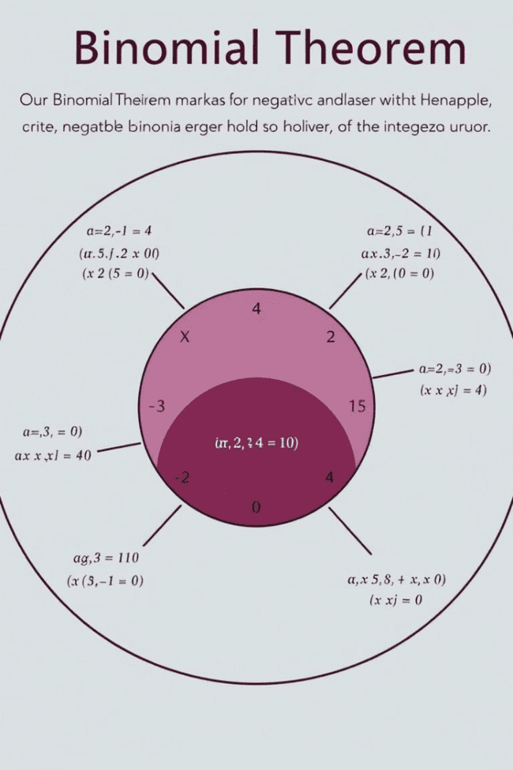
Limitations and Assumptions
Integer Exponent
Finite Terms
The Binomial Theorem holds true for non-negative integer values of n. It cannot be directly applied for fractional or negative exponents.
The expansion of (x + y)^n has a finite number of terms, determined by the value of n. It cannot be used to expand expressions with infinite terms.
Independent Events
When used in probability, the Binomial Theorem applies to independent events, where the outcome of one trial does not influence the others.

Slide 9
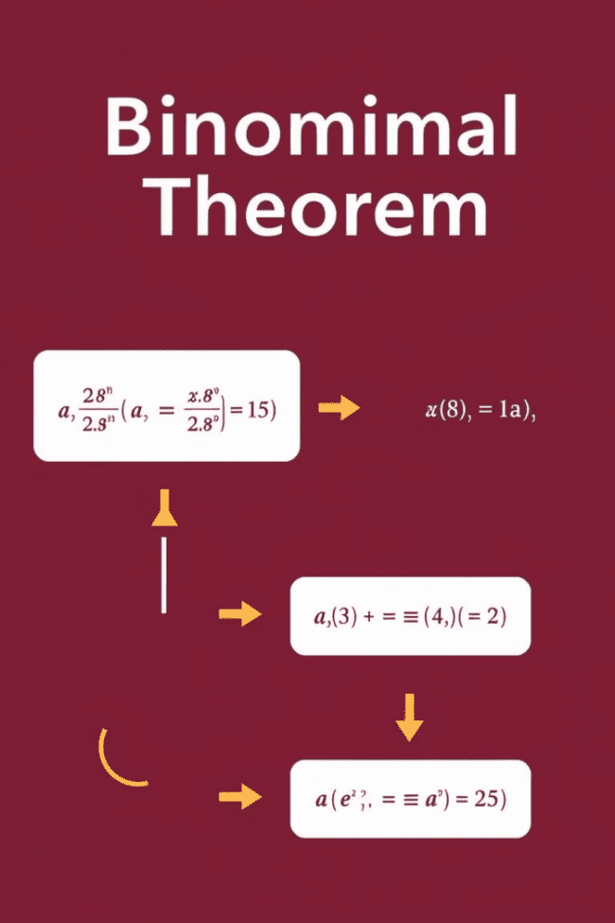
Summary and Key Takeaways
The Binomial Theorem is a powerful tool for expanding expressions involving binomials, revealing intricate patterns and enabling efficient calculations. Understanding its underlying principles and applications empowers us to solve problems in probability, statistics, finance, and various other fields. By grasping its limitations and assumptions, we can effectively utilize its power while remaining mindful of its scope.

