Slide 1


Unlocking Parabolas: The Art of Completing the Square

Slide 2



Unlocking Parabolas
Welcome to the journey of
! In this presentation, we will explore the .
This technique not only simplifies quadratic
equations but also reveals the beauty of parabolic graphs. Let's dive into the world of curves and creativity!

Slide 3

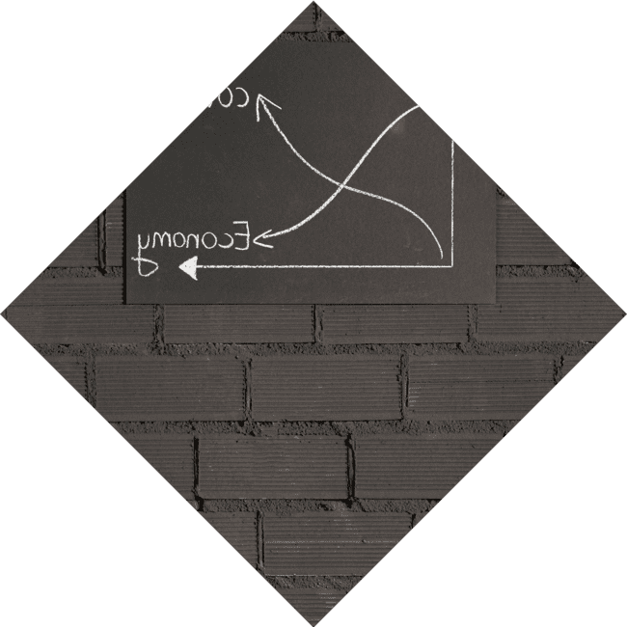





Understanding Quadratics
Quadratic equations take the form
of
. Understanding their structure is crucial for
. The represents the graphical solution of these equations,
revealing the and
. Let's break it down!

Slide 4
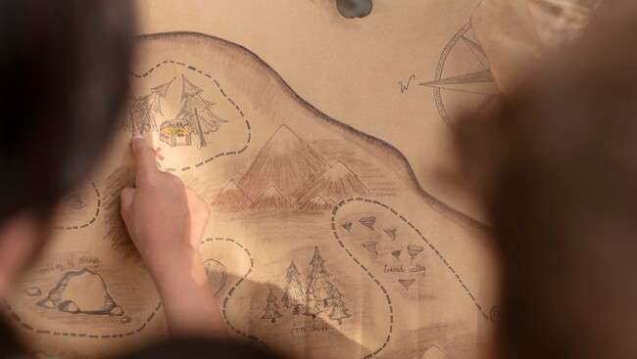


What is Completing the
Square?
transforms a quadratic equation into a perfect square trinomial. This process allows us to rewrite the equation in vertex form, making it easier to analyze the parabola's properties, such as its
and
. It's like finding a hidden treasure!

Slide 5






Step-by-Step Process
To complete the square, follow these
steps: 1.
the constant term. 2. the coefficient of x by 2 and
it. 3. and this value inside the equation. 4.
the perfect square trinomial. It's a
journey worth taking!

Slide 6
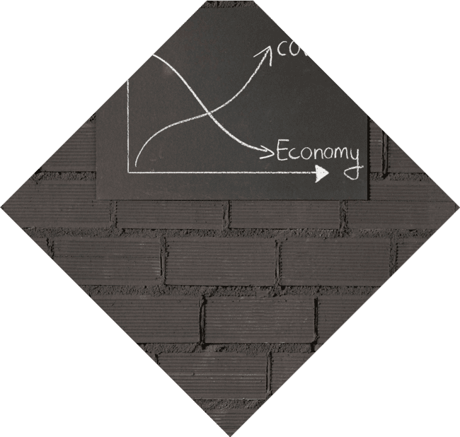



Graphical Interpretation
Completing the square not only simplifies equations but also enhances our understanding of the . The vertex form, , reveals the (h, k) directly. This interpretation allows us to visualize how changes in parameters affect the parabola's shape.

Slide 7
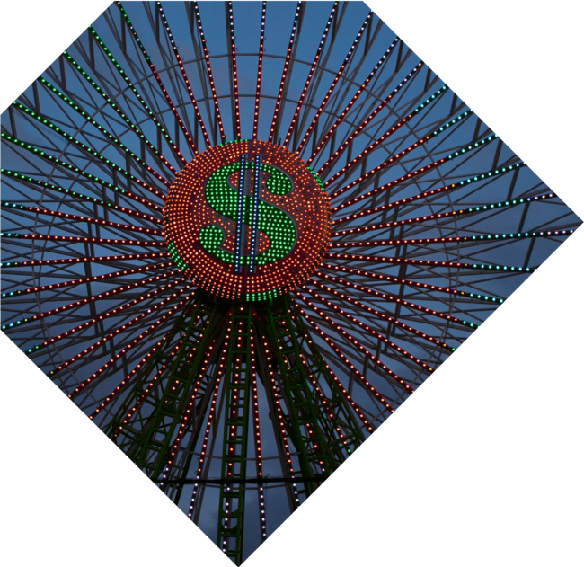



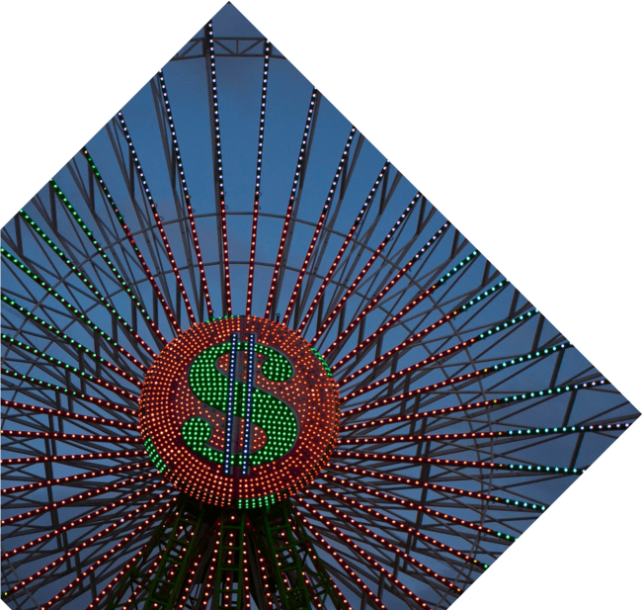
Real-World Applications
The technique of completing the square has numerous applications in ,
, and . From
optimizing area to analyzing projectile
motion, understanding parabolas is essential. By mastering this art, you can unlock solutions to real-world problems creatively!

Slide 8



Common Mistakes
While completing the square, common mistakes include miscalculating the
and forgetting to the
equation. It's crucial to double-check your work and ensure every step is followed.
Remember, practice makes perfect in this
artistic endeavor!

Slide 9
Conclusion: Embrace the Art
Completing the square is more than a mathematical technique; it's an form that unlocks the mysteries of parabolas. By embracing this process, you can appreciate the elegance of quadratic functions and their applications. Let's continue to explore and create with these powerful tools!

Slide 10
Thanks!
Do you have any questions?
youremail@email.com
+91 620 000 838
www.yourwebsite.com @yourusername

