Slide 1

Cramer's Rule
Cramer's Rule provides a systematic method for solving systems of linear equations. It leverages the concept of determinants to express the solution for each unknown variable in terms of determinants of specific matrices.
IO
by IKENNA ONYI

Slide 2
What is Cramer's Rule?
Definition
Application
Cramer's Rule is a method for solving systems of linear equations by using determinants. It provides a closed-form expression for the solution of each variable in the system.
This rule is applicable to systems of linear equations where the number of equations is equal to the number of unknowns. The coefficients of the variables form a matrix, and the determinants of various matrices derived from this coefficient matrix are used to determine the values of the unknowns.

Slide 3

Solving Systems of Linear Equations
Systems of Equations
Methods for Solving
Cramer's Rule's Role
A system of linear equations consists of two or more equations with the same unknowns. The goal is to find the values of the unknowns that satisfy all equations simultaneously.
Various methods exist to solve systems of linear equations, such as substitution, elimination, and Gaussian elimination. Cramer's Rule provides an alternative approach, particularly useful for systems with a specific structure.
Cramer's Rule offers a systematic and efficient method for solving systems of linear equations, especially when dealing with matrices and determinants.

Slide 4



Determinants and Matrices
Matrices
Determinants
A matrix is a rectangular array of numbers, symbols, or expressions arranged in rows and columns. Each element is identified by its row and column index.
The determinant of a square matrix is a scalar value that can be calculated using a specific formula. It represents certain properties of the matrix and is used in various mathematical operations.

Slide 5
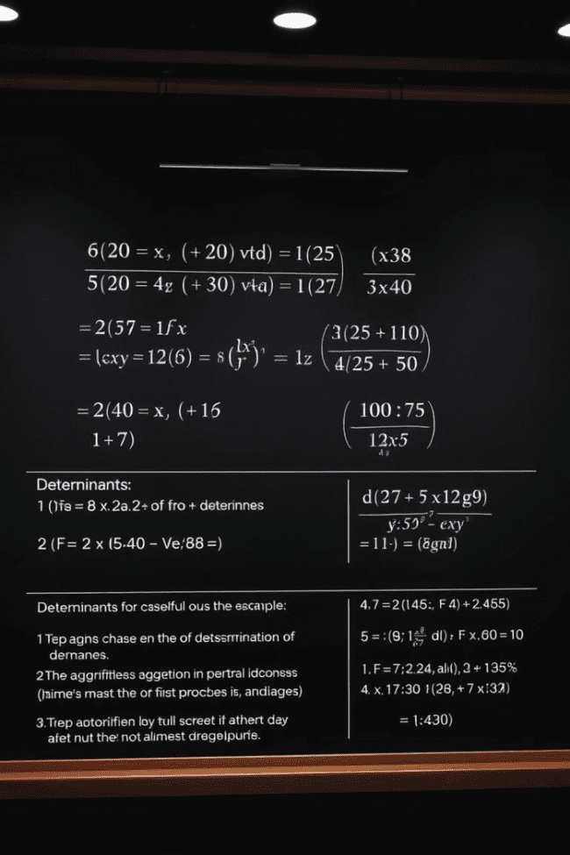
Calculating Determinants
1
For a 2x2 matrix, the determinant is calculated by subtracting the product of the elements on the diagonal from the product of the elements on the off-diagonal.
2
For larger matrices, determinants are calculated recursively using cofactor expansion or other methods. The determinant involves a combination of multiplications and additions of matrix elements.
3
Once the determinant is calculated, it can be used in various mathematical operations, including finding inverses of matrices, solving linear equations, and determining the eigenvalues of a matrix.

Slide 6
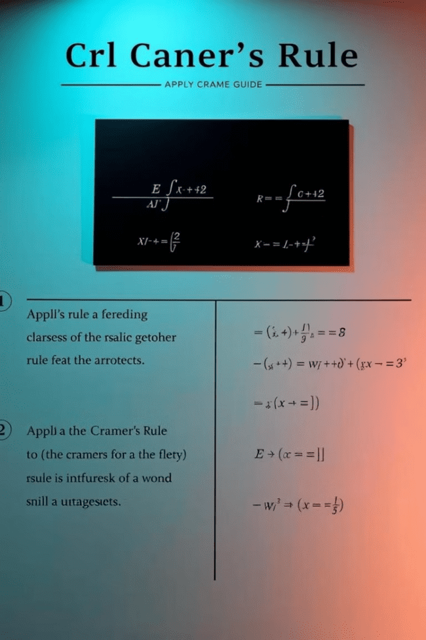




Applying Cramer's Rule
Step 1
Write the system of linear equations in matrix form.
Step 2
Calculate the determinant of the coefficient matrix (denoted as D).
Step 3
Replace the column corresponding to the variable you want to solve for with the constant terms of the system. Calculate the determinant of this new matrix.
Step 4
Divide the determinant from step 3 by the determinant from step 2 to find the value of the variable.

Slide 7




Step-by-Step Example
1
Problem
2
Matrix Form
3
Determinant Calculation
4
Solution
Consider the system of linear equations: 2x + 3y = 7, x - y = -2. We can apply Cramer's Rule to find the values of x and y by following the steps outlined in the previous card.

Slide 8
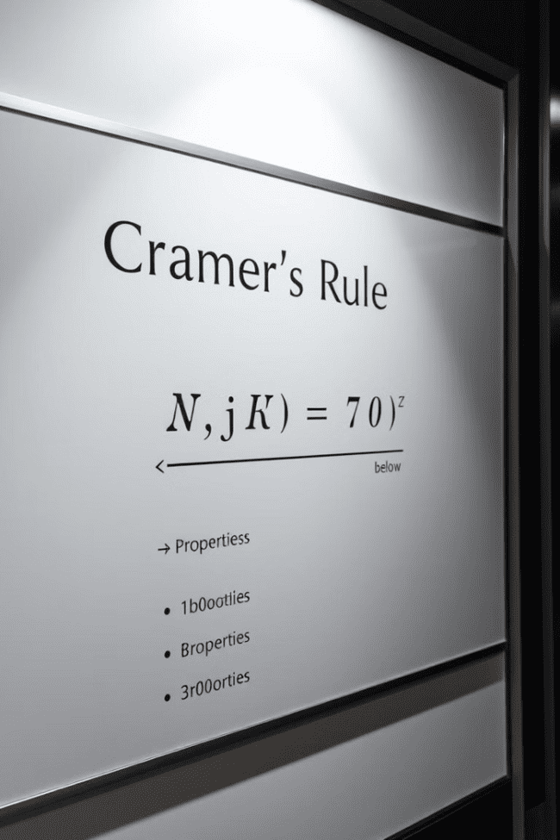
Cramer's Rule Properties
1
Existence
Cramer's Rule guarantees a unique solution for the system of linear equations only if the determinant of the coefficient matrix (D) is non-zero.
2
Solution
If D is non-zero, the solution for each variable can be expressed as a ratio of determinants.
3
Singular Matrix
If D is zero, the system either has no solution or infinitely many solutions. This indicates that the coefficient matrix is singular.

Slide 9
Advantages and Limitations
Advantages
1
Systematic approach, provides a closed-form solution, applicable to various problems in linear algebra.
Limitations
2
Only works for systems with an equal number of equations and unknowns, computationally expensive for large matrices, may not be the most efficient method in all cases.

Slide 10

Conclusion and Key Takeaways
Cramer's Rule offers a powerful tool for solving systems of linear equations, particularly when the number of equations equals the number of unknowns. It leverages determinants to provide a systematic approach to finding solutions. While Cramer's Rule has limitations, its ability to provide a closed-form solution makes it a valuable method in various mathematical applications. Remember, understanding the properties and limitations of Cramer's Rule will help you determine its appropriateness for specific problems.

