Slide 1
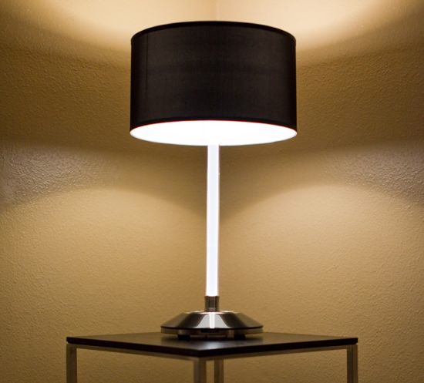
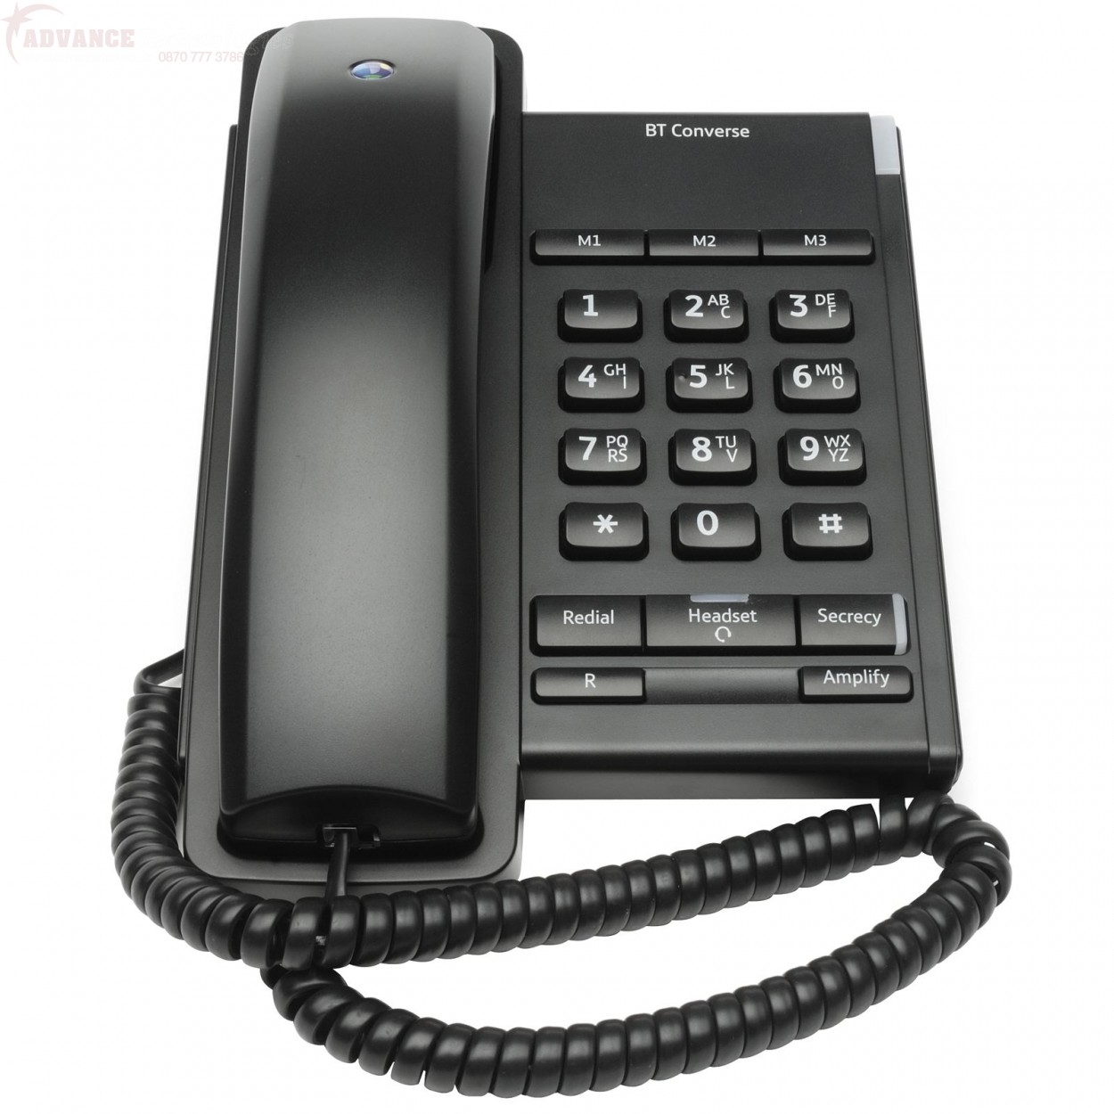
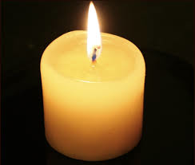
How Light Travels
Which is the odd one out and why?

Slide 2
How do you see an object?
Light from the object enters your eye.
Do you see all objects in the same way?
There are two ways you see objects:
You see some objects because they are light sources.
You see other objects by reflected light.

Slide 3
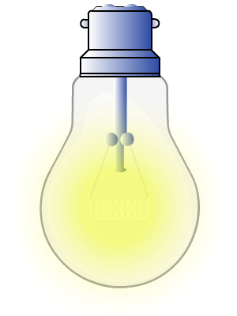

A luminous object gives out light and can also be called a light source.
How does light from a light bulb and other light sources reach your eye?
Light travels in a straight line directly into your eye.

Slide 4

Objects that do not give out light are non-luminous.
How does your eye see non-luminous objects such as a book?
Light from the light source strikes the book and some of the light is reflected into your eye.

