Slide 1
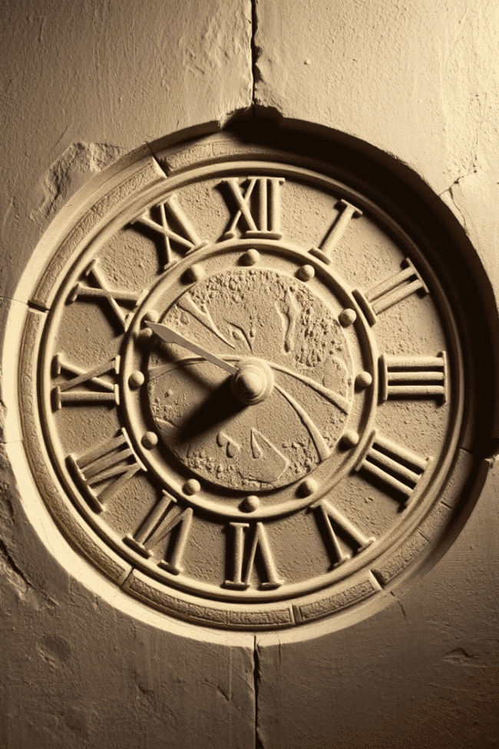


Roman Numerals
Roman numerals, a timeless system of representing numbers, have a rich and fascinating history that has endured for centuries. Originating in ancient Rome, this numerical system has played a crucial role in various aspects of human civilization, from architecture and art to literature and mathematics. In this presentation, we will explore the origins, principles, and modern applications of this iconic numerical system, uncovering its enduring significance and impact on the world.
by Onyedikachi Onwurah

Slide 2
Origin and Development of Roman Numerals
Enduring Legacy
Early Origins
Despite the development of more advanced numerical systems, such as the decimal system, Roman numerals have continued to hold a prominent place in various fields, including architecture, art, and literature. Their distinctive symbols and time-honored traditions have cemented their status as a timeless and iconic representation of numerical values.
The origins of Roman numerals can be traced back to ancient Rome, where they were first used as a practical and intuitive way to represent numerical values. The system evolved from the use of tally marks and gradually became a more sophisticated and standardized form of numerical representation.
1
2
3
Expansion and Adoption
As the Roman Empire grew, the use of Roman numerals spread throughout the known world, becoming a universal language for recording and communicating numerical information. The system's simplicity and adaptability contributed to its widespread adoption, making it an integral part of various civilizations and cultures.

Slide 3
Roman Numeral System Principles
Symbols and Values
Additive and Subtractive Notation
Positional Significance
The Roman numeral system is based on seven primary symbols: I (1), V (5), X (10), L (50), C (100), D (500), and M (1,000). These symbols are combined and repeated to represent different numerical values, following a set of principles and rules.
The placement of Roman numeral symbols is crucial, as their position determines their relative value. The symbols are written from left to right, with the larger values positioned on the left and the smaller values on the right.
In the Roman numeral system, numbers are represented through a combination of additive and subtractive notation. Smaller values are typically added together, while a smaller value placed before a larger value indicates subtraction (e.g., IV represents 4, and IX represents 9).

Slide 4
Representing Numbers with Roman Numerals
1
Simple Representation
2
Subtractive Notation
Roman numerals use a straightforward approach to represent numbers, where each symbol corresponds to a specific value. For example, the number 7 is represented as VII, and the number 24 is written as XXIV.
The subtractive notation in Roman numerals allows for more efficient representation of larger numbers. By placing a smaller value before a larger value, the number can be reduced. For instance, IV represents 4 (5 - 1), and IX represents 9 (10 - 1).
3
Repeated Symbols
4
Placing Symbols
Roman numerals allow for the repetition of symbols to represent larger values. However, there are specific rules governing the number of times a symbol can be repeated before switching to a different symbol. For example, III represents 3, but IIII is not used, and IV is used instead.
The positioning of Roman numeral symbols is crucial, as it determines the value they represent. The symbols are written from left to right, with the larger values on the left and the smaller values on the right.

Slide 5
Advantages and Limitations of Roman Numerals
Advantages
Limitations
Adaptability
Roman numerals have several advantages, including their simplicity, visual clarity, and historical significance. The system is easy to learn and use, and its distinctive symbols have become a universal language for representing numerical values in various fields, from architecture to art and literature.
Despite their strengths, Roman numerals also have limitations. They are less efficient for performing mathematical calculations compared to the modern decimal system, and they lack the flexibility to represent larger numbers without becoming unwieldy. Additionally, the system can be susceptible to errors, especially when dealing with complex numerical expressions.
While the limitations of Roman numerals have led to the widespread adoption of the decimal system, the iconic symbols have continued to hold significance in various applications. Their adaptability and enduring legacy have ensured that Roman numerals remain an important part of human civilization, serving as a testament to the ingenuity and ingenuity of our ancestors.

Slide 6
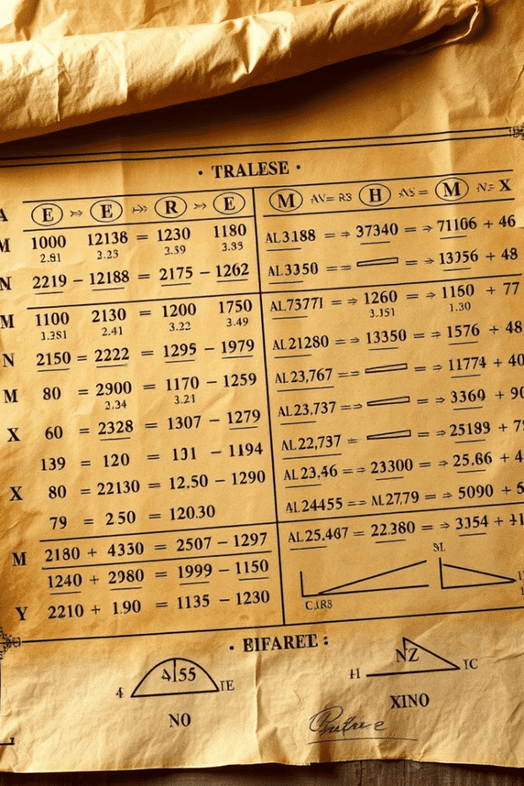



Roman Numerals in Math and Calculations
Addition
Adding Roman numerals is a straightforward process, where the corresponding symbols are combined. For example, V + II = VII, and XX + XV = XXXV.
Subtraction
Subtraction in the Roman numeral system involves the use of the subtractive notation, where a smaller value is placed before a larger value. For instance, IX represents 9 (10 - 1), and XL represents 40 (50 - 10).
Multiplication and Division
Performing multiplication and division with Roman numerals can be more challenging, as the system lacks a standardized method for these operations. However, techniques such as repeated addition or subtraction can be used to approximate the results.

Slide 7



Roman Numerals in Architecture and Design
Structural Design
Timekeeping
Ceremonial and Commemorative Use
Roman numerals have been extensively used in architecture, with the symbols often carved into the structural elements of buildings, such as columns, arches, and facades. This practice not only served a practical purpose but also added a sense of grandeur and timelessness to the structures.
Roman numerals have been a common feature in traditional clock and watch designs, providing a classic and elegant way to display the time. The use of these symbols on sundials, clocks, and timepieces has contributed to their enduring presence in architectural and design landscapes.
In the realm of architecture and design, Roman numerals have also been employed for ceremonial and commemorative purposes, such as inscriptions on monuments, plaques, and memorials. This practice helps to preserve the historical significance and legacy of these iconic symbols.

Slide 8
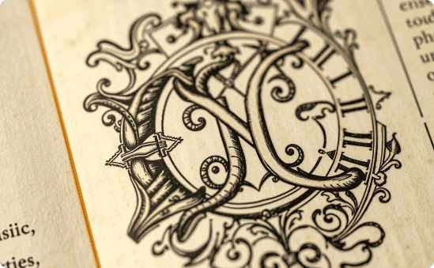


Roman Numerals in Literature and Art
Manuscript Illumination
Chapter and Section Headings
Artistic Incorporation
In the realm of literature, Roman numerals have been extensively used in the ornamentation and illumination of ancient manuscripts. Scribes and artists often incorporated the iconic symbols into the elaborate designs and illustrations that adorned the pages of these historic texts.
Roman numerals have been a common feature in the formatting and organization of literary works, often used to number chapters, sections, or other structural elements. This practice lends a sense of tradition and formality to the presentation of the text, while also serving as a practical tool for navigation and reference.
The iconic symbols of the Roman numeral system have also found their way into various forms of art, from painting and sculpture to decorative crafts. Artists have often incorporated these timeless symbols into their works, using them to convey a sense of history, tradition, and cultural significance.

Slide 9

Modern-Day Applications of Roman Numerals
Timekeeping
Roman numerals continue to be widely used in clock and watch designs, adding a classic and elegant touch to modern timekeeping devices.
Naming Conventions
Roman numerals are commonly used for naming conventions, such as identifying monarchs (e.g., Queen Elizabeth II), organizational divisions (e.g., Super Bowl LVI), and chapters in books.
Branding and Trademarks
Many companies and brands have incorporated Roman numerals into their logos and branding, leveraging the symbols' timeless appeal and association with quality and tradition.
Numeration in Documents
Roman numerals are still used in various formal and official documents, such as the pagination of legal documents, academic papers, and other publications.

Slide 10
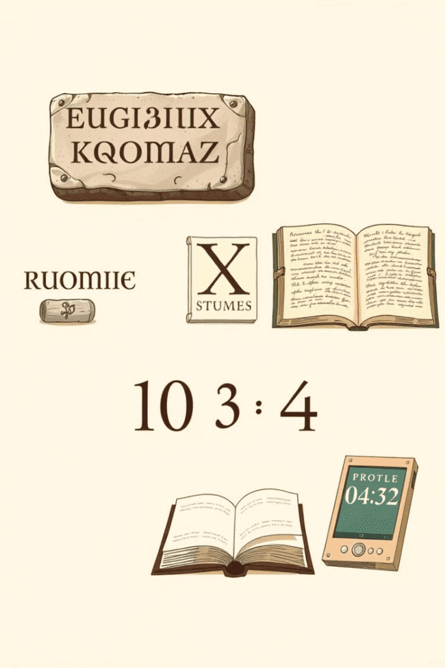
Wrapping Up: The Enduring Legacy of Roman Numerals
As we've explored, the history and significance of Roman numerals extend far beyond their practical applications. These iconic symbols have become an integral part of human civilization, leaving an indelible mark on various aspects of our world, from architecture and art to literature and mathematics. Despite the development of more advanced numerical systems, Roman numerals continue to hold a special place in our collective consciousness, serving as a testament to the ingenuity and enduring legacy of our ancestors. As we move forward, the timeless allure of these symbols will undoubtedly continue to captivate and inspire us, reminding us of the rich tapestry of our shared human experience.

