Slide 1



Probability: Understanding the Fundamentals
Probability is a fundamental concept in mathematics that deals with the likelihood of events occurring. It provides a framework for quantifying uncertainty and making predictions about the future. From everyday decisions to complex scientific models, probability plays a crucial role in our understanding of the world.
by Onyedikachi Onwurah

Slide 2

Introduction to Probability
Random Events
Sample Space
Probability studies random events, where outcomes are uncertain and can vary each time the event occurs. For example, flipping a coin can result in either heads or tails, but the outcome is unpredictable.
The sample space is the set of all possible outcomes of an experiment. In the coin flip example, the sample space is {Heads, Tails}.
Probability of Events
The probability of an event is the proportion of times that event is expected to occur in a large number of repetitions. It is expressed as a number between 0 and 1, where 0 indicates impossibility and 1 indicates certainty.

Slide 3

Definitions and Notations
Term
Definition
Notation
Event
A specific outcome or set of outcomes in a sample space.
A, B, C, etc.
Probability of an Event
The likelihood of an event occurring.
P(A), P(B), P(C), etc.
Complement of an Event
The set of all outcomes in the sample space that are not in the event.
A', B', C', etc.

Slide 4
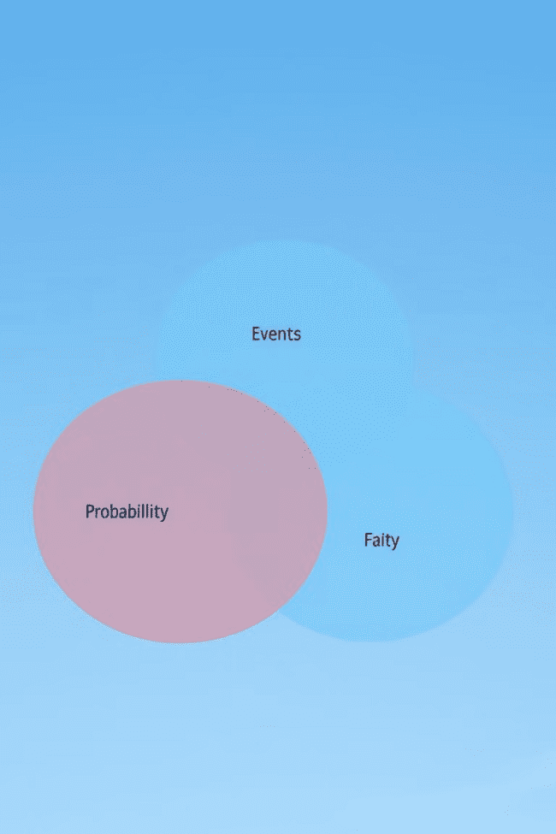
Probability Axioms and Rules
1
Axiom 1
2
Axiom 2
The probability of any event is always non-negative. P(A) ≥ 0 for any event A.
The probability of the sample space is 1. P(S) = 1, where S is the sample space.
3
Axiom 3
4
Additional Rules
If A and B are mutually exclusive events, then the probability of A or B occurring is the sum of their individual probabilities. P(A ∪ B) = P(A) + P(B).
Probability rules, such as the addition rule, the multiplication rule, and Bayes' Theorem, are derived from these axioms and provide a framework for calculating probabilities of complex events.

Slide 5
Probability Distributions
A probability distribution describes the probabilities of all possible outcomes of a random variable. It is a mathematical function that assigns probabilities to each value in the sample space. Probability distributions are essential for understanding the variability of random phenomena and making informed decisions based on uncertain information.
Discrete Distributions
Continuous Distributions
A discrete distribution describes the probability of a finite number of outcomes or outcomes that can be counted. Examples include the Bernoulli distribution and the binomial distribution.
A continuous distribution describes the probability of an infinite number of outcomes that can take any value within a given range. Examples include the normal distribution and the exponential distribution.

Slide 6
Discrete Probability Distributions
Discrete probability distributions are used to model random variables that can only take on a finite number of values or a countably infinite number of values. These distributions are often used to represent events such as the number of successes in a fixed number of trials, the number of customers arriving at a store in a given hour, or the number of defects in a batch of products.
Bernoulli Distribution
1
Represents the probability of success or failure in a single trial.
2
Binomial Distribution
Represents the probability of a specific number of successes in a fixed number of trials.
Poisson Distribution
3
Represents the probability of a specific number of events occurring in a fixed interval of time or space.

Slide 7
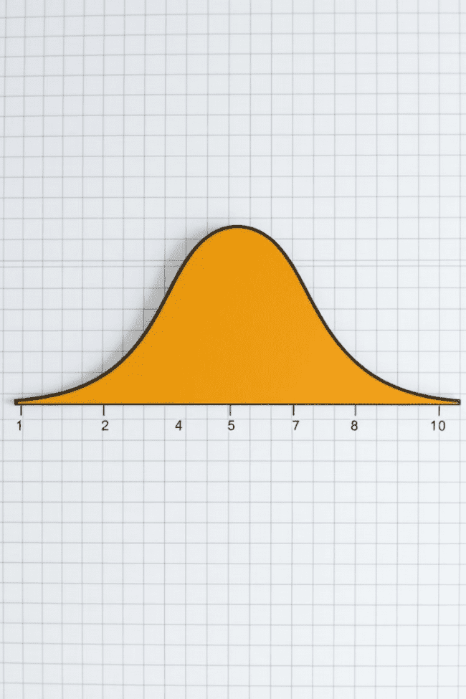



Continuous Probability Distributions
Continuous probability distributions are used to model random variables that can take on any value within a given range. These distributions are often used to represent events such as the height or weight of individuals, the temperature of a room, or the time it takes for a device to fail.
Normal Distribution
A bell-shaped curve that is commonly used to model many natural phenomena.
Exponential Distribution
A distribution that describes the time between events in a Poisson process.
Uniform Distribution
A distribution where all values within a given range have an equal probability.

Slide 8
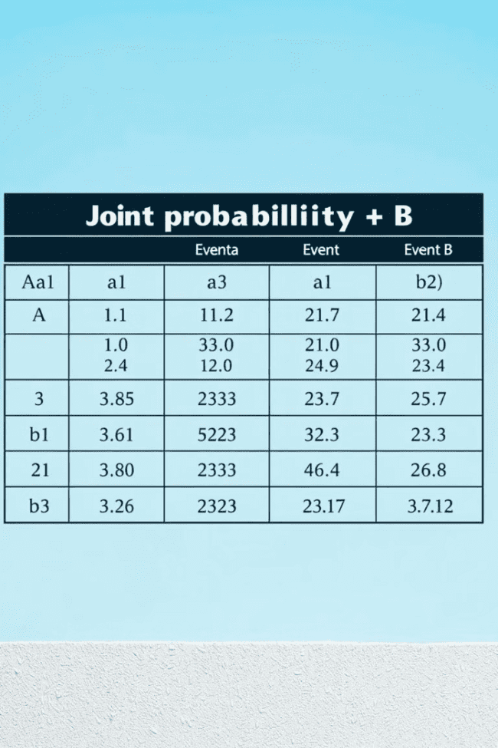


Conditional Probability and Independence
Conditional probability refers to the probability of an event occurring given that another event has already occurred. It is denoted by P(A|B), which represents the probability of event A happening given that event B has already happened.
Independence
Dependence
Two events are considered independent if the occurrence of one event does not affect the probability of the other event occurring. In this case, P(A|B) = P(A).
Two events are considered dependent if the occurrence of one event does affect the probability of the other event occurring. In this case, P(A|B) ≠ P(A).

Slide 9
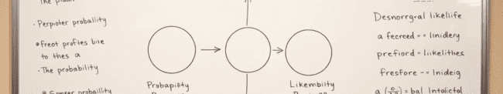
Bayes' Theorem
Bayes' Theorem is a fundamental rule of probability that provides a way to update our beliefs about an event based on new evidence. It relates the prior probability of an event, the likelihood of observing new evidence given the event, and the posterior probability of the event after observing the evidence. The formula is:
P(A|B) = (P(B|A) * P(A)) / P(B)
Bayes' Theorem is widely used in various fields, including medicine, finance, and machine learning, for making inferences and decisions under uncertainty.

Slide 10
Applications and Real-World Examples
Probability has numerous applications in various fields, including:
Statistics: Analyzing data, conducting hypothesis tests, and drawing inferences about populations.
Finance: Pricing financial instruments, managing risk, and making investment decisions.
Insurance: Assessing risks, setting premiums, and managing claims.
Medicine: Designing clinical trials, diagnosing diseases, and developing new treatments.
Machine Learning: Building predictive models, making classifications, and solving complex problems.
Probability plays a vital role in understanding and managing uncertainty in our daily lives and in numerous professional fields.

