Slide 1

Expected Value: A Powerful Tool for Decision-Making
Expected value is a fundamental concept in probability and statistics. It represents the average outcome of a random variable, weighted by its probability distribution. In essence, it provides a way to quantify the potential value of an uncertain event or decision.
oi
by onyi ik

Slide 2
What is Expected Value?
Definition
Key Concept
Expected value, denoted as E(X), is the average of the possible values of a random variable, weighted by their probabilities. It represents the long-term average outcome if the event is repeated many times.
Expected value helps make informed decisions in situations involving uncertainty by providing a numerical measure of the potential outcomes. This is particularly useful in decision-making, where we need to assess the likely consequences of different choices.

Slide 3
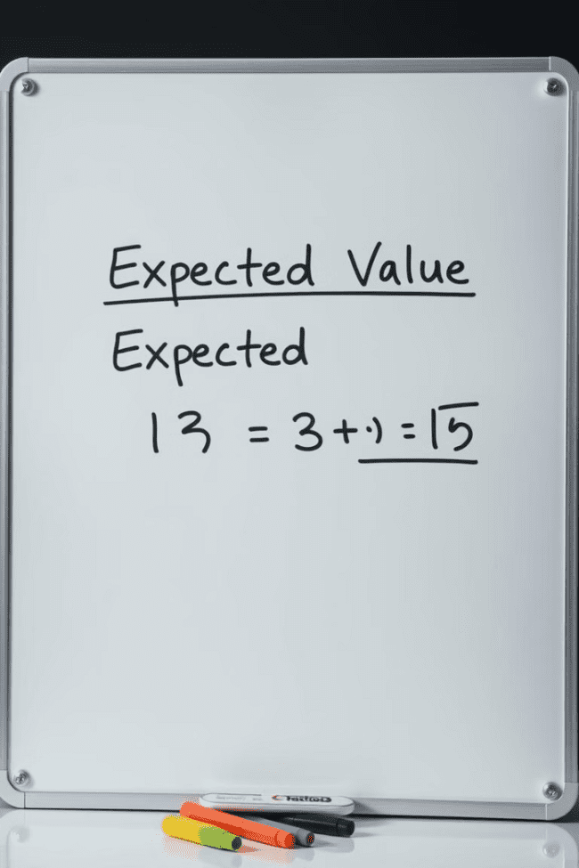
Calculating Expected Value
1
Formula
2
Example
Expected Value (E(X)) = Σ[xi * P(xi)], where:
Consider a coin flip with a fair coin. The possible outcomes are heads (H) and tails (T) with equal probabilities (0.5). E(X) = (H * 0.5) + (T * 0.5) = 0.5 + 0.5 = 1. This indicates that over many coin flips, the average outcome is 1.
• xi represents the value of each possible outcome.
• P(xi) represents the probability of each outcome.

Slide 4
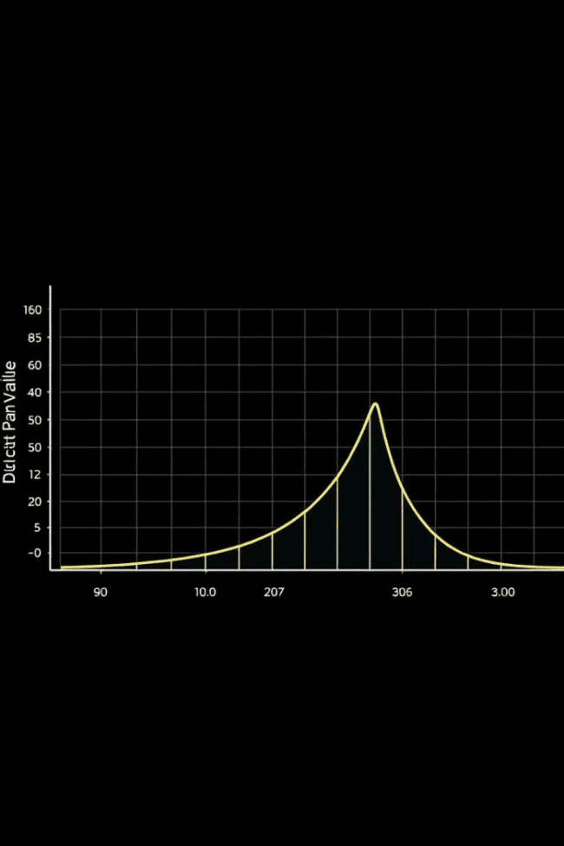
Expected Value for Discrete Distributions
Discrete Variable
Calculating E(X)
A discrete variable can only take on a finite number of values or a countable number of values. For instance, the number of heads in 3 coin flips (0, 1, 2, 3) or the number of defective items in a sample.
The formula for calculating E(X) remains the same. We sum the product of each possible outcome and its probability. For example, if we have a probability distribution for the number of defective items in a sample, we calculate E(X) by summing the products of each outcome (number of defective items) and its corresponding probability.

Slide 5



Expected Value for Continuous Distributions
Continuous Variable
Calculating E(X)
A continuous variable can take on any value within a given range. Examples include height, weight, or temperature.
For continuous distributions, E(X) is calculated using integration. We integrate the product of the variable (x) and the probability density function (f(x)) over the entire range of possible values.

Slide 6
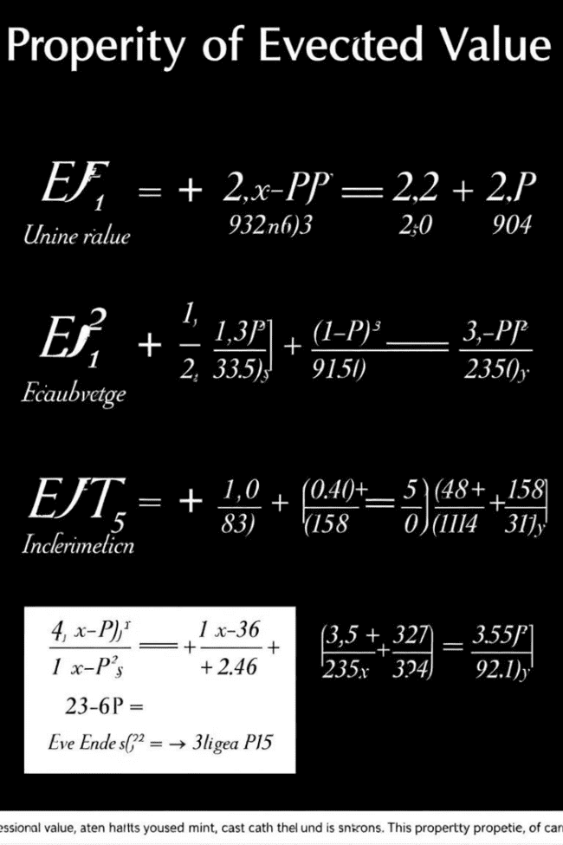
Properties of Expected Value
1
Linearity
E(aX + b) = aE(X) + b, where a and b are constants. This property is essential for working with linear combinations of random variables.
2
Additivity
E(X + Y) = E(X) + E(Y), where X and Y are random variables. This implies that the expected value of the sum of two random variables equals the sum of their individual expected values.
3
Non-negativity
If X is a non-negative random variable, then E(X) ≥ 0. This means that the expected value of a non-negative random variable cannot be negative.

Slide 7



Expected Value and Decision-Making
Expected Value as a Guide
Expected value provides a framework for decision-making under uncertainty. It helps us compare different options by quantifying their potential outcomes and risks.
Making Optimal Choices
We tend to choose the option with the highest expected value, as it represents the best long-term outcome. However, it's crucial to consider other factors like risk tolerance and potential losses.

Slide 8



Expected Value and Risk
Risk Aversion
Individuals often exhibit risk aversion, meaning they prefer certain outcomes to uncertain ones with the same expected value. This implies that they may choose options with lower expected values but greater certainty.
1
Risk Tolerance
2
Risk tolerance reflects an individual's willingness to accept uncertainty in pursuit of higher potential rewards. Higher risk tolerance can lead to choices with greater expected values but also higher potential losses.
Risk Premium
3
The risk premium is the extra amount of expected return required to compensate for the risk of an investment. This is a measure of the value investors place on avoiding uncertainty.

Slide 9

Applications of Expected Value
1
Insurance
Insurance premiums are calculated based on expected value, taking into account the probability of claims and the average cost of claims.
2
Finance
Expected value is crucial in investment decisions, where investors evaluate the potential returns and risks of different assets. It helps determine optimal portfolio allocations.
3
Gambling
Expected value is used to analyze the fairness of games of chance, determining whether a game is favorable to the player or the house.

Slide 10
Key Takeaways
Decision-Making Tool
1
Expected value provides a valuable framework for decision-making in situations involving uncertainty.
Quantifies Potential Outcomes
2
It helps quantify the potential value of different choices, taking into account their probabilities.
Risk and Reward
3
Understanding risk tolerance and expected value is essential for making informed decisions that balance potential rewards with acceptable risk levels.

