Slide 1


Unlocking the Curves: A Journey Through Rational Function Graphing

Slide 2





Introduction to Rational Functions
Welcome to our journey through
! In this presentation, we will explore the fascinating world of
, unlocking the secrets
behind their shapes and behaviors. Let's embark on this
together!

Slide 3


What Are Rational Functions?
are expressions formed
by the ratio of two . Understanding their structure is crucial for graphing. We will delve into their
to uncover how they influence the graph's shape and behavior.

Slide 4






Identifying Key Features
To graph rational functions effectively, we must identify such as
, , and .
These elements provide insight into the
function's overall behavior and help us sketch accurate graphs.

Slide 5
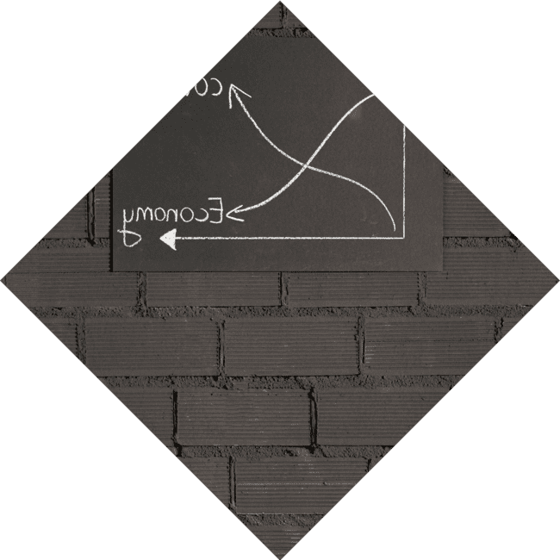


Finding Asymptotes
Asymptotes are crucial in understanding rational functions.
occur where the denominator is zero, while
indicate the function's behavior as x approaches infinity. Mastering these concepts is essential for precise graphing.

Slide 6


Graphing Techniques
Graphing rational functions involves a mix of . Start by plotting intercepts, then draw asymptotes, and finally sketch the curve considering the behavior around these features. This systematic approach leads to more accurate and
insightful graphs.

Slide 7





Real-World Applications
Rational functions appear in various real- world scenarios, from to
. Understanding how to graph
them provides insights into
and can help solve practical problems, making this knowledge invaluable.

Slide 8


Common Mistakes to Avoid
When graphing rational functions, it's easy to make mistakes. Common pitfalls include neglecting or
misplacing intercepts. By being aware of
these issues, you can improve your graphing accuracy and avoid confusion.

Slide 9

Conclusion: Mastering the Curves
In conclusion, mastering the art of graphing
unlocks a deeper
understanding of their behavior. By focusing on key features and applying effective techniques, you can confidently navigate through the curves of mathematics.

Slide 10
Thanks!
Do you have any questions?
youremail@email.com
+91 620 421 838
www.yourwebsite.com @yourusername

