Slide 1

Trigonometric Journeys: Mapping the Waves of Sine and Cosine

Slide 2





Introduction to Trigonometry
is the study of relationships between the angles and sides of triangles. In this presentation,
we will embark on
through the waves of and , exploring their unique properties and applications in various ﬁelds. Let's dive into the together!

Slide 3




Understanding Sine Waves
The is a fundamental concept in trigonometry, representing periodic oscillations.
It can be described as a smooth, continuous
wave that varies between and . Sine waves are essential in physics, engineering, and sound, providing insights into and .

Slide 4
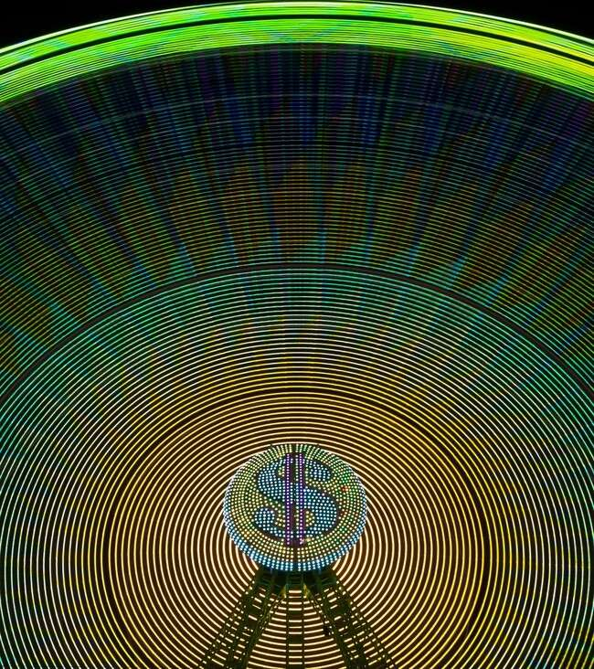




Exploring Cosine Waves
Similar to sine waves, also represent periodic functions. They are shifted horizontally compared to sine waves, starting at a maximum value of
. Cosine functions play a vital role in
understanding widely used in
and are
and
.

Slide 5
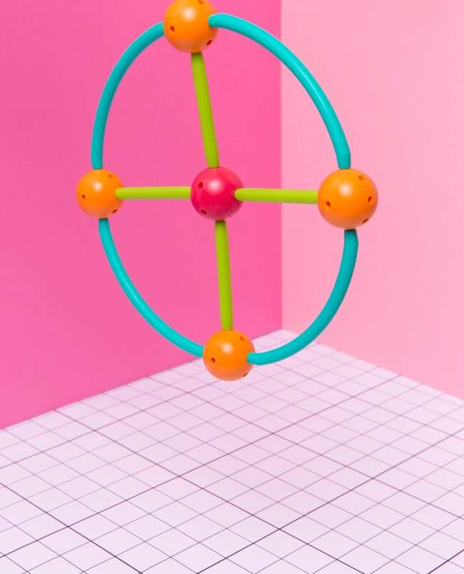



The Unit Circle Connection
The is a powerful tool in trigonometry, linking angles to sine and cosine values. Each point on the circle corresponds to an angle, where the represents cosine and the represents sine. This connection is essential for visualizing trigonometric relationships.

Slide 6








Applications in Real Life
Sine and cosine functions are not just theoretical; they have
in various ﬁelds. From
and
to
, these waves help us
understand and create patterns, analyze signals, and simulate natural phenomena. Their impact is truly
.

Slide 7


Harmonics and Sound Waves
In the realm of , sine and cosine waves are the building blocks of sound. Harmonics arise from the combination of these waves, creating rich tones and complex sounds. Understanding their interaction allows musicians and sound engineers to manipulate and enhance audio experiences.

Slide 8
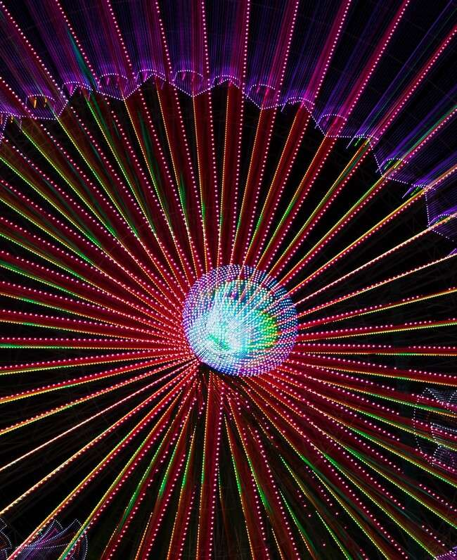


Visualizing Trigonometric Functions
Visual representation of
enhances comprehension.
Tools like graphs and animations help
illustrate the behavior of sine and cosine waves, making it easier to grasp their periodic nature and transformations.
This visualization is crucial for both learners and educators.

Slide 9



Conclusion: The Wave of Learning
Our journey through the world of and has revealed the beauty and utility of these fundamental functions. From their mathematical properties to real-world applications, understanding these waves enriches our knowledge of the universe. Let’s continue to ride the !

Slide 10
Thanks!
Do you have any questions? youremail@email.com
+91 620 000 838
www.yourwebsite.com @yourusername

