Slide 1
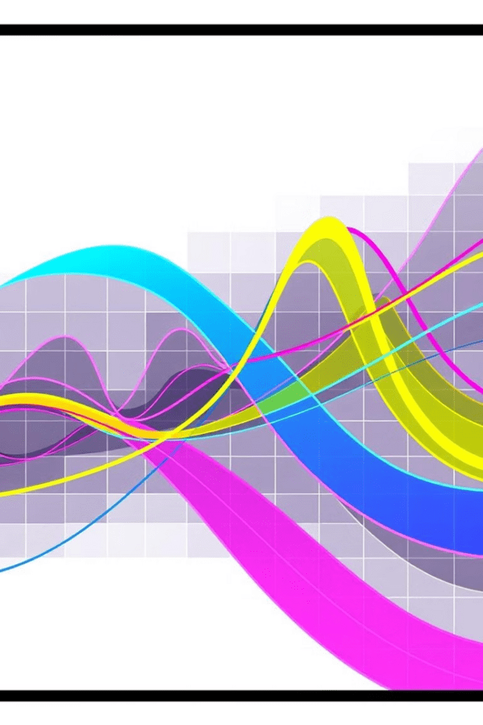
Piecewise Functions
This presentation will explore the fascinating world of piecewise functions, providing a comprehensive overview of their definition, graphing, applications, and more. Join us as we delve into the complexities and intricacies of these versatile mathematical constructs.
oi
by onyi ik

Slide 2
Introduction to Piecewise Functions
Building Blocks of Functions
Unifying Multiple Rules
Piecewise functions are like building blocks, constructed from various function pieces. Each piece applies to a specific portion of the domain, seamlessly combining to form a single function.
They allow us to express complex relationships that might require multiple rules based on different input values. Think of it as a set of instructions for how a function should behave depending on the input.

Slide 3
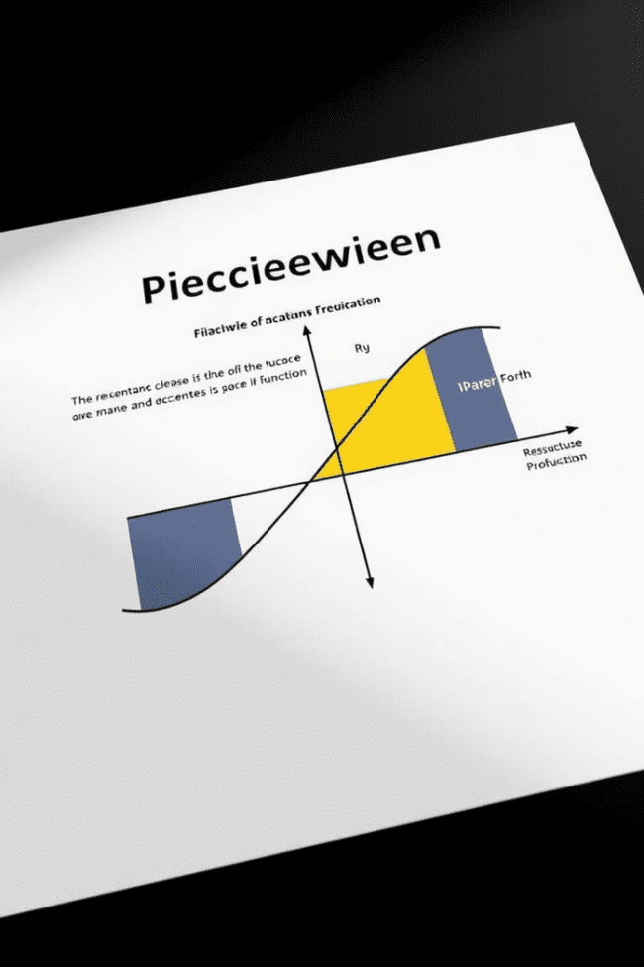
Definition and Examples
Formal Definition
Example
A piecewise function is a function defined by multiple subfunctions, each with a specific domain. The function's value is determined by which subfunction applies to the given input.
Consider a function defined as follows: f(x) = x for x < 0, f(x) = x^2 for x >= 0. This function consists of two pieces: a linear piece for x < 0 and a quadratic piece for x >= 0.

Slide 4
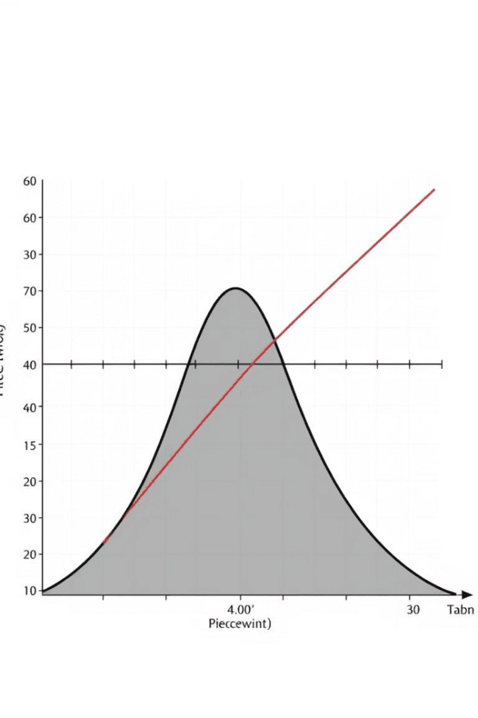



Graphing Piecewise Functions
Plot Each Piece
First, graph each subfunction separately, only considering its specific domain.
Connect the Pieces
Combine the graphs of the individual pieces, ensuring they are connected or disconnected based on the function's definition.
Boundary Points
Pay attention to the boundary points where the domain shifts. These points may be included or excluded based on the function's definition.

Slide 5
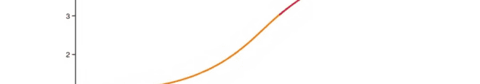
Step Functions
Step functions are commonly used to model situations where the output changes in discrete steps, such as pricing structures or postage rates.
A step function is a piecewise function where each piece is a constant value within a specific interval.
1
2
3
These functions resemble a staircase, with horizontal steps and abrupt jumps at the interval boundaries.

Slide 6
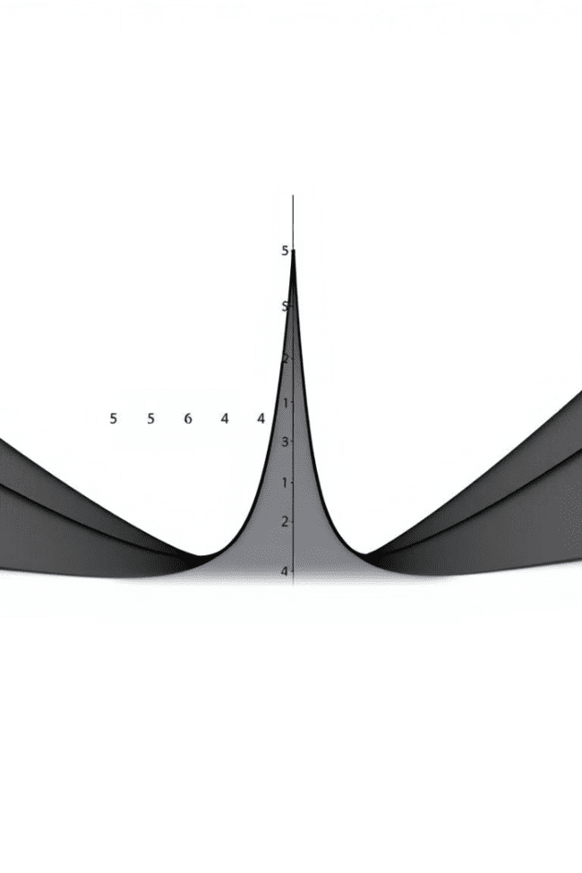



Absolute Value Functions
Definition
The absolute value function, denoted by |x|, returns the magnitude of a number, regardless of its sign.
Piecewise Representation
It can be expressed as a piecewise function: f(x) = x for x >= 0 and f(x) = -x for x < 0.
V-Shape Graph
The graph of the absolute value function has a distinctive V-shape, symmetric about the y-axis.

Slide 7
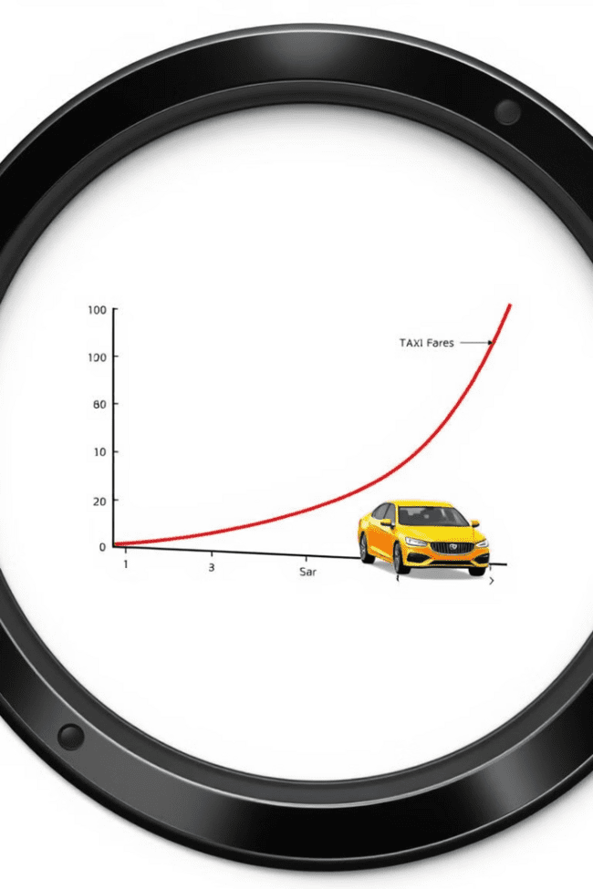
Modeling Real-World Scenarios
1
Taxi Fares
Taxi fares often have a base fee and a variable cost per mile, making them ideal candidates for piecewise functions.
2
Phone Plans
Phone plans frequently offer a certain amount of data or minutes for a flat fee, then charge an extra rate for usage beyond that limit.
3
Shipping Costs
Shipping costs can vary based on the weight or distance of a package, requiring piecewise functions to model their pricing.

Slide 8



Continuity and Piecewise Functions
Continuity
1
A function is continuous if its graph can be drawn without lifting the pen. This means there are no gaps or jumps in the graph.
Discontinuity
2
Piecewise functions can be discontinuous at the boundary points where the domain switches. This happens if the pieces don't connect seamlessly.
Analyzing Continuity
3
To determine continuity, check if the function's value at the boundary points is the same from both sides.

Slide 9
Operations with Piecewise Functions
Addition and Subtraction
1
To add or subtract piecewise functions, simply add or subtract the corresponding pieces in each domain interval.
Multiplication and Division
2
Multiplication and division of piecewise functions are also performed piece-wise, multiplying or dividing the corresponding pieces.
Domain Restrictions
3
Remember to consider any domain restrictions imposed by the functions being combined.

Slide 10



Applications and Problem-Solving

