Slide 1
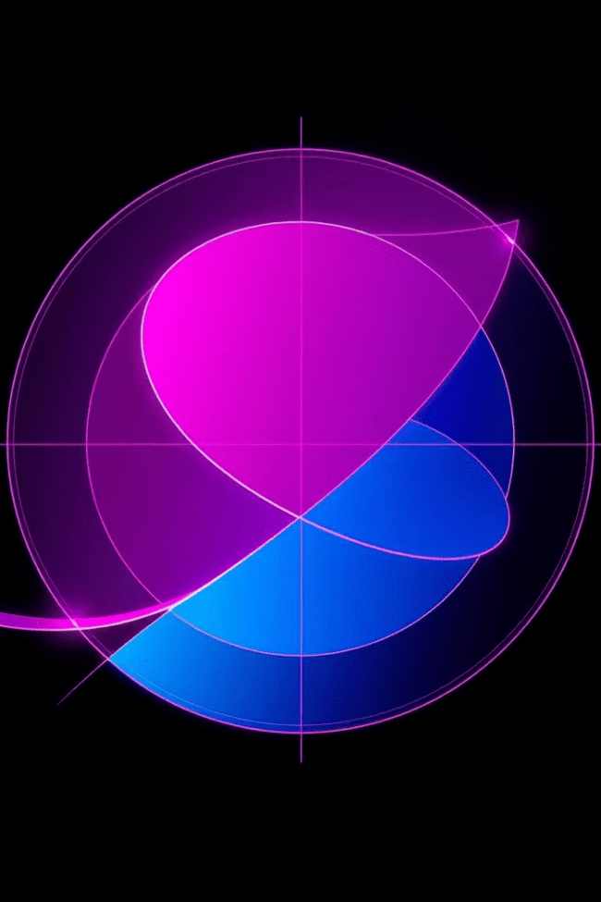


Exploring Conic Sections: A Journey Through Geometry
Welcome to our exploration of conic sections, a fascinating branch of geometry where we delve into the captivating shapes formed by the intersection of a plane and a double cone. Prepare to discover their unique definitions, characteristics, and wide-ranging applications in diverse fields.
by ONYEDIKACHI ONWURAH

Slide 2
Defining Conic Sections: The Interplay of Plane and Cone
The Essence
Commonalities
Conic sections arise when a plane intersects a double cone at different angles. The resulting shapes – circle, ellipse, parabola, and hyperbola – share fundamental properties and hold remarkable applications across various disciplines.
Conic sections are defined by their shared features: a focus (or foci) and a directrix. These elements play a crucial role in shaping their unique characteristics and applications.

Slide 3

The Circle: A Timeless Shape
Definition
Characteristics
A circle is a set of all points equidistant from a fixed point called the center. The distance from the center to any point on the circle is called the radius.
Circles are symmetrical, with every point on the circumference lying the same distance from the center. They are widely used in geometry, engineering, and other fields, from wheels to celestial bodies.

Slide 4

The Ellipse: A Stretched Circle
Definition
Characteristics
An ellipse is a set of all points where the sum of the distances from any point to two fixed points, called foci, is constant.
Ellipses exhibit a unique property: the sum of the distances from any point on the ellipse to its two foci is constant. This property makes ellipses crucial in understanding planetary orbits.

Slide 5
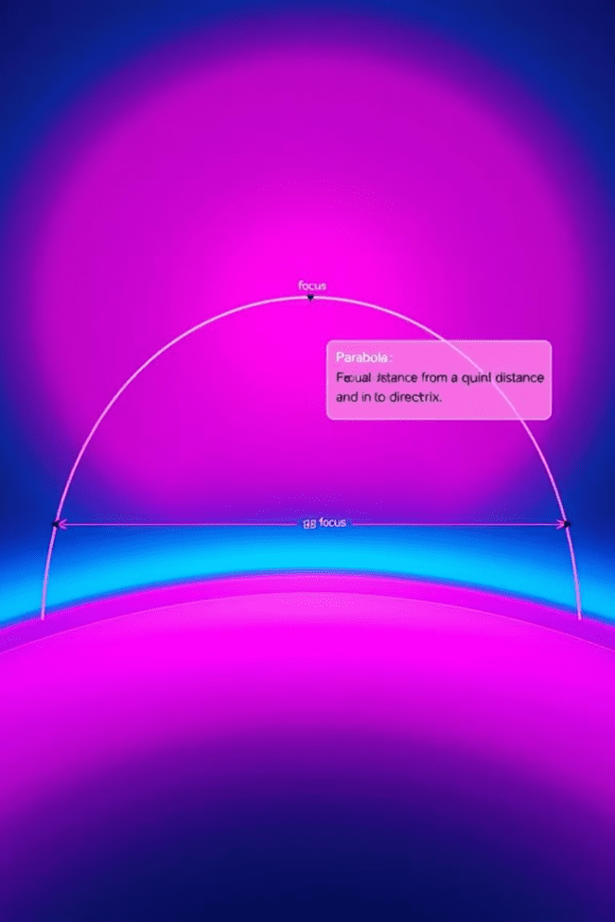


The Parabola: A U-Shaped Curve
Definition
Characteristics
A parabola is a set of all points where the distance from any point to a fixed point, called the focus, is equal to the distance from that point to a fixed line, called the directrix.
Parabolas are symmetrical about a line called the axis of symmetry. They have a unique shape that is widely used in satellite dishes, telescope reflectors, and other applications.

Slide 6
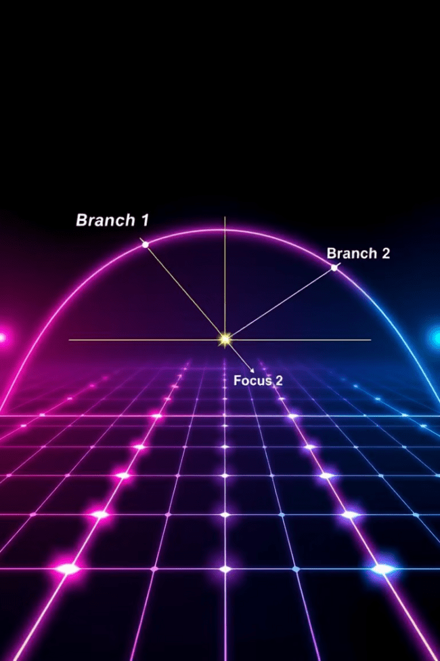
The Hyperbola: Two Branches of Wonder
1
Definition
A hyperbola is a set of all points where the difference between the distances from any point to two fixed points, called foci, is constant.
2
Characteristics
Hyperbolas have two branches that extend infinitely. They are defined by their foci and directrices, and their unique properties find applications in optics and other fields.

Slide 7
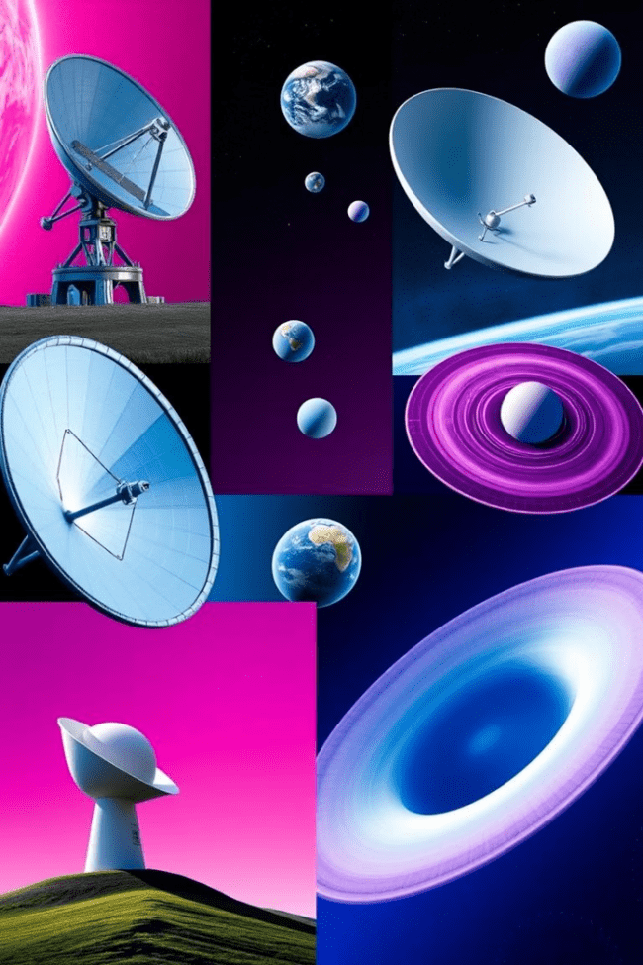



Applications of Conic Sections: From Space to Sound
Astronomy
Ellipses are crucial in understanding planetary orbits. Kepler's Laws describe how planets move in elliptical paths around the sun, with the sun at one focus of the ellipse.
Engineering
Parabolas are used in the design of satellite dishes, telescopes, and reflectors because of their ability to focus sound waves and light rays at a single point.
Architecture
Hyperbolic shapes appear in architecture, creating dynamic and visually appealing structures. The Gateway Arch in St. Louis is a prominent example.

Slide 8



Identifying Conic Sections: Unveiling Their Hidden Forms
1
Equations
2
Key Features
3
Identify Shape

Slide 9
Graphing Conic Sections: A Visual Journey
1
Circle
2
Ellipse
3
Parabola
4
Hyperbola

Slide 10

Conic Sections: A Legacy of Geometry
Our journey through conic sections has revealed their profound beauty and immense utility in various fields. Understanding these remarkable shapes empowers us to analyze and explore the world around us with greater clarity and insight.

