Slide 1

Unlocking Truths: The Art of Proof by Contradiction

Slide 2

Unlocking Truths
is a powerful method in mathematics. It allows us to establish the truth of a statement by demonstrating that assuming
the opposite leads to a contradiction. This creative approach not only enhances our understanding but also sharpens our logical reasoning skills. Let's embark on this journey together!

Slide 3
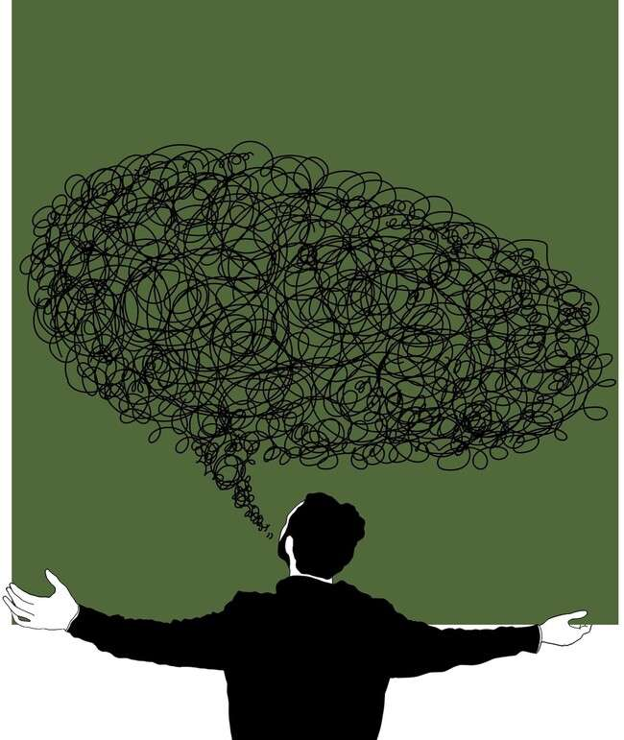
What is Proof by Contradiction?
involves assuming the negation of what we want to prove. If this assumption leads to an absurdity or contradiction, we conclude that the original statement must be true. This method is essential in various ﬁelds, especially in mathematics and logic.

Slide 4
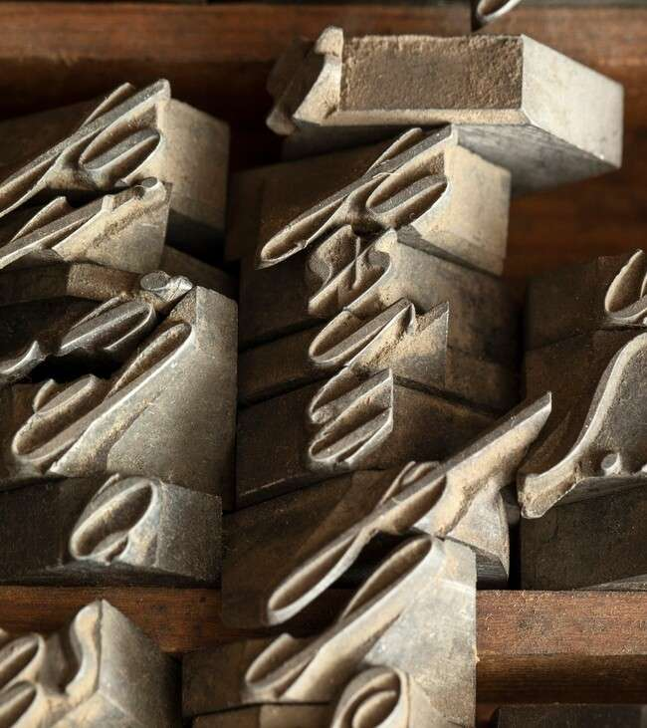

Historical Background
The roots of
can be traced back to ancient Greek mathematicians like . This method has stood the test of time, evolving through the works of philosophers and mathematicians, shaping the foundations of modern logic and mathematics.

Slide 5
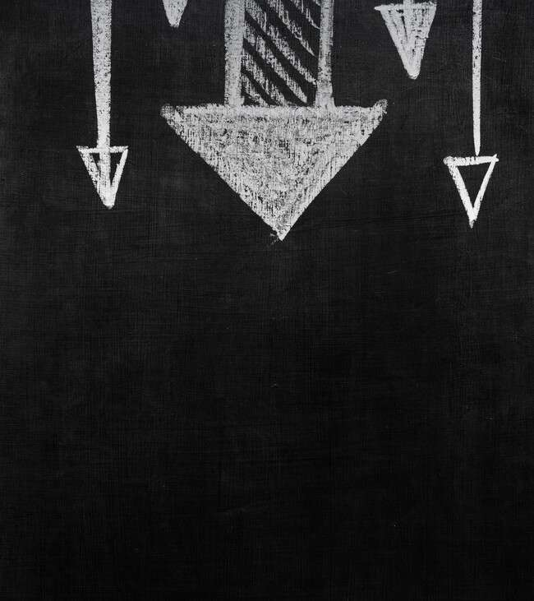
Steps of the Method
To apply ,
follow these steps: 1. Assume the negation of the statement. 2. Use logical reasoning to derive consequences. 3. If a contradiction arises, the original statement is validated. This structured approach is crucial for clear reasoning.

Slide 6
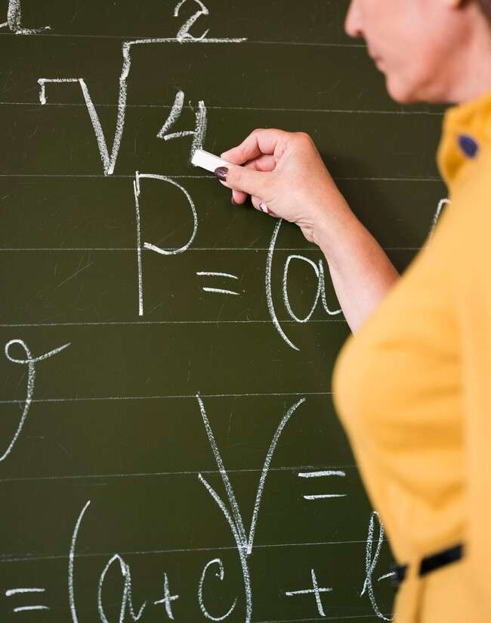

Examples in Mathematics
One classic example of proving that
is
. By assuming it is
rational and leading to a contradiction, we establish its irrationality. Such examples highlight the elegance and effectiveness of this method in mathematical proofs.

Slide 7

Applications Beyond Math
is not limited to mathematics. It ﬁnds applications in computer science, philosophy, and even everyday reasoning.
Understanding this method enhances critical thinking and problem-solving skills across various disciplines.

Slide 8

Common Pitfalls
While is powerful,
it can lead to confusion if not applied carefully. Misinterpreting assumptions
or overlooking logical connections can result in ﬂawed conclusions. Awareness of these pitfalls is essential for effective reasoning.

Slide 9
Conclusion
In conclusion, is a vital tool for unlocking truths in mathematics and beyond. By mastering this art, we enhance our logical reasoning and critical thinking abilities. Embrace this method to explore deeper truths and challenge assumptions!

Slide 10
Thanks!
Do you have any questions? youremail@email.com
+91 620 000 838
www.yourwebsite.com @yourusername

