Slide 1


Unlocking the Secrets: Mastering Logarithmic Equations

Slide 2






Introduction to Logarithmic Equations
Welcome to this presentation on
! We will explore
their and in various fields. Understanding these
equations will help you unlock their
and master their use in problem-solving. Get ready to dive into the fascinating world of logarithms!

Slide 3


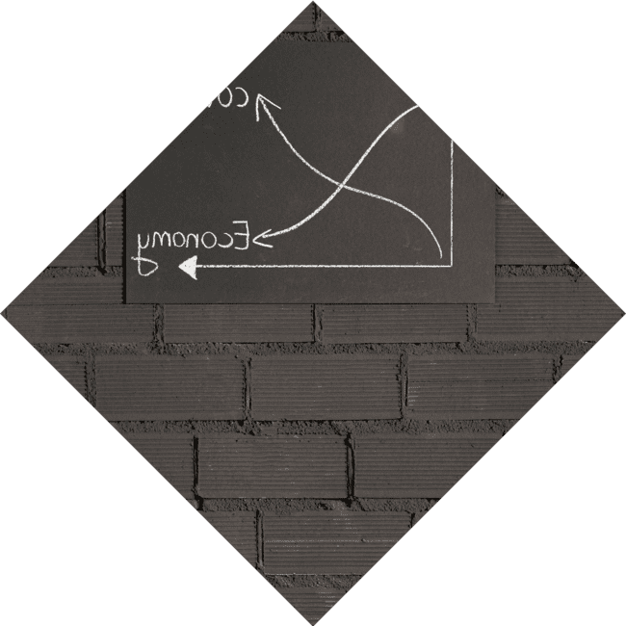



What is a Logarithm?
A is the inverse operation of . It answers the question: to what exponent must a base be raised to produce a given number? For example, in the equation , is the base, is the result, and is the
exponent. Let's unravel this concept
further!

Slide 4





Properties of Logarithms
Logarithms have several
that simplify calculations. The most important ones include the
, , and .
These properties allow us to manipulate logarithmic expressions efficiently, making them a powerful tool in mathematics and science.

Slide 5



Solving Logarithmic Equations
To solve logarithmic equations, we often convert them into . This process involves isolating the logarithm and using its properties to rewrite the equation. Understanding this technique is crucial for mastering logarithmic equations and tackling complex problems.

Slide 6
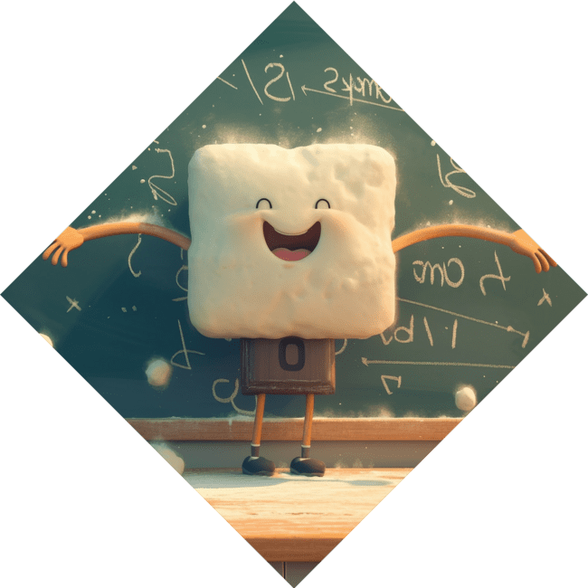

Common Mistakes to
Avoid
When working with logarithmic equations, it's essential to avoid common . Some pitfalls include ignoring the domain restrictions and misapplying logarithmic properties. By being aware of these errors, you can enhance your problem-solving skills and achieve better results.

Slide 7





Applications in Real Life
Logarithmic equations are not just theoretical; they have real-world
! From measuring
(decibels) to calculating
in chemistry, logarithms play a vital role in various fields. Understanding their applications can deepen your appreciation for this
mathematical concept.

Slide 8


Practice Makes Perfect
To master logarithmic equations, practice is key! Engage with a variety of problems, from simple to complex, to build your confidence. Utilize resources such as textbooks, online exercises, and study groups to enhance your understanding and skills in logarithmic equations.

Slide 9

Conclusion: Logarithmic Mastery
In conclusion, mastering
opens doors to a deeper understanding of
mathematics. By grasping their properties, solving techniques, and applications, you can unlock their secrets. Keep practicing, and you'll find logarithms to be an invaluable tool in your mathematical toolkit!

Slide 10
Thanks!
Do you have any questions?
youremail@email.com
+91 620 000 838
www.yourwebsite.com @yourusername

