Slide 1


Unlocking the Parabola: Mastering Vertex Form of Quadratic Functions

Slide 2



Unlocking the Parabola
to our journey of mastering the of quadratic functions! In this presentation, we will explore the beauty and utility of parabolas, focusing on how to unlock their secrets through understanding their vertex. Let's dive into the world
of quadratic equations!

Slide 3



Understanding Quadratics
Quadratic functions are represented by the equation . The graph of a quadratic is a .
Understanding these functions is
crucial for solving various mathematical problems, from physics to finance. Let’s break down the components that make up this
fascinating shape!

Slide 4
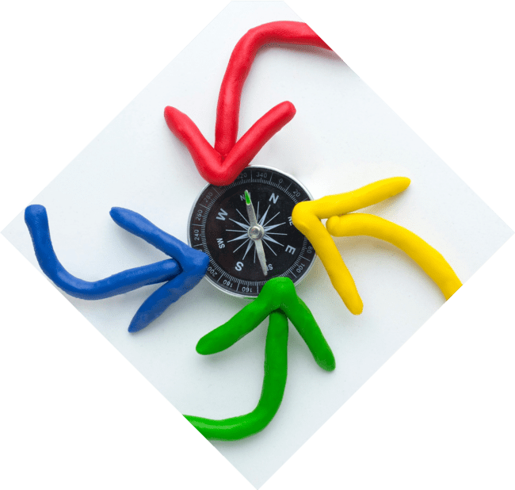



Vertex Form Explained
The expressed as
of a quadratic function is
, where (h, k) is
the . This form allows us to easily identify the vertex and graph the parabola. Understanding this form is key to mastering quadratic functions!

Slide 5
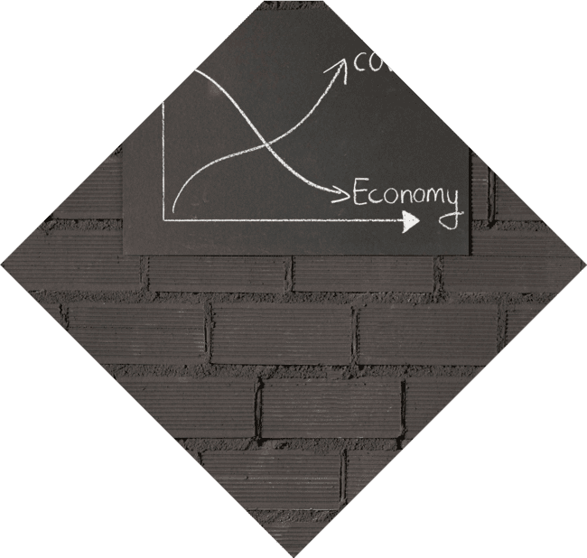


Finding the Vertex
To find the using vertex form, simply identify the values of and . The vertex (h, k) gives us crucial information about the parabola's position and direction.
Remember, if is positive, the parabola opens upwards; if negative, it opens downwards!

Slide 6
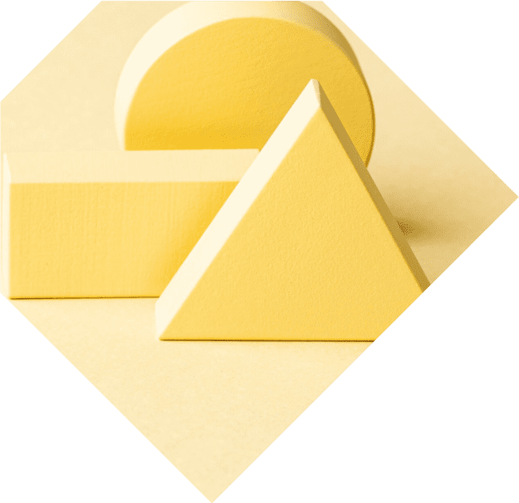



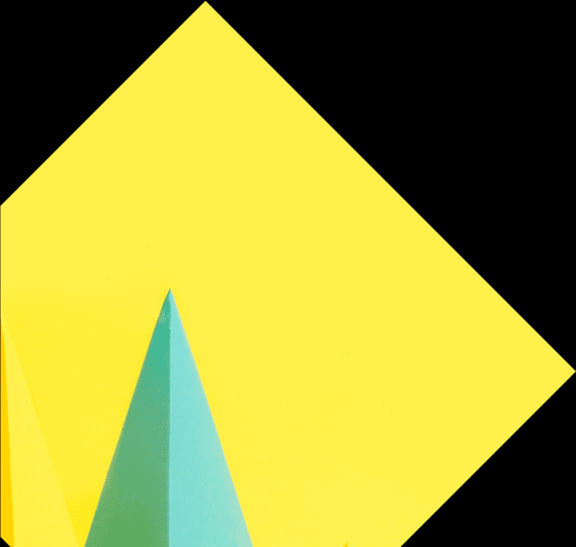
Graphing with Vertex Form
Graphing a quadratic function in
is straightforward. Start by plotting the vertex, then use the value to determine the width and direction of the
parabola. This approach simplifies the graphing process, making it more intuitive and visually appealing!

Slide 7
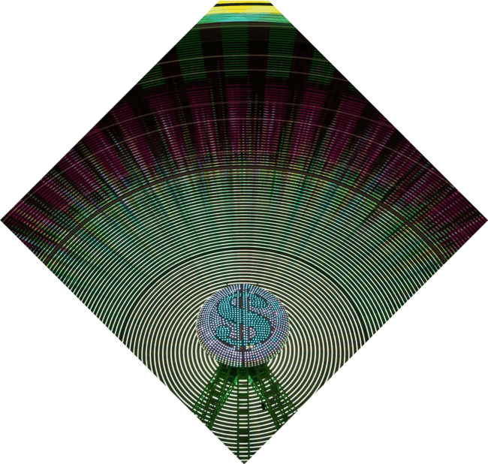
Applications of Vertex Form
The is not just for graphing; it has practical applications in real-world scenarios. From optimizing profits in business to determining the trajectory of projectiles in physics, mastering this form opens doors to solving complex problems creatively!

Slide 8
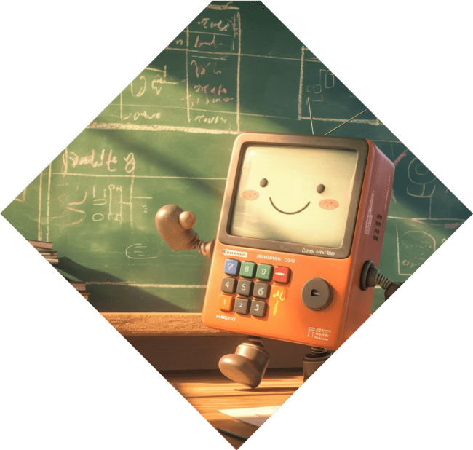

Common Mistakes to Avoid
When working with vertex form, be mindful of common pitfalls. Misidentifying and , or confusing the direction of the parabola based on the value can lead to errors.
Stay vigilant, and practice will help you avoid these mistakes!

Slide 9

Conclusion: Mastering the Parabola
In conclusion, unlocking the of quadratic functions empowers you to graph and interpret parabolas with confidence. With practice, you can master this essential mathematical tool and apply it creatively in various fields. Keep exploring the wonders of mathematics!

Slide 10
Thanks!
Do you have any questions?
youremail@email.com
+91 620 421 838
www.yourwebsite.com @yourusername

