Slide 1
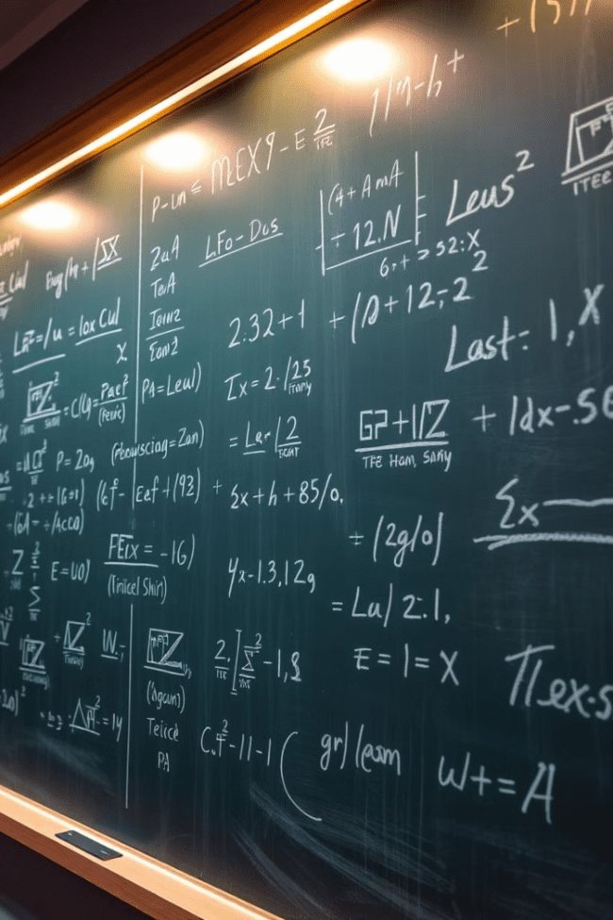

Introduction to Algebra: Simple Equations
Algebra is a fundamental branch of mathematics that allows us to represent and manipulate unknown quantities using variables and equations. In this introduction, we will explore the basics of simple algebraic equations and how they can be used to solve real-world problems.
by Onyedikachi Ikenna Onwurah

Slide 2

What is Algebra?
1
Symbolic Language
2
Generalization
Algebra is a symbolic language that uses letters, numbers, and operators to represent and manipulate quantities and relationships.
Algebra allows us to generalize mathematical concepts and solve problems beyond specific numerical values.
3
Problem-Solving
4
Versatility
Algebraic equations and expressions are powerful tools for modeling and solving a wide range of real-world problems.
Algebra is the foundation for more advanced mathematics, including calculus, linear algebra, and higher-level problem-solving.

Slide 3
Algebraic Expressions and Variables
Algebraic Expressions
Variables
Operations
Algebraic expressions are mathematical phrases that combine variables, numbers, and operations. They can represent a wide range of quantities and relationships.
Variables are letters (usually x, y, or z) that represent unknown or changing quantities. They allow us to generalize and solve problems without specific numerical values.
The basic algebraic operations include addition, subtraction, multiplication, and division. These operations are used to manipulate and solve algebraic expressions.

Slide 4
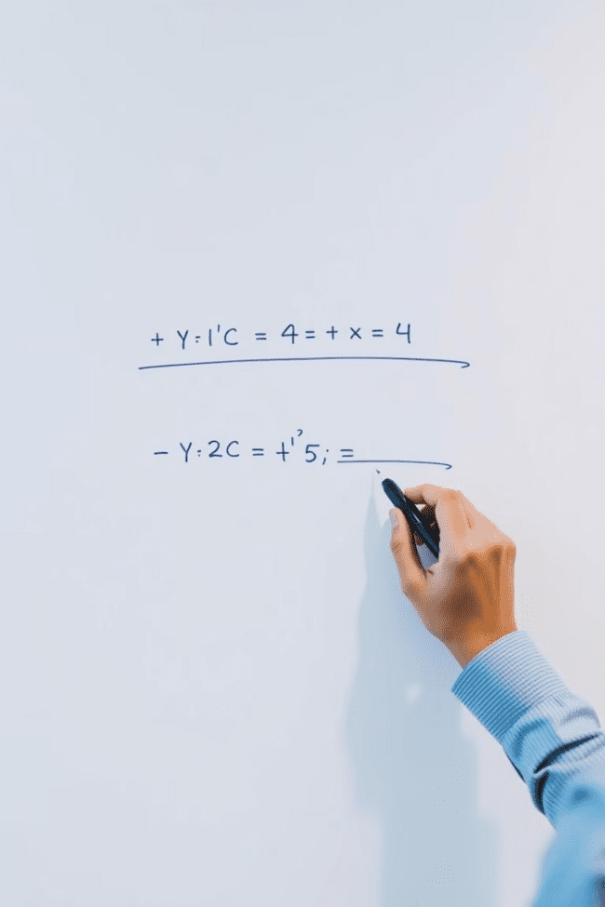
Solving Simple Linear Equations
1
Isolate the Variable
The first step in solving a simple linear equation is to isolate the variable on one side of the equation by performing inverse operations.
2
Combine Like Terms
Next, we combine any like terms (terms with the same variable) on each side of the equation to simplify the expression.
3
Solve for the Variable
Finally, we perform the necessary operations to solve for the unknown variable, ensuring that the equation remains balanced on both sides.

Slide 5
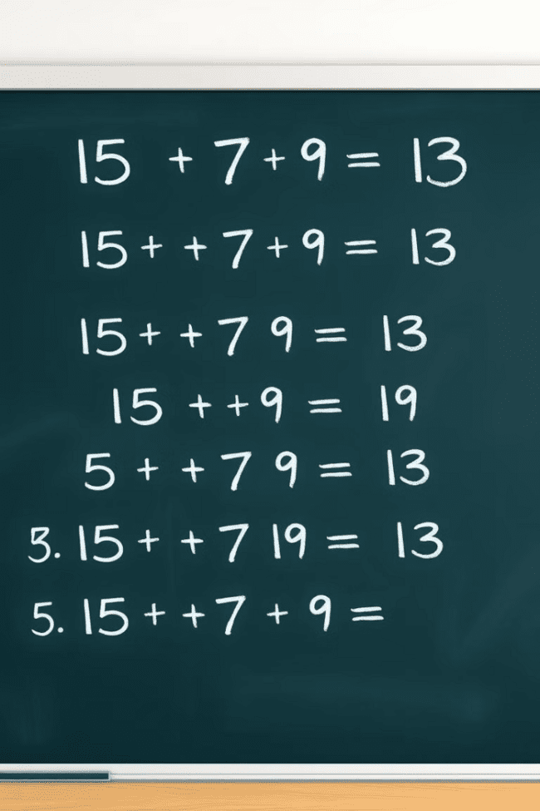
Addition and Subtraction Equations
Addition Equations
Subtraction Equations
Addition equations involve combining variables and constants using the addition operation. The goal is to isolate the variable and solve for its value.
Subtraction equations involve subtracting variables and constants from both sides of the equation. The process is similar to solving addition equations, but with the subtraction operation.
Key Strategies
Utilize inverse operations, combine like terms, and maintain the balance of the equation to solve both addition and subtraction equations effectively.

Slide 6




Multiplication and Division Equations
Multiplication Equations
Division Equations
Key Strategies
Multiplication equations involve variables and constants combined using the multiplication operation. The goal is to isolate the variable and solve for its value.
Division equations involve dividing variables and constants on both sides of the equation. The process is similar to solving multiplication equations, but with the division operation.
Utilize inverse operations, simplify fractions, and maintain the balance of the equation to solve both multiplication and division equations effectively.

Slide 7
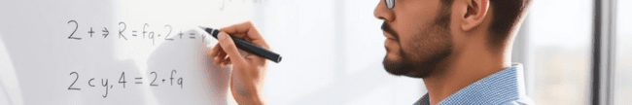




Applying Equations in Real-World Scenarios
Identify the Problem
Translate to an Equation
Solve the Equation
Interpret the Solution
The first step in applying equations to real-world scenarios is to clearly identify the problem and the relationships between the known and unknown quantities.
Next, we translate the problem statement into an algebraic equation, using variables to represent the unknown quantities.
Once the equation is set up, we can apply the strategies we've learned to solve for the unknown variable(s).
Finally, we interpret the solution in the context of the original problem to answer the question or make informed decisions.

Slide 8

Strategies for Solving Algebraic Problems
Understand the Problem
Carefully read and analyze the problem statement to identify the known and unknown quantities, as well as the relationships between them.
Translate to an Equation
Represent the problem using algebraic expressions and equations, using variables to stand for the unknown quantities.
Simplify and Isolate
Simplify the equation by combining like terms and isolating the variable on one side using inverse operations.
Solve for the Variable
Perform the necessary operations to solve for the unknown variable, ensuring the equation remains balanced.
Check the Solution
Verify the solution by substituting the found value back into the original equation and ensuring it satisfies the problem statement.

Slide 9

Conclusion and Key Takeaways
1
Algebraic Foundations
2
Solving Equations
Algebra is a fundamental branch of mathematics that allows us to represent and manipulate unknown quantities using variables and equations.
By understanding the basics of algebraic expressions, variables, and operations, we can effectively solve simple linear equations through a step-by-step process.
3
Real-World Applications
4
Continuous Practice
Applying algebraic equations to real-world scenarios is a powerful problem-solving skill, allowing us to model relationships and make informed decisions.
Developing and refining algebraic problem-solving strategies through practice is key to mastering this essential mathematical discipline.

