Slide 1
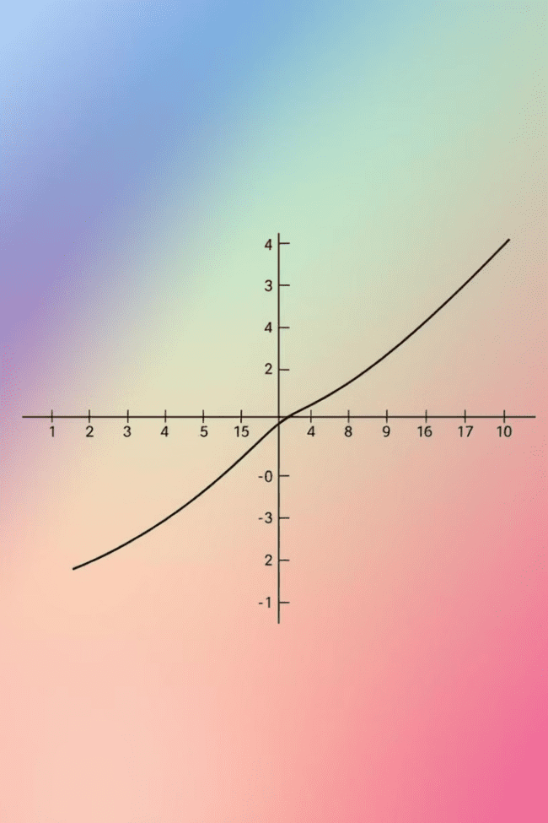
Logarithmic Functions
Logarithmic functions are essential tools in mathematics, with wide-ranging applications in various fields. Understanding their properties and graphs allows us to explore exponential growth and decay, solve equations, and model real-world phenomena. This presentation delves into the world of logarithmic functions, revealing their power and versatility.
OI
by ONYEDIKA IK

Slide 2
Properties of Logarithmic Functions
Inverse of Exponential Functions
Base of the Logarithm
Domain and Range
The base of a logarithmic function determines the rate of growth or decay. For example, a logarithm with a base of 10 grows much faster than a logarithm with a base of 2.
The domain of a logarithmic function is all positive real numbers, while the range is all real numbers. This means that you can only take the logarithm of a positive number, and the output can be any real number.
Logarithmic functions are the inverse of exponential functions. This means that if you take the logarithm of an exponential function, you get back the original input, and vice versa.

Slide 3
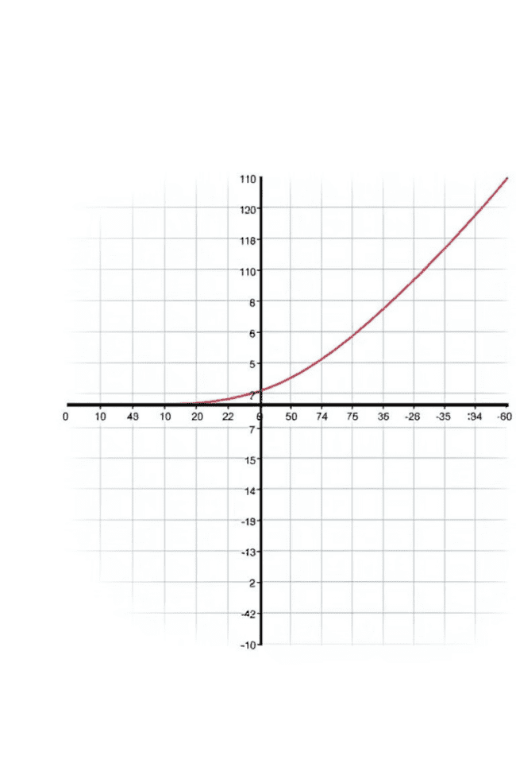



Graphing Logarithmic Functions
Base and Shape
The base of a logarithmic function directly impacts the shape of its graph. A larger base results in a steeper curve, while a smaller base produces a more gradual curve.
Asymptotes
Logarithmic functions have a vertical asymptote at x = 0. This means that the graph approaches the y-axis but never touches it.
Intercepts
A logarithmic function always passes through the point (1, 0). This is because the logarithm of 1 is always 0, regardless of the base.

Slide 4
Exponential Growth and Decay
Exponential Growth
Exponential Decay
Logarithmic functions are used to model exponential growth, where the rate of growth increases over time. This is often seen in areas like population growth, compound interest, and viral spread.
Logarithmic functions can also model exponential decay, where the rate of decrease decreases over time. This is common in scenarios like radioactive decay, drug concentration in the body, and depreciation of value.

Slide 5



Solving Logarithmic Equations
Isolate the Logarithmic Term
1
Use algebraic operations to isolate the logarithmic term on one side of the equation.
Convert to Exponential Form
2
Convert the logarithmic equation to its equivalent exponential form.
Solve for the Variable
3
Solve the resulting exponential equation for the unknown variable.

Slide 6
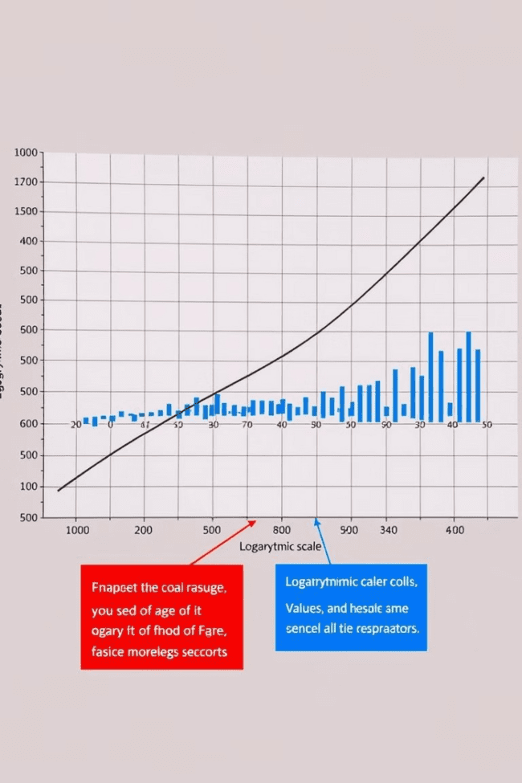



Logarithmic Scales and Applications
Earthquakes
The Richter scale, used to measure earthquake intensity, is based on logarithmic scales. Each increase of one unit on the scale represents a tenfold increase in seismic energy.
Sound Intensity
The decibel scale, measuring sound intensity, is logarithmic. Each increase of ten decibels represents a tenfold increase in sound pressure level.
pH Levels
The pH scale, used to measure the acidity or alkalinity of a solution, is based on logarithms. A pH of 7 is neutral, while lower pH values represent acidity and higher values indicate alkalinity.

Slide 7
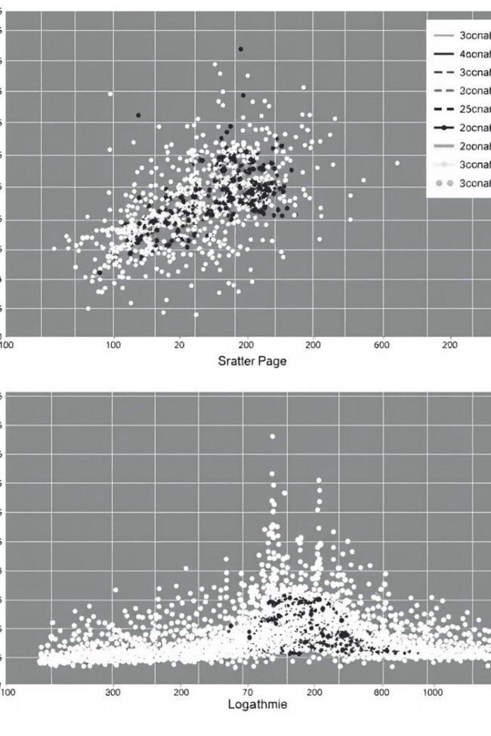
Logarithmic Transformation of Data
1
Linearizing Data
Logarithmic transformations can linearize data that exhibits exponential growth or decay, making it easier to analyze and understand.
2
Reducing Variability
Transforming data with a large range of values using logarithms can reduce variability and improve the accuracy of statistical analysis.
3
Visualizing Patterns
Logarithmic scales allow for better visualization of data with wide ranges, making it easier to identify trends and patterns.

Slide 8
Using Logarithms to Solve Problems
Exponential Growth
1
Logarithms can help determine the time it takes for a quantity to double or triple under exponential growth.
Exponential Decay
2
Logarithms can calculate the time it takes for a quantity to reduce to a certain percentage under exponential decay.
Interest Calculations
3
Logarithms can be used to calculate the time it takes for an investment to reach a desired value, considering compound interest.

Slide 9
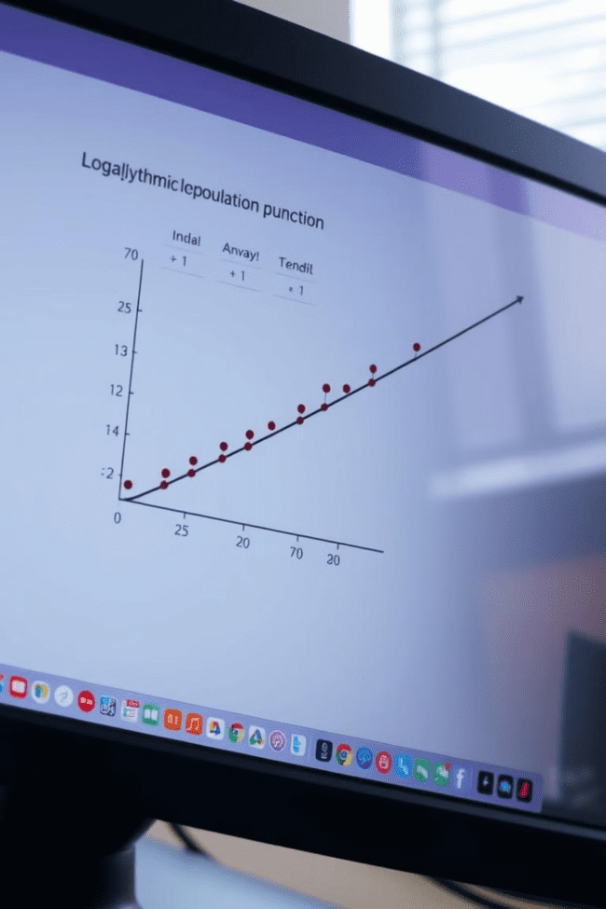
Modeling Real-World Phenomena with Logarithmic Functions
Population Growth
Radioactive Decay
Logarithmic functions can model population growth, which often follows a pattern of rapid growth initially, followed by a more gradual increase.
Logarithmic functions model radioactive decay, where the amount of radioactive material decreases over time at a decreasing rate.
Sound Intensity
Logarithmic functions can be used to model the intensity of sound, explaining why a tenfold increase in sound power corresponds to a ten-decibel increase.

Slide 10
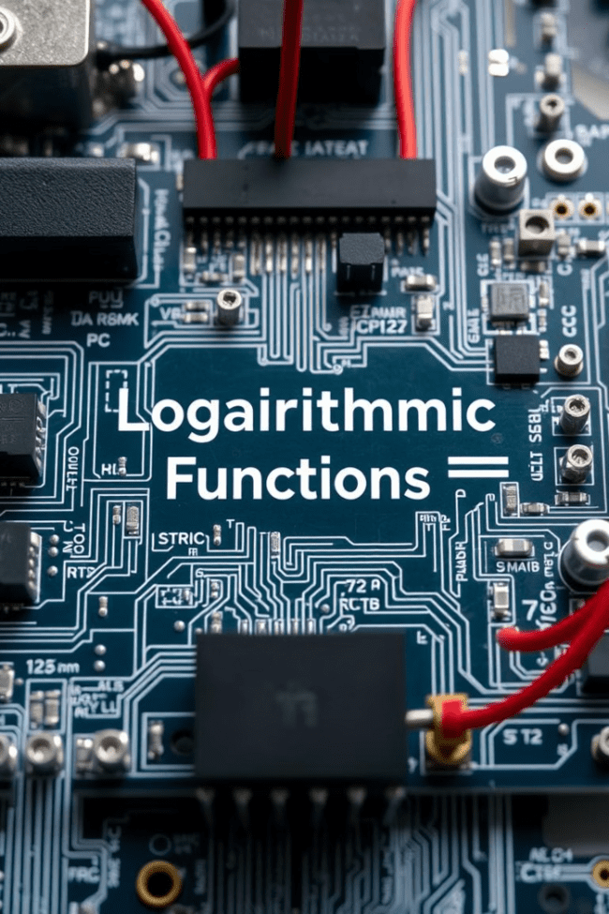
The Importance of Logarithmic Functions in Science and Technology
Logarithmic functions are fundamental to various scientific and technological fields. Their applications extend beyond modeling to areas like signal processing, image compression, and data analysis, making them indispensable tools in modern technology.

