Slide 1
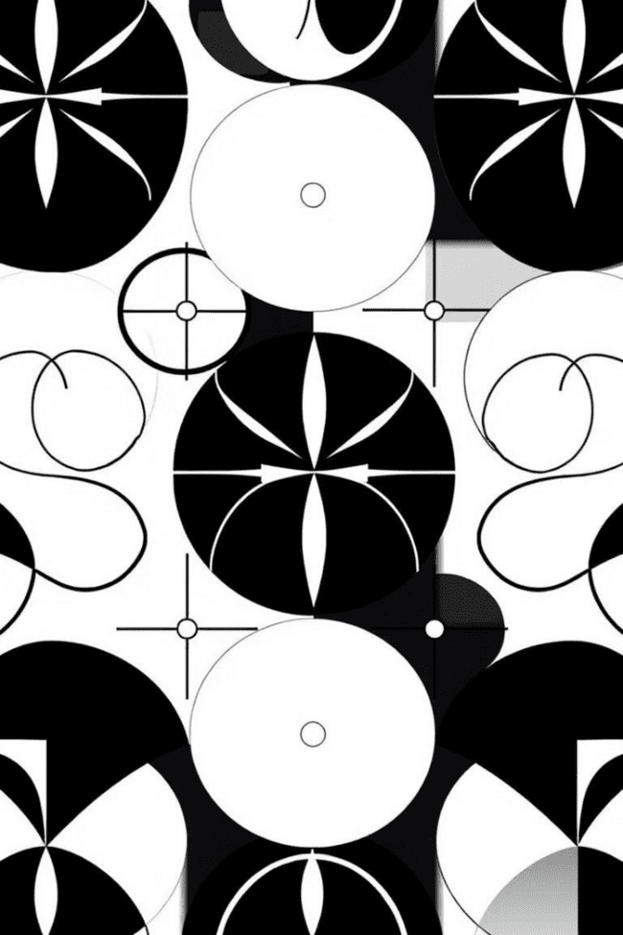

Set Theory: Fundamental Concepts
Set theory is a foundational branch of mathematics that provides a framework for studying collections of objects, known as sets. It forms the basis for many other mathematical disciplines and has applications in various fields, including computer science, logic, and the natural sciences. This presentation will explore the fundamental concepts of set theory, delving into set notation, set operations, and the properties that govern these mathematical entities.
by Onwurah Onyedikachi

Slide 2

What is Set Theory?
1
Definition of a Set
2
The Origins of Set Theory
3
Importance of Set Theory
A set is a well-defined collection of distinct objects or elements. These elements can be numbers, letters, symbols, or any other type of object that can be identified and grouped together.
Set theory was developed in the late 19th century by the German mathematician Georg Cantor. It emerged as a way to formally study and understand the concept of infinity, leading to the development of important mathematical concepts and theories.
Set theory provides a foundational framework for mathematics, allowing for the precise and logical definition of mathematical objects, operations, and relationships. It is essential for understanding the structure and properties of various mathematical systems.

Slide 3
Sets and Set Notation
Set Notation
Set Membership
Set Descriptions
Sets are typically denoted using curly braces, { }, with the elements of the set listed inside. For example, the set of even integers between 1 and 10 can be written as {2, 4, 6, 8, 10}.
To indicate that an element belongs to a set, the symbol "∈" is used. For instance, 5 ∈ {1, 2, 3, 4, 5} means that 5 is an element of the set.
Sets can also be defined using set-builder notation, which describes the elements of a set using a defining property. For example, the set of even integers between 1 and 10 can be written as {x | x is an even integer and 1 ≤ x ≤ 10}.

Slide 4

Set Operations
1
Union
The union of two sets A and B, denoted as A ∪ B, is the set of all elements that belong to either A, B, or both. It represents the collection of all distinct elements from both sets.
2
Intersection
The intersection of two sets A and B, denoted as A ∩ B, is the set of all elements that belong to both A and B. It represents the collection of elements that are common to both sets.
3
Complement
The complement of a set A, denoted as A', is the set of all elements that are not in A. It represents the set of all elements that are outside of the given set.

Slide 5





Properties of Sets
Equality
Subset
Two sets A and B are considered equal if they contain the same elements, regardless of the order in which the elements are listed.
A set A is a subset of a set B if all the elements of A are also elements of B. This is denoted as A ⊆ B.
Disjoint Sets
Empty Set
Two sets A and B are said to be disjoint if they have no elements in common, i.e., their intersection is an empty set.
The empty set, denoted as ∅, is the set that contains no elements. It is a fundamental concept in set theory.

Slide 6
Venn Diagrams and Set Visualization
Visualizing Sets
Understanding Set Relationships
Venn diagrams are a widely used graphical representation of sets and set operations. They depict sets as enclosed regions, allowing for the visualization of relationships between different sets and the application of set operations.
Venn diagrams make it easier to understand and analyze the relationships between sets, such as unions, intersections, and complements. They provide a powerful tool for problem-solving and logical reasoning in set theory.
Enhancing Conceptual Understanding
Versatility in Applications
By using Venn diagrams, students and professionals can develop a deeper understanding of set theory concepts, facilitating their ability to apply these principles in various mathematical and real-world contexts.
Venn diagrams can be used to represent and analyze a wide range of sets, from simple to complex, making them a valuable tool in fields like computer science, logic, and data analysis.

Slide 7




Applications of Set Theory
Computer Science
Logic and Reasoning
Probability and Statistics
Real-World Applications
Set theory is fundamental to the study of data structures, algorithms, and database management systems, where sets are used to represent and manipulate collections of data.
Set theory provides a framework for formal logic, enabling the precise definition of logical operations and the analysis of logical relationships, which are essential in fields like philosophy and computer science.
Set theory is the foundation for the mathematical concepts of probability, where sets are used to represent events and their relationships, facilitating the analysis of uncertain outcomes.
Set theory has numerous practical applications in various fields, such as biology (for classifying organisms), linguistics (for analyzing language structures), and social sciences (for modeling group relationships).

Slide 8


Conclusion: The Importance of Set Theory
Set theory is a fundamental branch of mathematics that provides a powerful framework for understanding and manipulating collections of objects. From its origins in the late 19th century to its widespread applications in modern fields, set theory has proven to be an essential tool for mathematical and scientific exploration. By mastering the concepts of sets, set operations, and set properties, students and professionals can develop a deeper appreciation for the elegance and utility of this mathematical discipline, which continues to shape the advancement of knowledge across various domains.

