Slide 1

Exploring the World of Complex Numbers
Welcome! Today, we'll delve into the fascinating realm of complex numbers, a powerful mathematical tool with profound implications across various fields. We'll uncover their definition, properties, and explore their representation, operations, and applications. Prepare to be amazed as we uncover the elegance and utility of complex numbers.
by Onyedikachi Ikenna Onwurah

Slide 2

Defining Complex Numbers and Their Properties
Definition
Key Properties
Complex numbers extend the real number system by incorporating the imaginary unit 'i,' where i² = -1. These numbers are expressed as a + bi, with 'a' and 'b' being real numbers. The real part is 'a,' and the imaginary part is 'b.'
Complex numbers exhibit unique properties. They are closed under addition, subtraction, multiplication, and division. Complex numbers also possess the commutative, associative, and distributive properties, making them amenable to algebraic operations. Importantly, every non-zero complex number has a multiplicative inverse.

Slide 3



Visualizing Complex Numbers on the Complex Plane
Real and Imaginary Axes
1
Representation
2
The complex plane provides a visual framework to represent complex numbers. The horizontal axis represents real numbers, and the vertical axis represents imaginary numbers. Each complex number a + bi is plotted as a point (a, b) in this plane.
Geometric Interpretation
The magnitude or modulus of a complex number is represented by its distance from the origin, and its argument or angle is measured counter-clockwise from the positive real axis. This geometric interpretation proves valuable in understanding complex number operations and their applications.
3

Slide 4
Addition and Multiplication of Complex Numbers
Addition
Multiplication
Adding complex numbers is straightforward: (a + bi) + (c + di) = (a + c) + (b + d)i. Geometrically, adding complex numbers is equivalent to vector addition in the complex plane. Simply add the corresponding real and imaginary components.
Multiplying complex numbers follows the distributive property: (a + bi) * (c + di) = (ac - bd) + (ad + bc)i. The geometric interpretation involves rotating and scaling complex numbers. This can be visualized using polar form.

Slide 5
Polar Form and Trigonometric Form
Polar Form
1
Complex numbers can be expressed in polar form: z = r(cosθ + isinθ), where 'r' is the modulus and 'θ' is the argument. The polar form provides a convenient way to represent complex numbers in terms of their magnitude and direction.
Trigonometric Form
The trigonometric form is closely related to polar form: z = rcisθ. This form utilizes the trigonometric functions cosine and sine to represent the real and imaginary components of a complex number. Both polar and trigonometric forms are widely used in applications.
2

Slide 6
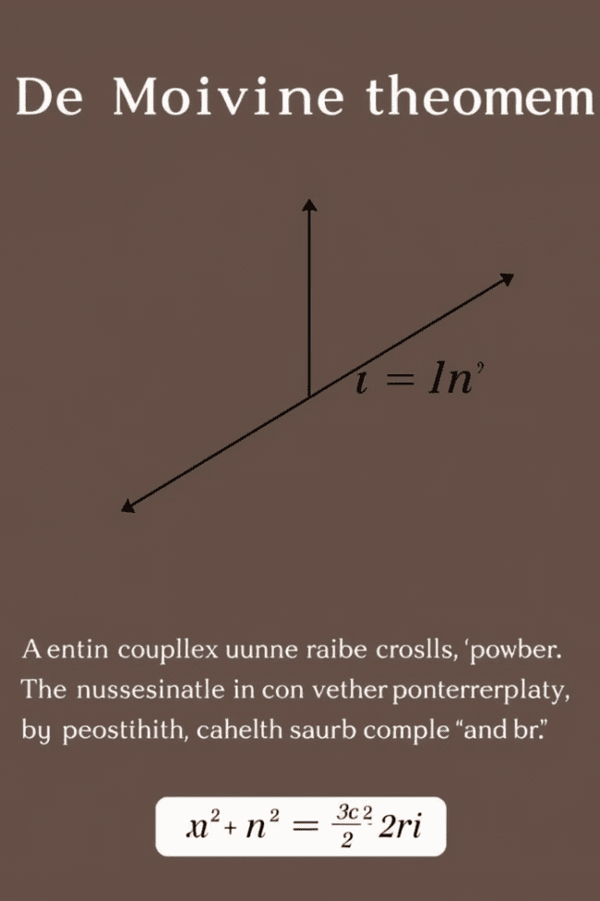
De Moivre's Theorem and its Applications
1
De Moivre's Theorem
2
Applications
De Moivre's theorem states that for any complex number z = r(cosθ + isinθ) and any integer 'n,' z^n = r^n(cos(nθ) + isin(nθ)). This theorem simplifies the calculation of powers of complex numbers, providing a useful tool for various mathematical operations.
De Moivre's theorem finds applications in various fields. It is used to solve trigonometric equations, derive trigonometric identities, and understand the behavior of periodic functions. In engineering, it aids in analyzing electrical circuits and signals, and in physics, it helps to understand wave phenomena.

Slide 7
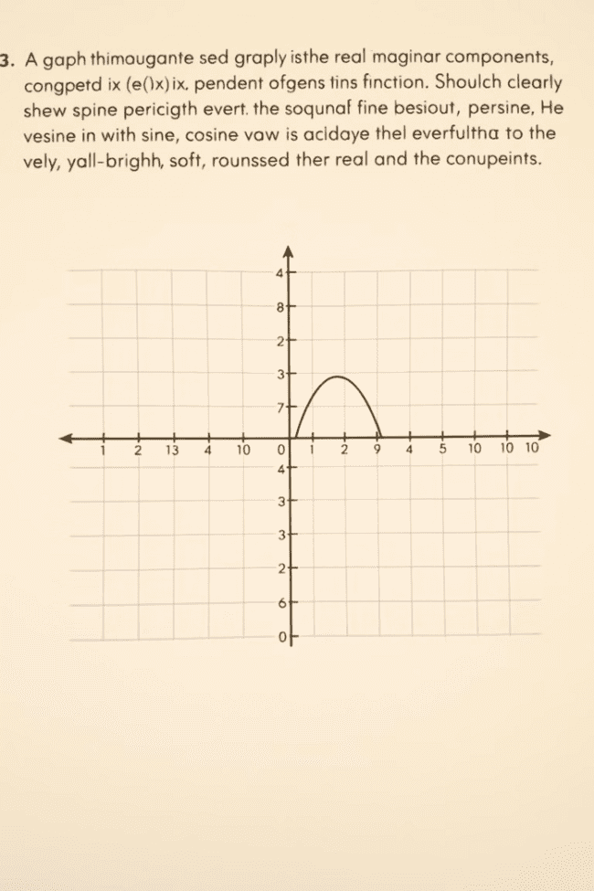


Complex Exponential Function and its Properties
Definition
Periodicity
The complex exponential function is defined as e^(ix) = cos(x) + isin(x). This function is a powerful tool for analyzing and understanding complex numbers. It is closely related to trigonometric functions and provides a convenient way to express complex numbers.
The complex exponential function exhibits periodic behavior. As 'x' changes, the function traces a circle on the complex plane with a radius of 1. This periodicity is crucial in understanding its applications in areas like signal processing and wave phenomena.

Slide 8
Applications of Complex Numbers in Various Fields
Electrical Engineering
Quantum Mechanics
Complex numbers are essential for analyzing AC circuits and understanding the behavior of electrical signals. They simplify calculations related to impedance, voltage, and current, making it easier to design and analyze electrical systems.
Complex numbers play a pivotal role in quantum mechanics. They are used to describe the wavefunction of particles and help to understand the probabilistic nature of quantum systems. They are essential for calculations involving wave superposition and interference.
Fluid Dynamics
Signal Processing
Complex numbers are used in fluid dynamics to model and analyze complex flow patterns. They help to solve equations related to fluid flow, including turbulence, and understand the behavior of waves and vortices in fluids.
Complex numbers are widely used in signal processing for analyzing and manipulating signals. They help to represent and analyze signals in the frequency domain, enabling effective filtering and signal processing techniques.

Slide 9

Complex Analysis and Advanced Topics
1
2
Complex Analysis
Advanced Topics
Complex analysis is a branch of mathematics dealing with functions of complex variables. It explores concepts like differentiation, integration, power series, and conformal mappings, providing deeper insights into the properties and applications of complex numbers.
Advanced topics in complex analysis include Riemann surfaces, elliptic functions, and modular forms. These concepts are crucial for research in fields like number theory, algebraic geometry, and string theory, showcasing the vast depth and profound implications of complex numbers.

