Slide 1
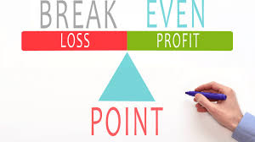
How to Solve The
Break-even Problem

Slide 2
Question #1
Jean decided to start-up a company to manufacture MP3 players. The production line setup expenses are $5775. The materials and labour cost is $50 for each MP3 player. After doing the marketing research, he found that the Co. can sell each MP3 player at $125. Conduct the break-even analysis to figure out the minimum production and selling units of the MP3 players.

Slide 3
Solution:
The break-even analysis is used by analysts to determine the minimum units the company has to manufactures and sells in order to start making profit. Any number of units less than that will lead to loss.
The company cost or expenses can be represented by the fixed cost plus the variable cost. C = 5775 + 50X
The company revenue is the product of the sold units (x) and the selling price for each unit $125. R = 125X

Slide 4
Continued
To calculate the break-even point, we have to equate the cost with the revenue
Cost = Revenue
C = R
5775 + 50X = 125X
We isolate for the variable X
125X – 50X = 5775
75X = 5775

Slide 5
Continued
X = 5775 /75
X = 77 units
No we know that the company has to manufactures and sells at least 77 MP3 players.
To know the revenue and the cost corresponds to 77 Mp3 players,
Substitute by X = 77 Mp3 players, in any one of the equations.
C = 5775 + 50X = 5775 + (50)(77) = $ 9625
R = 125X = (125)(77) = $ 9625
Any Production and sale less than 77 Mp3 players, will cause loss.
Any Production and sale more than 77 Mp3 players, will cause profit.

Slide 6
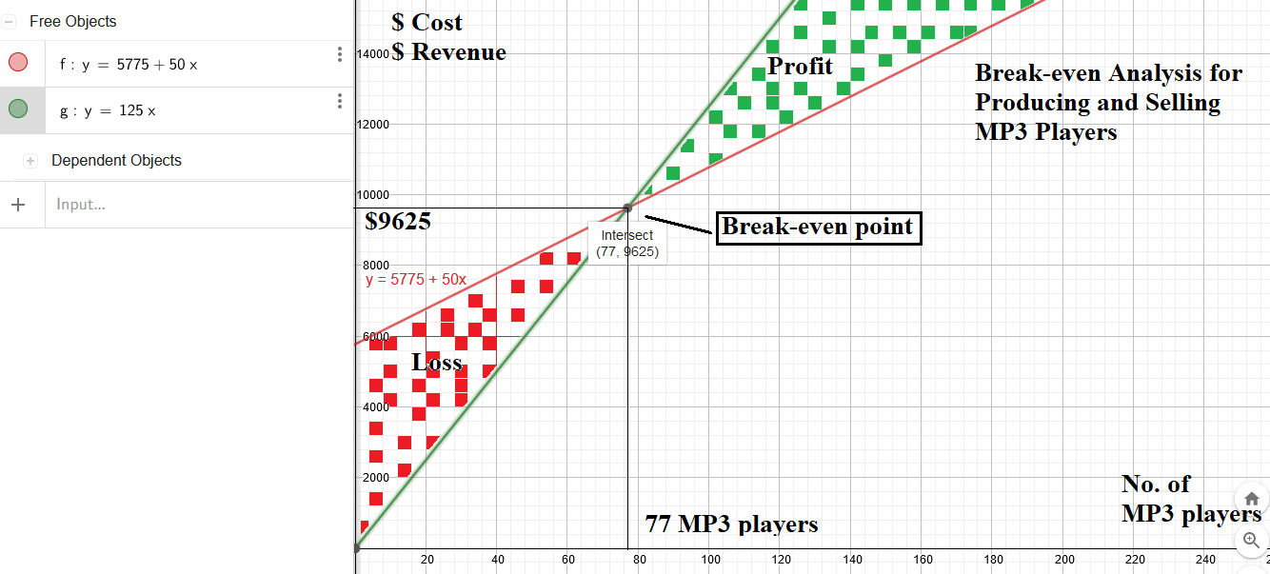
Continued

