Slide 1

Absolute Value Equations
Welcome to the exploration of absolute value equations! We'll delve into the fundamentals, explore various properties and techniques, and uncover practical applications of this essential concept. Let's begin with an introduction to absolute value.
IO
by IKENNA ONYI

Slide 2
Introduction to Absolute Value
Definition
Visual Representation
The absolute value of a number represents its distance from zero on a number line. It's always a non-negative value. For example, the absolute value of 5 is 5, and the absolute value of -5 is also 5. We denote the absolute value of x as |x|.
Imagine a number line. The absolute value of any number is its distance from the origin (zero), regardless of whether it's positive or negative. This distance is always positive.

Slide 3

Properties of Absolute Value
1
Property 1: Non-negativity
2
Property 2: Symmetry
3
Property 3: Multiplicativity
|x| = |-x|. The absolute value of a number and its negative are equal.
For any number x, |x| ≥ 0. The absolute value is always greater than or equal to zero.
|x * y| = |x| * |y|. The absolute value of a product is the product of the absolute values.

Slide 4
Solving Absolute Value Equations
Two Cases
Example
When solving equations involving absolute value, we need to consider two cases because the expression inside the absolute value can be positive or negative.
To solve |x - 3| = 7, we consider these two cases: 1. x - 3 = 7, which gives x = 10 2. x - 3 = -7, which gives x = -4

Slide 5



Graphing Absolute Value Equations
Vertex
1
The vertex is the lowest or highest point of the graph, depending on the equation.
Symmetry
2
The graph is symmetric about a vertical line passing through the vertex.
Slope
3
The graph has a constant slope on either side of the vertex.

Slide 6
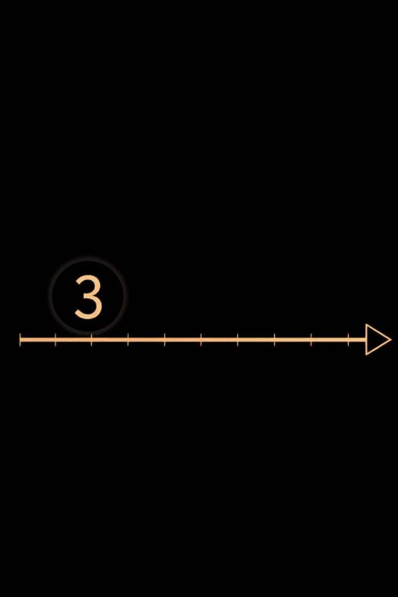


Absolute Value Inequalities
Less Than
Greater Than
For inequalities like |x| < a, the solution is a range of values between -a and a.
For inequalities like |x| > a, the solution is a range of values less than -a or greater than a.

Slide 7

Applications of Absolute Value Equations
1
Distance Problems
Absolute value equations can be used to represent distances between points, regardless of direction. For example, finding all points that are 5 units away from a given point on a number line.
2
Error Tolerance
In engineering and manufacturing, absolute value helps determine acceptable error ranges for measurements and tolerances. This ensures that parts meet specific standards.
3
Optimization Problems
Absolute value equations can be applied to problems where we need to minimize the difference between a desired value and a calculated value.

Slide 8
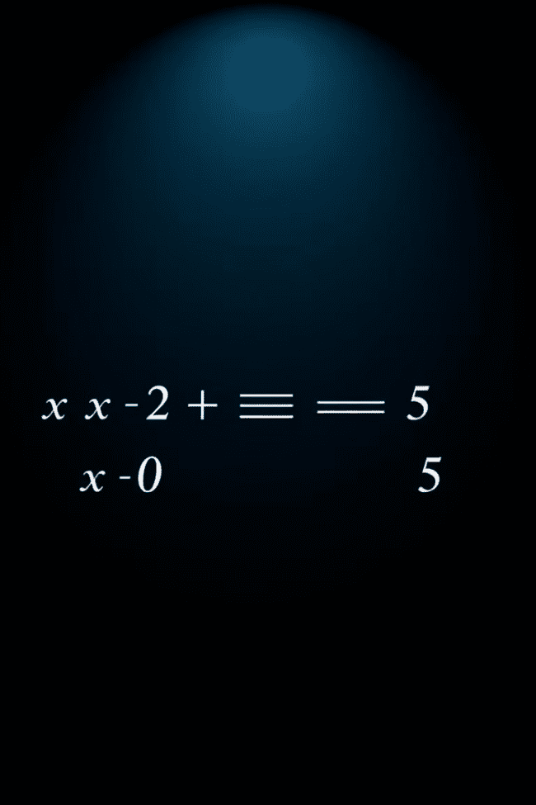
Combining Absolute Value Equations
Casework
Graphing
When multiple absolute value expressions are present, we need to consider different cases for each expression, leading to more complex solution sets.
Graphing the individual absolute value functions can help visualize the solution sets and understand how they intersect.
Algebraic Manipulation
Sometimes, algebraic manipulation can simplify the equation, making it easier to solve. This often involves isolating the absolute value expressions.

Slide 9
Common Mistakes and Misconceptions
Ignoring Cases
1
Forgetting to consider both positive and negative cases when solving absolute value equations.
Misinterpreting the Inequality Sign
2
Incorrectly applying the inequality sign in absolute value inequalities, leading to incorrect solution sets.
Forgetting the Vertex
3
Not including the vertex in the solution set for certain types of absolute value inequalities.

Slide 10

Summary and Key Takeaways
1
2
Definition
Solving
Absolute value represents distance from zero, always non-negative.
Two cases: positive and negative values within the absolute value.
3
4
Applications
Misconceptions
Distance, error tolerance, optimization, and more.
Avoid common mistakes related to cases and inequality signs.

