Slide 1

Unraveling the Mysteries: The Art and Science of Second-Order Differential Equations

Slide 2


Introduction to Second- Order Differential Equations
are pivotal in understanding various phenomena in physics and engineering. This presentation will explore their
, applications, and the
used to solve them. Join us as we delve into the art and science behind these fascinating
equations!

Slide 3





What Are Differential
Equations?
Differential equations are mathematical statements that relate a
function with its describe how a
time or space.
. They over equations
involve the second derivative, providing deeper insights into
and their behaviors.

Slide 4





Types of Second-Order Differential Equations
Second-order differential equations can be classiﬁed into and
categories. Linear equations have solutions that can be expressed as a of individual solutions, while nonlinear equations often exhibit
and unique challenges in solving.

Slide 5




Homogeneous vs. Non- Homogeneous
In the realm of second-order equations, we distinguish between and
forms. Homogeneous equations
equal zero, while non-homogeneous equations include a . Understanding this distinction is crucial for ﬁnding appropriate solutions.

Slide 6
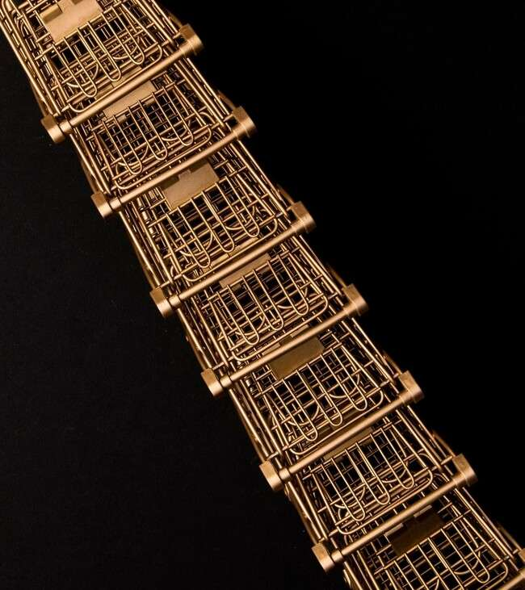





Applications in Real Life
Second-order differential equations are integral in various ﬁelds such as
, ,
and . They model
phenomena like ,
, and
showcasing their versatility and importance in real-world
applications.
,

Slide 7




Solving Techniques Overview
Solving second-order differential equations can be approached through several techniques,
including ,
, and . Each
method offers unique advantages depending on the equation's form and complexity, enhancing our toolkit for analysis.

Slide 8



Challenges and Mysteries
Despite their established methods, second-order differential equations still present and
. Nonlinear equations, in particular, can lead to unpredictable behaviors and require
innovative approaches to solve. Exploring these
challenges fuels ongoing research and discovery.

Slide 9


Conclusion: The Journey Ahead
The art and science of second-order differential equations unveil a world of and
. As we continue to explore these equations, we inspire innovation and deepen our understanding of the
natural world. Let's embrace the journey ahead!

Slide 10
Thanks!
Do you have any questions? youremail@email.com
+91 620 000 838
www.yourwebsite.com @yourusername

