Slide 1
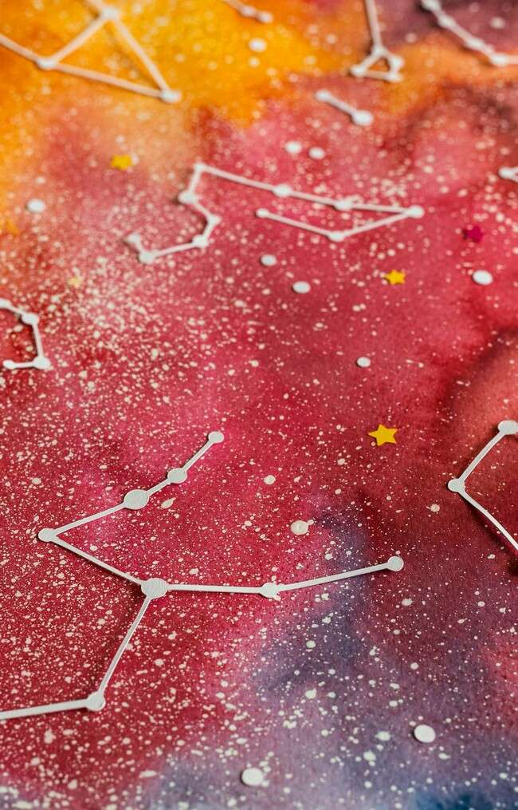
Unlocking the Universe: A Journey Through Set Theory Basics

Slide 2
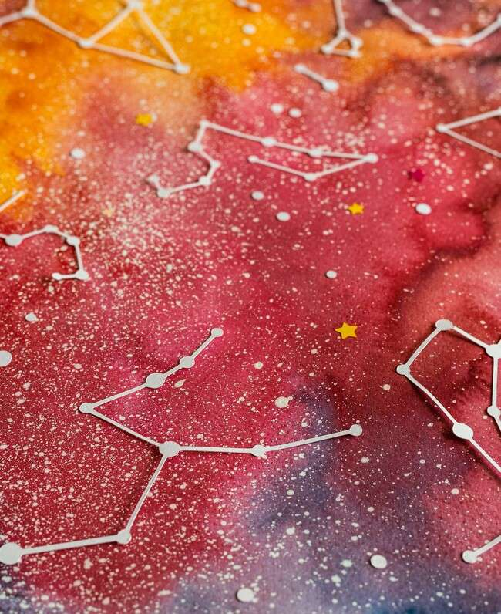


Introduction to Set Theory
Welcome to
creative journey into the basics of
. Here, we will explore the
: a
fundamental concepts that form the backbone of mathematics and logic, revealing how sets can help us understand the world around us.

Slide 3
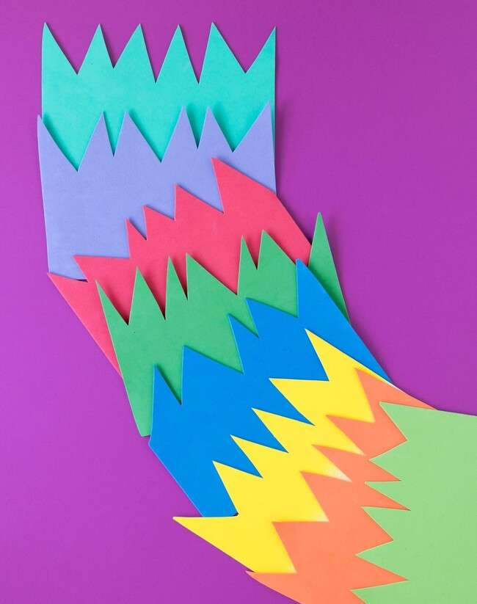

What is a Set?
A is a collection of distinct objects, considered as an object in its own right. These objects can be anything: numbers, letters, or even other sets! The beauty of sets lies in their simplicity and versatility in representing
.

Slide 4


Elements of a Set
Each item in a set is called an . Elements are unique, and their order does not matter. For example, the set {1, 2, 3} is the same as {3, 2, 1}.
Understanding how elements interact within sets is crucial for grasping more complex concepts.

Slide 5
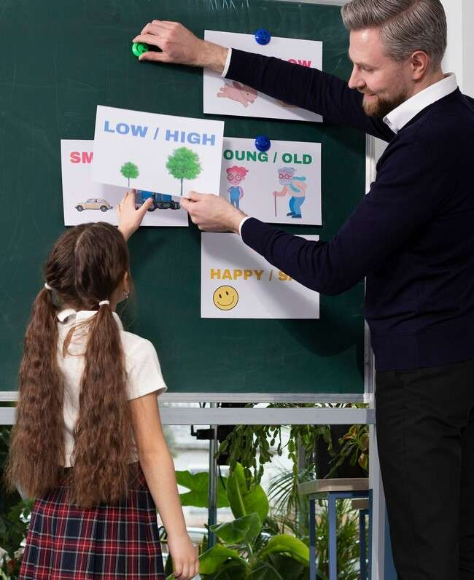




Types of Sets
Sets can be categorized into various types: , , , and
. Each type serves a
unique purpose in mathematics, helping us to deﬁne and manipulate collections of objects effectively.

Slide 6


Set Operations
Set theory involves several such as union, intersection, and
difference. These operations allow us to
combine and compare sets, unveiling relationships between different collections and enriching our understanding of mathematical structures.

Slide 7
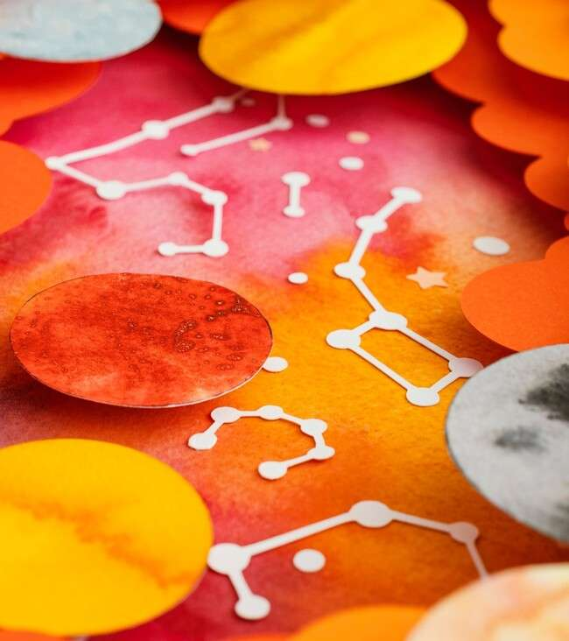



Applications of Set Theory
Set theory has vast applications in
, , and
. It provides a foundational framework for data organization, enabling efﬁcient problem-solving and decision-making across various ﬁelds.

Slide 8


Challenges in Set Theory
While set theory is powerful, it also presents challenges, such as
and complexities in deﬁning sets. Understanding these challenges can deepen our appreciation for the elegance and intricacies of mathematical thought.

Slide 9
Conclusion: The Journey Continues
As we conclude our journey through the basics of , remember that this is just the beginning. The concepts we've explored serve as a gateway to deeper mathematical understanding and discovery. Keep questioning and exploring!

Slide 10
Thanks!
Do you have any questions? youremail@email.com
+91 620 000 838
www.yourwebsite.com @yourusername

