Slide 1

Exploring the Foundations: An Introduction to Basic Geometric Shapes

Slide 2





Introduction to Geometry
In this presentation, we will explore the of geometry, focusing on .
Understanding these shapes is essential for grasping more complex geometric concepts. Let's dive into the world of , , and
to build a strong foundation.

Slide 3
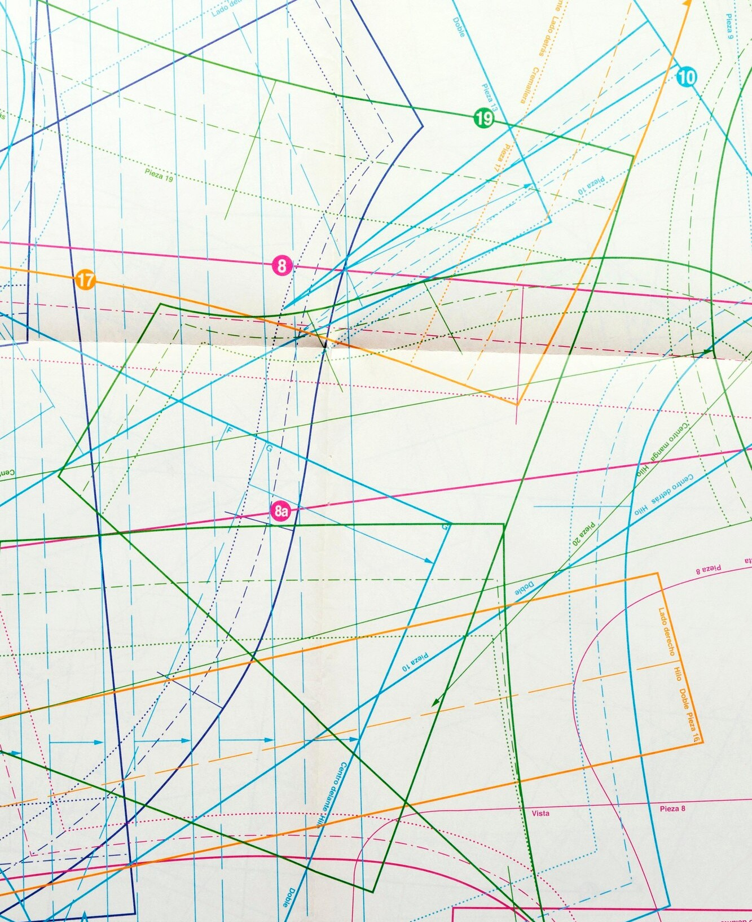



What is a Point?
A is a fundamental concept in geometry, representing a speciﬁc location in space. It has
—no length, width, or height. Points are often labeled with and serve as the building blocks for more complex shapes.

Slide 4




Understanding Lines
A is a straight one-dimensional ﬁgure that extends inﬁnitely in both directions. It has but no width or height. Lines can be deﬁned by any two points on them and are essential for creating shapes like and
.

Slide 5
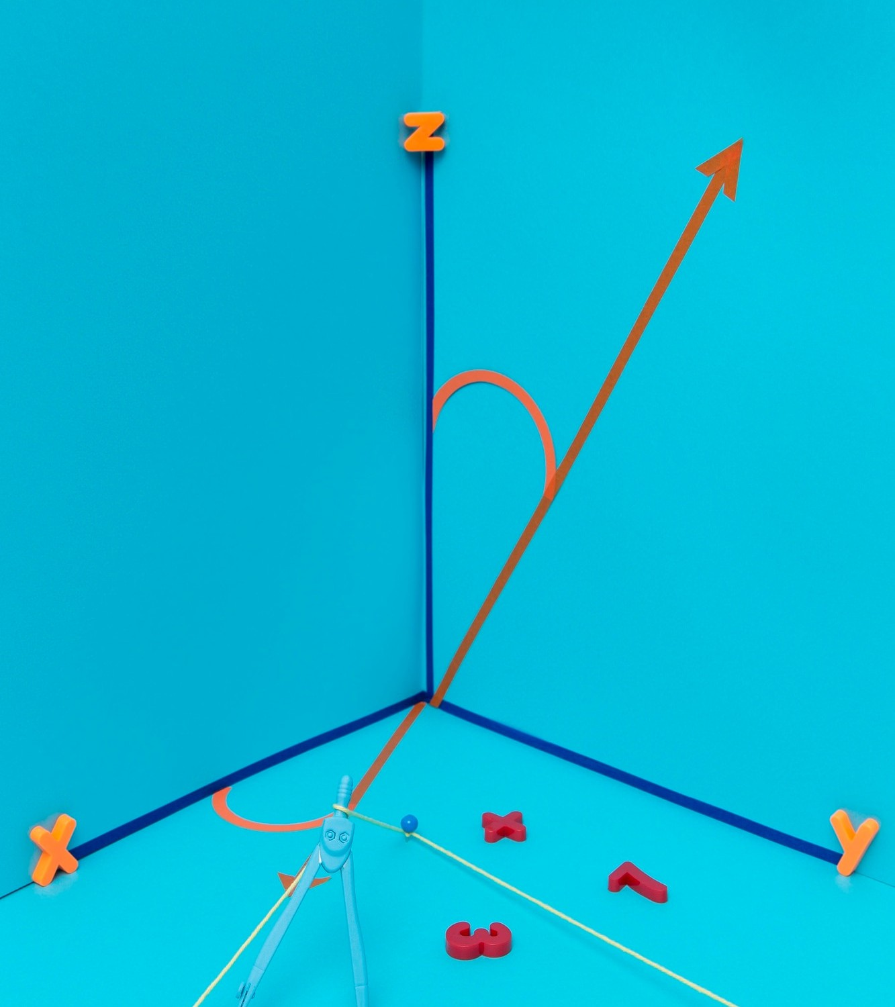






Exploring Angles
An is formed by two rays that share a common endpoint, known
as the in
as
. Angles are measured
and can be categorized
, , or based on
their measure. Understanding angles is crucial for constructing shapes.

Slide 6





Triangles: The Basics
A is a polygon with three edges and three vertices. It is classiﬁed into different types based on its sides and angles, such as , , and . Triangles are fundamental in geometry due to their properties and applications.

Slide 7




Circles Deﬁned
A is a shape where all points are equidistant from a central point known as the . The distance from the center to any point on the circle is called the . Circles are prevalent in everyday life and have unique properties.

Slide 8



Rectangles and Squares
A is a four-sided polygon (quadrilateral) with opposite sides that are equal in length. A is a special type of rectangle where all four sides are equal. Both shapes are essential in various applications, from
architecture to design.

Slide 9








Conclusion and Key Takeaways
In summary, we have explored the of basic geometric shapes, including , , , ,
, , and . Understanding these shapes is crucial for further studies in geometry and its applications in
the real world.

Slide 10
Thanks!
Do you have any questions? youremail@email.com
+91 620 421 838
www.yourwebsite.com @yourusername

