Slide 1


Matrices and Determinants: A Comprehensive Overview
Welcome to our exploration of matrices and determinants, fundamental concepts in mathematics with wide-ranging applications in various fields. This presentation will guide you through the essentials, starting with an introduction to matrices, their operations, and the concept of determinants. We'll then delve into properties, cofactor expansion, and the inverse of a matrix, concluding with real-world examples of their applications. Join us as we unravel the power and versatility of matrices and determinants.
by ONYEDIKACHI ONWURAH

Slide 2

Introduction to Matrices
Definition
Examples
Matrices are rectangular arrays of numbers, symbols, or expressions arranged in rows and columns. They are essential for representing and manipulating data in various mathematical and scientific contexts. The order of a matrix, denoted by m x n, specifies the number of rows (m) and columns (n).
A matrix can be used to represent a system of linear equations, a transformation of points in space, or even a network of relationships. For instance, consider a matrix representing the coefficients of a set of linear equations, where each row represents an equation and each column represents a variable.

Slide 3
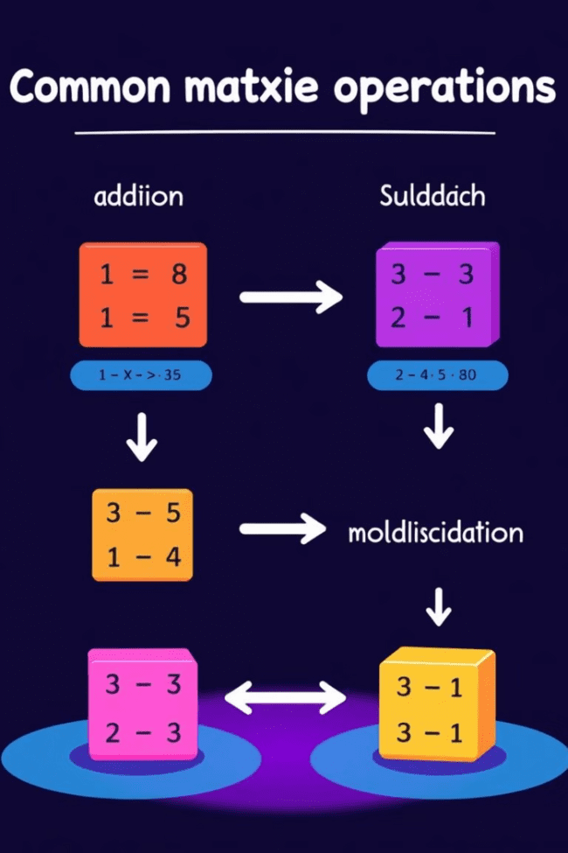
Matrix Operations
1
Addition and Subtraction
2
Multiplication
Matrices of the same order can be added or subtracted by adding or subtracting corresponding elements.
Matrix multiplication is a more complex operation, involving the dot product of rows of the first matrix with columns of the second matrix. The resulting matrix has dimensions defined by the number of rows in the first matrix and the number of columns in the second matrix.
3
Scalar Multiplication
A scalar can be multiplied by a matrix by multiplying each element of the matrix by the scalar. This operation scales the matrix without altering its shape.

Slide 4



Determinants
Definition
A determinant is a scalar value associated with a square matrix, calculated from its elements.
1
Calculation
The determinant of a 2x2 matrix is calculated by multiplying the elements on the main diagonal and subtracting the product of the elements on the off-diagonal. The calculation for larger matrices involves a more complex process, utilizing cofactor expansion or row reduction methods.
2
Applications
3
Determinants play crucial roles in determining the invertibility of a matrix, solving systems of linear equations, and calculating eigenvalues and eigenvectors in linear algebra.

Slide 5
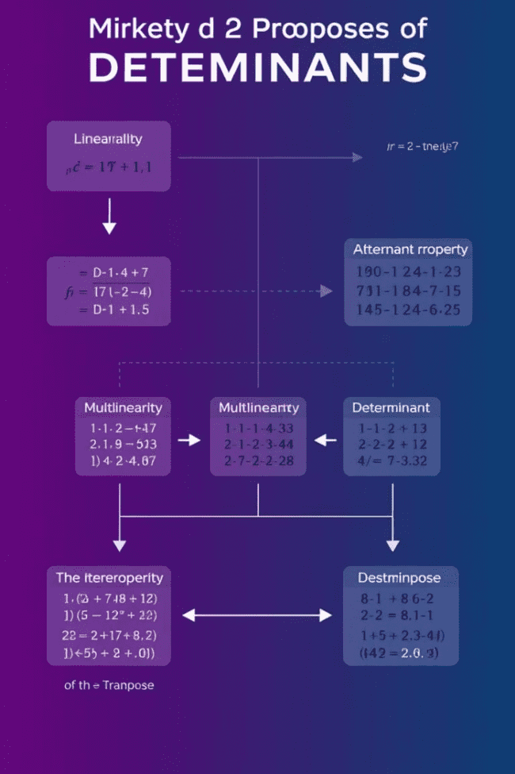
Properties of Determinants
Determinant of the Identity Matrix
Determinant of a Transpose
The determinant of a matrix's transpose is equal to the determinant of the original matrix.
The determinant of the identity matrix is always 1.
Determinant of a Multiplied Matrix
Determinant of a Product of Matrices
The determinant of a matrix multiplied by a scalar is equal to the scalar raised to the power of the matrix's order multiplied by the determinant of the original matrix.
The determinant of the product of two matrices is equal to the product of their determinants.

Slide 6
Cofactor Expansion
Definition
1
Cofactor expansion is a recursive method for calculating the determinant of a matrix.
Steps
2
Choose a row or column, calculate the minor and cofactor of each element, and multiply each element by its cofactor. Sum up the results to obtain the determinant.
Example
3
For a 3x3 matrix, choose a row or column, find the minors and cofactors, and multiply them. Sum up the results to get the determinant.

Slide 7




Inverse of a Matrix
Definition
The inverse of a square matrix is another matrix that, when multiplied by the original matrix, results in the identity matrix. Not all matrices have inverses.
Calculation
To find the inverse of a matrix, calculate the determinant, find the adjoint matrix, and divide the adjoint by the determinant. If the determinant is zero, the matrix does not have an inverse.
Applications
Matrix inverses are essential in solving systems of linear equations, representing geometric transformations, and solving problems in linear algebra.

Slide 8

Applications of Matrices and Determinants
1
2
Computer Graphics
Cryptography
Matrices are used to represent transformations like translation, rotation, and scaling of objects in 3D space.
Matrices and determinants are used in encryption algorithms to transform plaintext into ciphertext, ensuring secure communication.
3
4
Data Analysis
Engineering
Matrices are fundamental for representing and manipulating data in statistical analysis, machine learning, and data visualization.
Matrices are used in structural analysis, circuit theory, and control systems to model and solve complex engineering problems.

