Slide 1
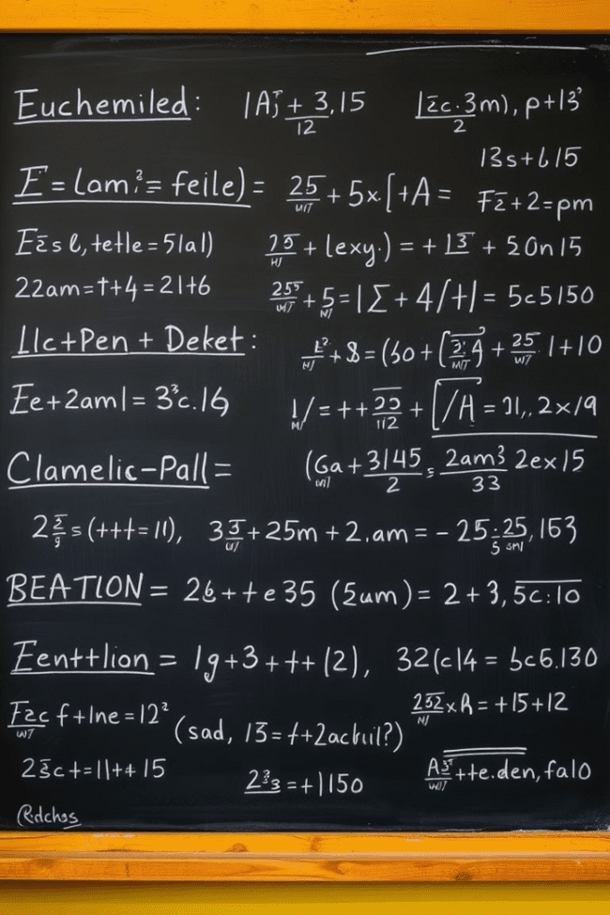


Introduction to Polynomials
Polynomials are fundamental mathematical expressions that play a crucial role in various branches of mathematics, science, and engineering. They are algebraic expressions composed of variables and coefficients, with the variables raised to non-negative integer powers. Understanding the properties, operations, and applications of polynomials is essential for problem-solving and advanced mathematical concepts.
by Onyedikachi Onwurah

Slide 2
Definition and Terminology
1
Polynomial Definition
2
Polynomial Terminology
3
Polynomial Classification
A polynomial is an expression that consists of variables and coefficients, where the variables are raised to non-negative integer powers. Polynomials can be represented in the form: a₀ + a₁x + a₂x² + ... + aₙxⁿ, where a₀, a₁, a₂, ..., aₙ are the coefficients and n is the degree of the polynomial.
The individual terms of a polynomial are called monomials. The coefficient of a monomial is the numerical factor that multiplies the variable(s). The degree of a monomial is the sum of the exponents of the variables. The degree of a polynomial is the highest degree of its monomials.
Polynomials can be classified based on the number of terms, the number of variables, and the degree of the polynomial. Common types include linear, quadratic, cubic, and higher-degree polynomials.

Slide 3
Polynomial Degree and Coefficients
Degree of a Polynomial
Polynomial Coefficients
Polynomial Notation
The degree of a polynomial is the highest exponent of the variable(s) in the expression. For example, the polynomial 3x² + 2x + 5 has a degree of 2, as the highest exponent is 2.
The coefficients of a polynomial are the numerical factors that multiply the variables. In the polynomial 3x² + 2x + 5, the coefficients are 3, 2, and 5. The coefficient of the variable with the highest degree is called the leading coefficient.
Polynomials are often written using the standard polynomial notation, where the terms are arranged in descending order of the exponents. This helps in understanding the degree and structure of the polynomial.

Slide 4
Addition and Subtraction of Polynomials
Adding Polynomials
To add polynomials, we combine like terms by adding the coefficients of the terms with the same variable and power. For example, to add 3x² + 2x + 5 and 4x² - x + 2, we get 7x² + x + 7.
Simplifying Polynomials
After addition or subtraction, we can simplify the resulting polynomial by combining like terms and reducing the expression to the simplest form.
1
2
3
Subtracting Polynomials
To subtract polynomials, we treat the subtraction as adding the opposite of the second polynomial. We combine like terms by subtracting the coefficients of the terms with the same variable and power. For example, to subtract 4x² - x + 2 from 3x² + 2x + 5, we get -x² + 3x + 3.

Slide 5
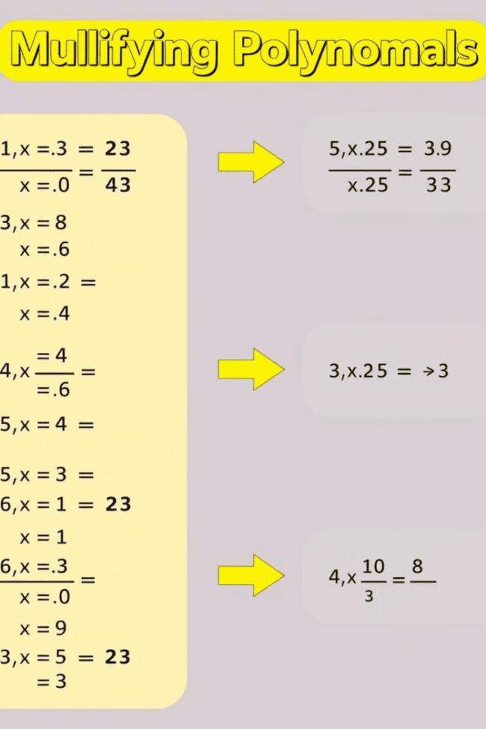



Multiplication of Polynomials
Distributive Property
To multiply two polynomials, we use the distributive property. We multiply each term of the first polynomial by each term of the second polynomial, and then add the resulting products.
Polynomial Multiplication
For example, to multiply (2x + 3) and (4x - 1), we would distribute each term of the first polynomial to the second polynomial: (2x × 4x) + (2x × -1) + (3 × 4x) + (3 × -1), resulting in 8x² + -2x + 12x + -3.
Simplifying the Product
After multiplying the polynomials, we can simplify the result by combining like terms to obtain the final expression: 8x² + 10x - 3.

Slide 6
Division of Polynomials
Long Division of Polynomials
1
Dividing polynomials is more complex than addition, subtraction, or multiplication. The most common method is the long division algorithm, which involves repeatedly dividing the divisor into the dividend and subtracting the result.
2
Polynomial Division Steps
1. Arrange the divisor and dividend in descending order of the variable exponents. 2. Divide the leading term of the dividend by the leading term of the divisor. 3. Multiply the divisor by the result of step 2 and subtract it from the dividend. 4. Bring down the next term of the dividend and repeat steps 2-3 until the degree of the remainder is less than the degree of the divisor.
Quotient and Remainder
3
The result of the long division process will be the quotient and the remainder, if any. The quotient represents the result of the division, and the remainder, if it exists, is the part of the dividend that could not be divided by the divisor.

Slide 7
Factoring Polynomials
Purpose of Factoring
Common Factoring Methods
Factoring polynomials is the process of breaking down a polynomial expression into a product of simpler polynomial expressions. Factoring is important because it can simplify algebraic expressions, solve equations, and provide insights into the structure and properties of polynomials.
Some common factoring methods include: - Factoring by greatest common factor (GCF) - Factoring by grouping - Factoring quadratic expressions - Factoring higher-degree polynomials using various techniques
Factoring and Applications
Importance of Factoring
Factored forms of polynomials have many applications, such as solving polynomial equations, simplifying expressions, and understanding the roots and graphs of polynomial functions.
Mastering the art of factoring polynomials is essential for success in advanced mathematics, as it lays the foundation for more complex algebraic manipulations and problem-solving techniques.

Slide 8




Polynomial Functions and Graphs
Quadratic Functions
Cubic Functions
Higher-Degree Polynomials
Graphing Polynomials
Polynomial functions of degree 3, known as cubic functions, have a S-shaped curve. They can be represented in the form f(x) = ax³ + bx² + cx + d, where a, b, c, and d are real numbers.
Polynomial functions of degree 2, known as quadratic functions, have a characteristic parabolic shape. They can be represented in the form f(x) = ax² + bx + c, where a, b, and c are real numbers.
Polynomial functions of degree 4 or higher can have a variety of shapes, depending on the coefficients and the degree of the polynomial. They can exhibit multiple turning points, oscillations, and complex behaviors.
The graphs of polynomial functions can be used to analyze their properties, such as the number of real roots, the end behavior, and the location of local maxima and minima.

Slide 9
Applications of Polynomials
Engineering
Polynomials are used to model various engineering systems, such as electrical circuits, mechanical structures, and control systems.
Science
In physics, polynomials are used to describe the motion of objects, the behavior of fluids, and the properties of materials. In chemistry, they are used to model chemical reactions and phase changes.
Economics
Polynomials are used to model economic relationships, such as supply and demand, production functions, and growth rates.
Computer Science
Polynomials are used in algorithms, data structures, and numerical analysis to solve computational problems efficiently.
Polynomials are ubiquitous in various fields, from engineering and science to economics and computer science. Their versatility and the ability to model complex relationships make them an essential tool in modern problem-solving and decision-making processes.

Slide 10
Conclusion and Key Takeaways
1
Polynomials are Fundamental
2
Understanding Operations and Properties
Polynomials are fundamental algebraic expressions that play a crucial role in various branches of mathematics, science, and engineering.
Mastering the operations of addition, subtraction, multiplication, and division, as well as the properties of polynomials, is essential for problem-solving and advanced mathematical concepts.
3
Factoring and Graph Analysis
4
Widespread Applications
Factoring polynomials and understanding their graphical representations provide insights into the structure and behavior of these expressions, with numerous applications in various fields.
Polynomials are ubiquitous in the real world, with applications ranging from engineering and science to economics and computer science, making them an indispensable tool in modern problem-solving.
By understanding the fundamental concepts, properties, and applications of polynomials, students and professionals can unlock the power of these versatile mathematical expressions and apply them effectively in their respective fields.

