Slide 1

Matrices and Determinants
This presentation will provide an overview of matrices and determinants, exploring their key properties, operations, and applications. We will delve into the core concepts, from matrix operations to solving systems of linear equations and understanding eigenvalues and eigenvectors. This exploration will highlight their significant role in diverse fields like mathematics, physics, computer science, and more.
OI
by ONYEDIKA IK

Slide 2
Introduction to Matrices
Definition
Types
A matrix is a rectangular array of numbers, symbols, or expressions arranged in rows and columns. Each element is identified by its row and column index.
Matrices come in different types based on their size, structure, and properties, including square matrices, row matrices, column matrices, identity matrices, and zero matrices.

Slide 3
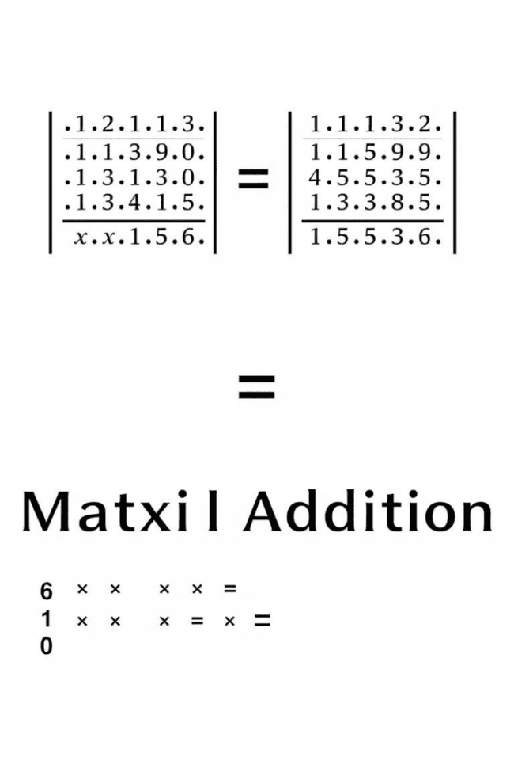
Matrix Operations
Addition
Subtraction
Adding matrices involves adding corresponding elements. The matrices must have the same dimensions for this operation to be valid.
Similar to addition, subtracting matrices involves subtracting corresponding elements. The matrices must have the same dimensions.
Scalar Multiplication
Matrix Multiplication
Multiplying a matrix by a scalar involves multiplying each element of the matrix by the scalar value.
Multiplying matrices involves a more complex process where the elements of the first matrix are multiplied by the corresponding elements of the second matrix and then summed.

Slide 4
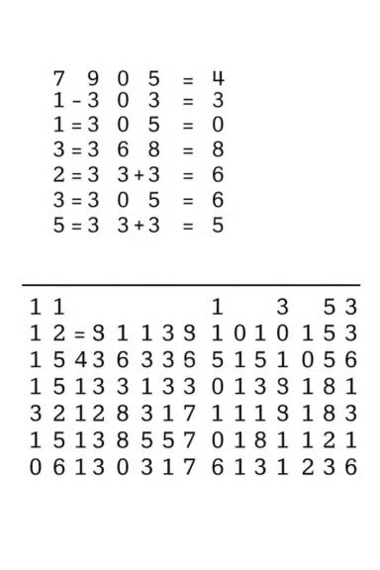



Inverse of a Matrix
Definition
The inverse of a square matrix, if it exists, is another matrix that, when multiplied by the original matrix, yields the identity matrix.
Calculation
The inverse of a matrix can be calculated using various methods, such as the Gauss-Jordan elimination method or the adjugate method.
Conditions
Not all square matrices have an inverse. A matrix has an inverse if and only if its determinant is non-zero.

Slide 5
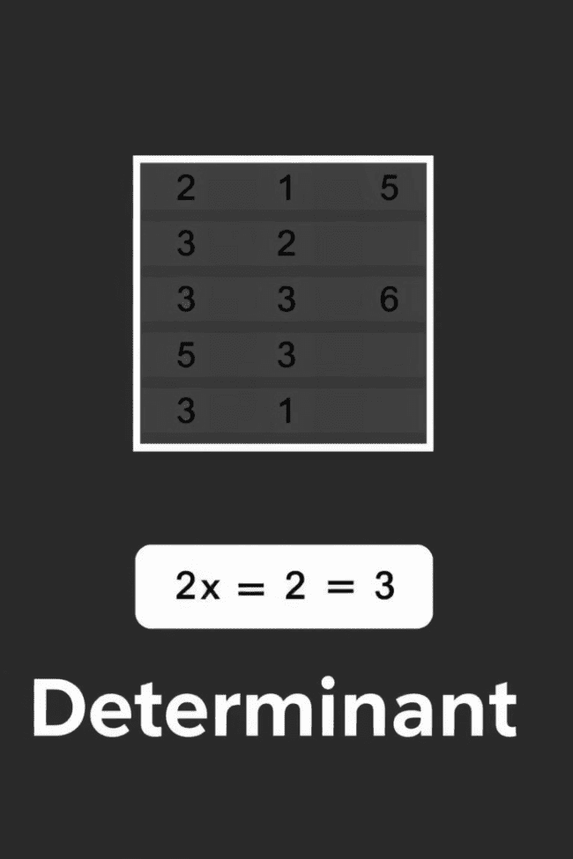



Determinants of a Matrix
Definition
The determinant of a square matrix is a scalar value that represents certain properties of the matrix, such as its invertibility and the volume of the parallelepiped formed by its columns.
Calculation
Calculating the determinant involves a specific set of rules that depend on the size of the matrix. For small matrices, there are simple formulas, while larger matrices require expansion methods.
Significance
Determinants play a crucial role in various mathematical and scientific applications, including solving systems of linear equations, finding eigenvalues, and calculating volumes.

Slide 6
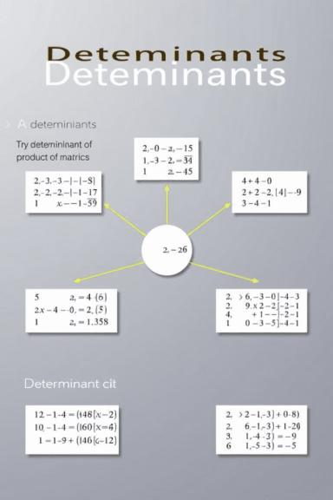
Properties of Determinants
1
Determinant of Transpose
2
Determinant of Product
The determinant of the transpose of a matrix is equal to the determinant of the original matrix.
The determinant of the product of two matrices is equal to the product of their determinants.
3
Determinant of Scalar Multiple
The determinant of a scalar multiple of a matrix is equal to the scalar raised to the power of the matrix's order multiplied by the determinant of the original matrix.

Slide 7
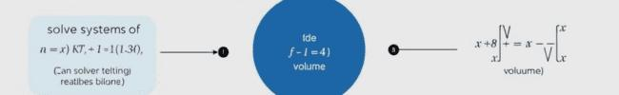
Applications of Determinants
Solving Linear Equations
Geometric Applications
Determinants are used in Cramer's rule to solve systems of linear equations. This method involves calculating determinants of various matrices to find the values of the unknown variables.
Determinants can be used to calculate volumes of parallelepipeds formed by vectors represented by the columns of a matrix. They also have applications in finding areas of triangles and parallelograms.
1
2
3
Eigenvalues and Eigenvectors
Determinants are used in finding eigenvalues and eigenvectors of a matrix. Eigenvalues represent the scaling factors of eigenvectors, which are the directions that remain unchanged after linear transformation.

Slide 8



Solving Systems of Linear Equations
Matrix Representation
Systems of linear equations can be conveniently represented using matrices. The coefficients of the variables form the coefficient matrix, and the constants form a column vector.
1
Gaussian Elimination
2
Gaussian elimination is a method for solving systems of linear equations by transforming the coefficient matrix into an upper triangular form. This method utilizes row operations.
Cramer's Rule
3
Cramer's rule provides a solution for systems of linear equations using determinants. It involves calculating determinants of various matrices related to the coefficient matrix.

Slide 9
Eigenvalues and Eigenvectors
Definition
1
Eigenvalues and eigenvectors are special pairs of values and vectors associated with a matrix that represent directions that remain unchanged under linear transformation.
Characteristic Equation
2
Eigenvalues are found by solving the characteristic equation, which is obtained by setting the determinant of the difference between the matrix and the scalar multiple of the identity matrix to zero.
Applications
3
Eigenvalues and eigenvectors have numerous applications in various fields, including stability analysis, principal component analysis, and quantum mechanics.

Slide 10

Conclusion and Key Takeaways
Matrices and determinants are fundamental mathematical concepts that find widespread applications in mathematics, science, engineering, and other fields. Understanding their properties, operations, and applications is essential for solving problems involving linear systems, transformations, and various geometric calculations. This presentation provided a comprehensive overview of these concepts, highlighting their significance and versatility.

