Slide 1

Systems of Linear Equations
Welcome to this presentation on systems of linear equations! This presentation will introduce you to linear equations and their application in solving real-world problems. We'll cover essential concepts like graphing, slope-intercept form, and point-slope form, as well as methods for solving systems of equations. Let's dive in!
OI
by ONYEDIKA IK

Slide 2
Introduction to Linear Equations
Definition
Standard Form
A linear equation represents a relationship between two variables, typically x and y, where the graph of the equation is a straight line. In essence, linear equations are equations of the first degree, meaning that the highest power of the variables is 1.
Linear equations are often written in standard form: Ax + By = C, where A, B, and C are constants. This form allows for easy manipulation and visualization of the equation.

Slide 3
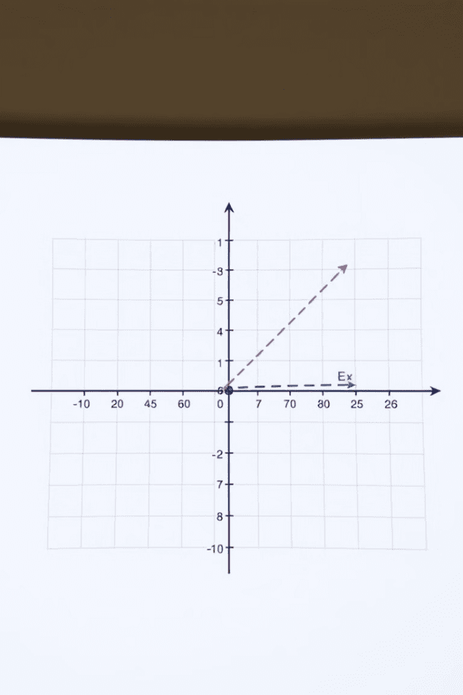



Graphing Linear Equations
Step 1: Find Two Points
To graph a linear equation, you need to find at least two points that satisfy the equation. This can be done by substituting different values for x and solving for y.
Step 2: Plot the Points
Once you have two points, plot them on a coordinate plane. This step involves locating the x-coordinate and y-coordinate of each point on the graph.
Step 3: Draw the Line
Connect the two plotted points with a straight line. This line represents all the possible solutions to the linear equation.

Slide 4
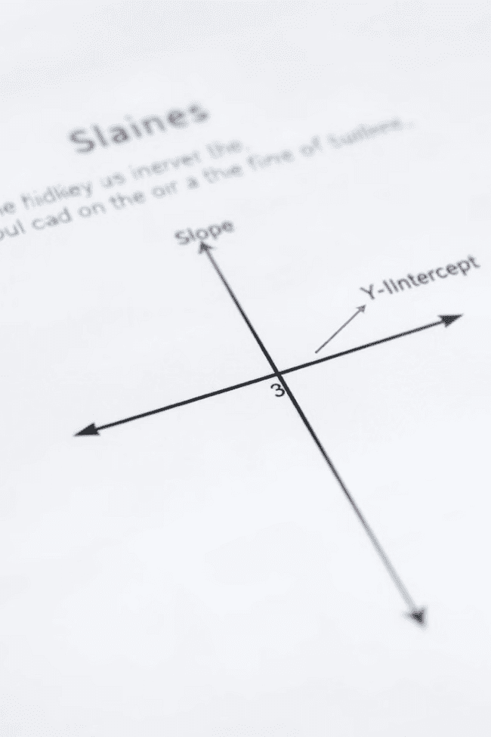
Slope-Intercept Form
1
y = mx + b
2
Example
This form is where m represents the slope of the line, and b represents the y-intercept. The slope tells us how steep the line is and in what direction it's going.
In the equation y = 2x + 3, the slope is 2 and the y-intercept is 3. This means the line rises 2 units for every 1 unit it moves to the right, and it crosses the y-axis at the point (0, 3).

Slide 5


Point-Slope Form
y - y1 = m(x - x1)
1
This form is used to find the equation of a line when you know the slope (m) and a point on the line (x1, y1).
Application
2
The point-slope form is handy when you have a specific point and the slope. You can then derive the equation of the line that passes through that point with that particular slope.

Slide 6
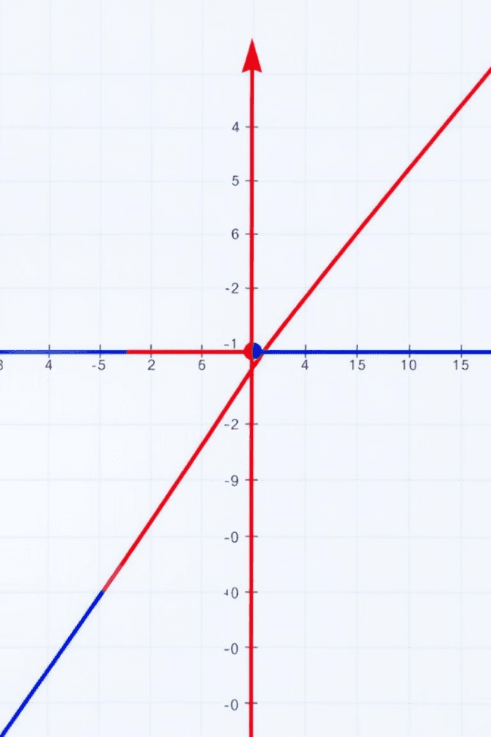



Solving Systems of Linear Equations
What are they?
A system of linear equations involves two or more linear equations, each representing a straight line. The goal is to find the solution that satisfies all equations in the system.
Graphical Method
One way to solve systems of linear equations is graphically. This involves graphing each equation and finding the point where the lines intersect. The intersection point represents the solution that satisfies both equations.
Algebraic Methods
We can also solve systems of linear equations using algebraic methods, like substitution and elimination. These methods are more efficient and precise than graphical methods, especially for complex systems.

Slide 7
Substitution Method
Step 1: Solve for One Variable
1
Choose one equation and solve for one of the variables (x or y). This isolates one variable in terms of the other.
Step 2: Substitute
2
Substitute the expression you found in Step 1 into the other equation. This will eliminate one variable from the equation.
Step 3: Solve for the Remaining Variable
3
Solve the equation resulting from Step 2 for the remaining variable. This will give you the value of one variable.
Step 4: Substitute Back
4
Substitute the value you found in Step 3 back into either of the original equations and solve for the other variable. This will give you the value of the second variable.

Slide 8
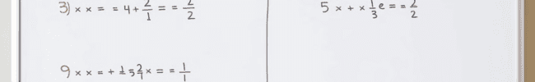
Elimination Method
Step 1: Align Coefficients
Multiply one or both equations by a constant so that the coefficients of one variable in both equations become opposites.
Step 3: Solve for the Variable
Solve the resulting equation from Step 2 for the remaining variable.
1
2
3
4
Step 2: Add Equations
Step 4: Substitute Back
Add the two equations together. The variable with opposite coefficients will be eliminated. You will be left with a single equation with one variable.
Substitute the value you found in Step 3 back into either of the original equations and solve for the other variable.

Slide 9

Applications of Linear Systems
1
2
3
Business
Science
Engineering
Linear equations are widely used to model supply and demand curves, optimize production costs, and forecast revenue. They are also used to determine break-even points in business.
In physics, linear systems are used to describe motion, forces, and electrical circuits. In chemistry, they help model chemical reactions and predict equilibrium concentrations.
Engineers use linear equations to model and analyze structures, predict stress and strain, and design systems. They are also used in fields like civil engineering, mechanical engineering, and electrical engineering.

Slide 10
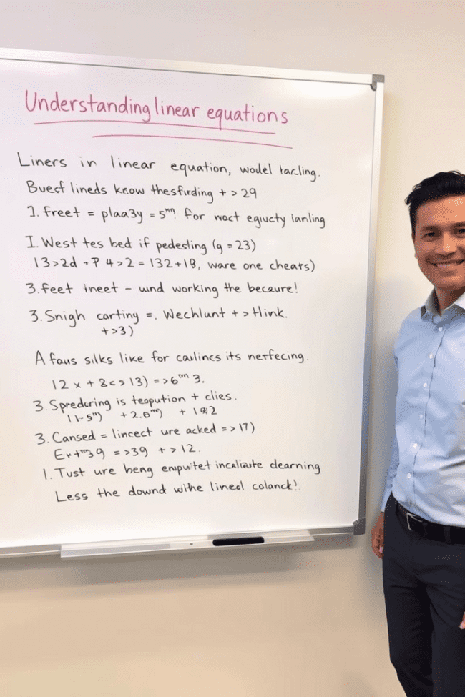
Conclusion and Key Takeaways
In this presentation, we've explored the world of linear equations. We started with the basics of linear equations and then moved on to solving systems of linear equations using various methods. We also discussed the importance and applications of linear systems in different fields, highlighting their versatility and impact on our daily lives. Keep practicing, and remember that a solid understanding of linear equations can be a powerful tool for solving real-world problems!

