Slide 1
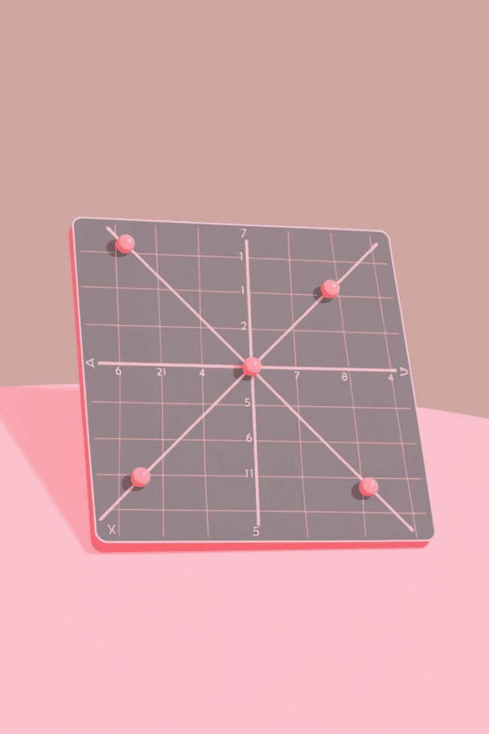


A Journey into Coordinate Geometry
Welcome to our exploration of coordinate geometry! Prepare to delve into the fascinating world of the Cartesian plane, where points, lines, and circles come alive with numbers and equations.
by Onyedikachi Ikenna Onwurah

Slide 2
Understanding the Coordinate Plane
Foundation of Geometry
Two Axes
The Cartesian plane is a fundamental concept in geometry, providing a framework for representing and analyzing geometric objects using numbers.
The plane is defined by two perpendicular axes, the x-axis and the y-axis, intersecting at the origin (0, 0).

Slide 3
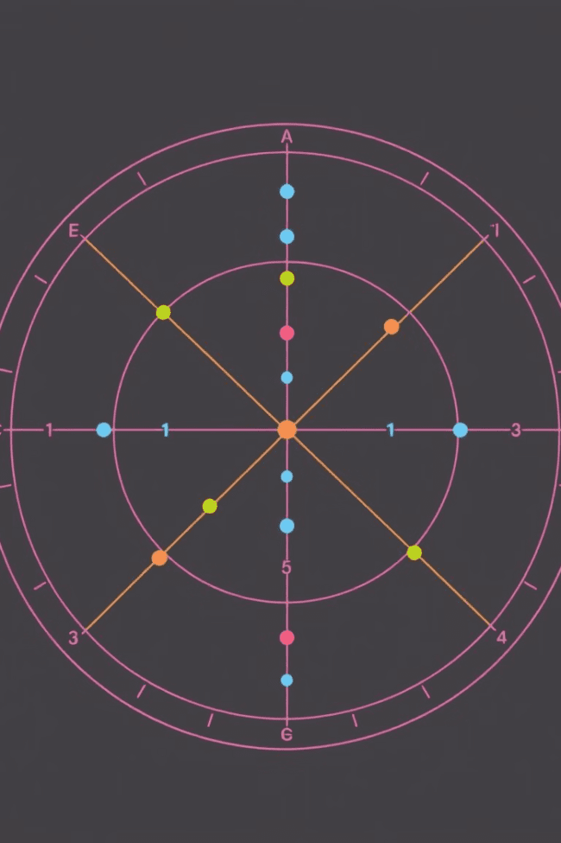
Plotting Points and Defining Coordinates
1
1. Locating Points
2
2. Defining Coordinates
Every point on the plane has a unique set of coordinates (x, y) that represent its position relative to the axes.
The x-coordinate represents the horizontal distance from the origin, and the y-coordinate represents the vertical distance.

Slide 4

The Distance Formula and Midpoint Formula
Distance Formula
Midpoint Formula
Calculates the distance between two points using the coordinates of the points and the Pythagorean theorem.
Determines the midpoint of a line segment by averaging the x-coordinates and y-coordinates of its endpoints.

Slide 5
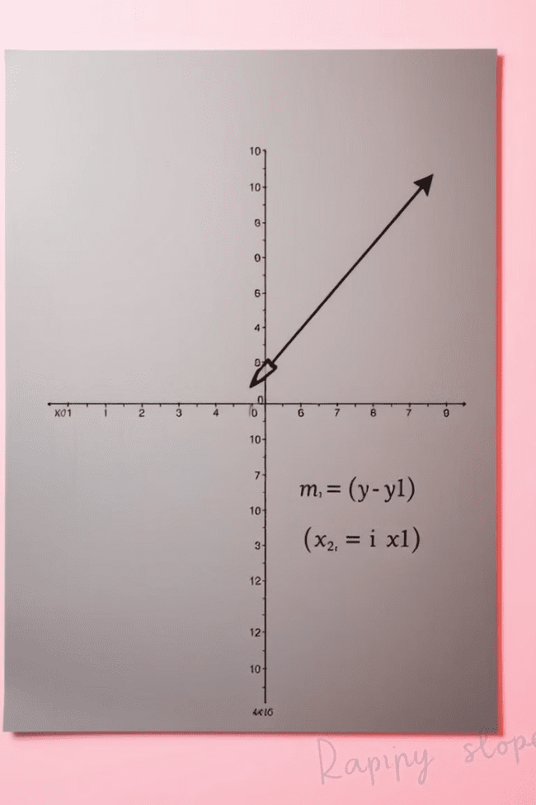


Slope and Equation of a Line
Slope
Equation
Represents the steepness and direction of a line. It's calculated as the ratio of the vertical change to the horizontal change.
Expresses the relationship between the x and y coordinates of points on the line in the form y = mx + b.

Slide 6
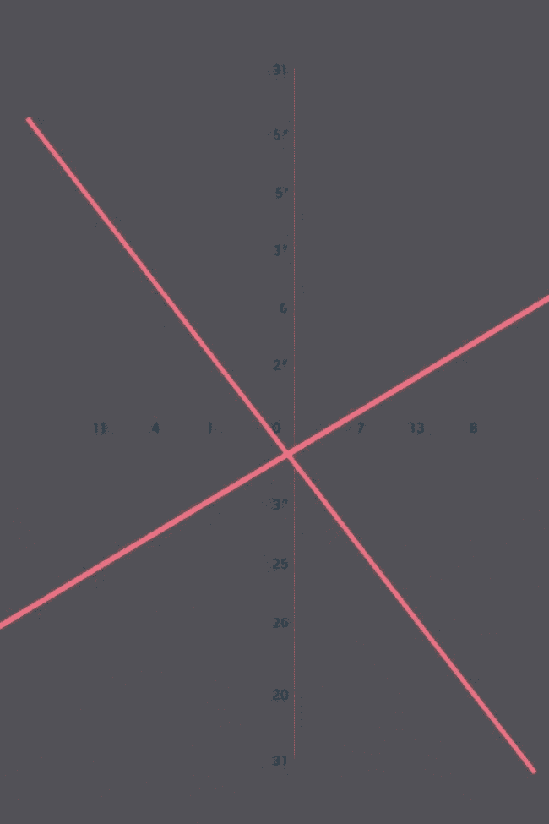
Parallel and Perpendicular Lines
1
Parallel lines have the same slope.
2
Perpendicular lines have slopes that are negative reciprocals of each other.

Slide 7
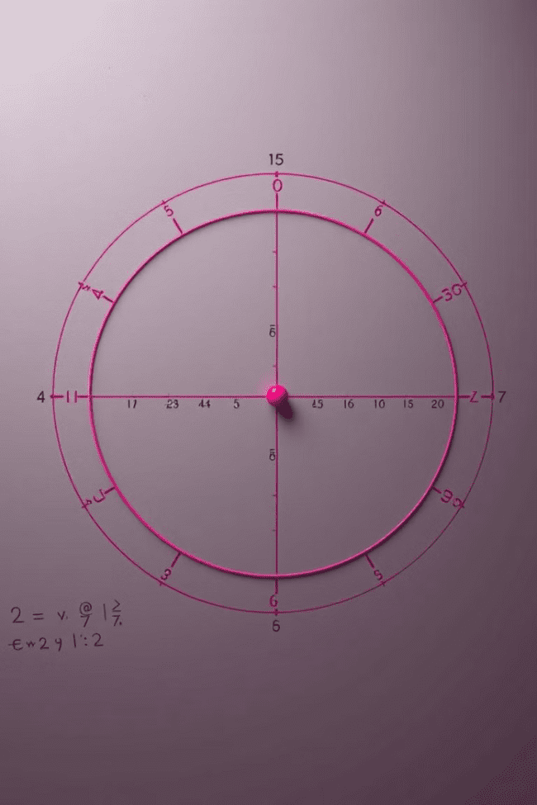


Circles and their Equations
Definition
A circle is defined as the set of all points that are equidistant from a fixed point called the center.
Equation
The standard form of the equation of a circle is (x - h)² + (y - k)² = r², where (h, k) is the center and r is the radius.

Slide 8



Applications of Coordinate Geometry
Navigation
1
GPS systems rely on coordinate geometry to pinpoint locations.
Engineering
2
Design and construction utilize coordinate geometry for precision.
Computer Graphics
3
Coordinate geometry forms the basis for creating and manipulating images.

