Slide 1
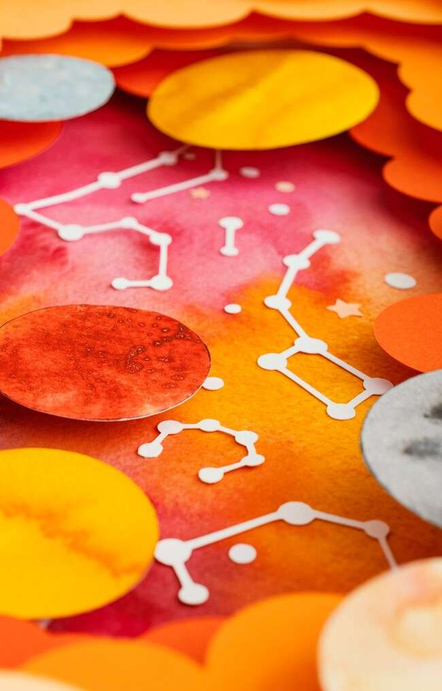
Unraveling the Mysteries: A Creative Journey into Differential Equations

Slide 2


Introduction to Differential Equations
Welcome to our journey into the world of ! Here, we will
explore their signiﬁcance, applications,
and the approaches to solving them. Join us as we unravel the mysteries hidden within these mathematical expressions and discover how they shape our understanding of the universe.

Slide 3




What Are Differential Equations?
are mathematical equations that relate a function with its derivatives. They are essential in describing various phenomena in
, , and .
Understanding these equations allows us to model real-world situations and predict future behaviors.

Slide 4





Types of Differential Equations
Differential equations can be classiﬁed into and equations.
involve functions of a single variable, while
involve multiple variables. Each type has its unique characteristics and
applications in different ﬁelds.

Slide 5
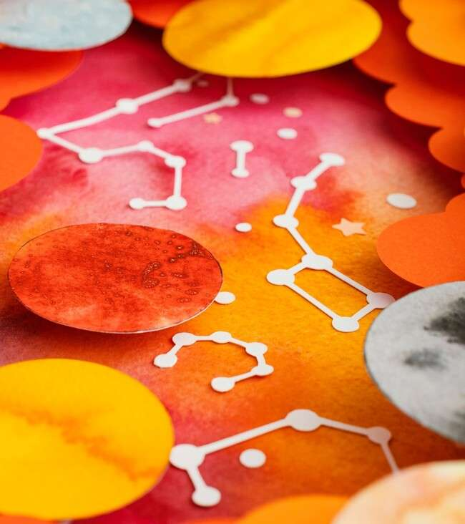


Applications in Real Life
From predicting modeling
to
, differential
equations are everywhere! They help scientists and engineers solve complex problems by providing a framework for understanding dynamic systems and making informed decisions based on mathematical predictions.

Slide 6





Creative Methods of Solving
Solving differential equations can be approached creatively using techniques like ,
, and .
Each method offers unique insights and can be tailored to the speciﬁc problem, allowing for innovative solutions and deeper understanding.

Slide 7

The Role of Technology
In today's world, technology plays a crucial role in solving differential equations. With the help of
and software, we can tackle complex equations that were once deemed
unsolvable, opening new avenues for research
and discovery.

Slide 8


Challenges and Misconceptions
Many people encounter challenges when learning about differential equations, often due to
about their complexity. By embracing a
and breaking down problems into manageable parts, anyone can gain conﬁdence
and proﬁciency in this fascinating area of mathematics.

Slide 9
Conclusion: Embrace the Journey
As we conclude our exploration of differential equations, remember to the journey of learning. With creativity and curiosity, you can unlock the mysteries of these equations and appreciate their impact on the world around us. Keep questioning and exploring!

Slide 10
Thanks!
Do you have any questions? youremail@email.com
+91 620 000 838
www.yourwebsite.com @yourusername

