Slide 1



Vectors: Understanding the Fundamentals
Welcome to our exploration of vectors, a fundamental concept in mathematics and physics. This presentation aims to provide a comprehensive understanding of vectors, from their basic definition to their diverse applications in various fields.
by ONYEDIKACHI ONWURAH

Slide 2
Vector Representations
Visual Representation
Component Representation
Vectors are often represented visually as arrows. The length of the arrow corresponds to the magnitude of the vector, and the arrow's direction indicates the vector's direction in space.
Vectors can also be represented using components, which are the projections of the vector onto the coordinate axes. This allows for a more precise and quantitative representation of vectors.

Slide 3
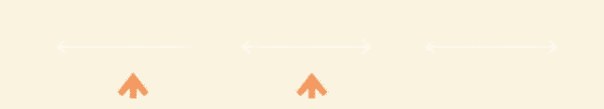
Vector Operations
1
Addition
2
Subtraction
3
Scalar Multiplication
Vectors can be added together to find their resultant vector, which represents the combined effect of the individual vectors. This is achieved by placing the tail of one vector at the head of the other.
Vector subtraction involves finding the difference between two vectors. It can be thought of as adding the negative of the second vector to the first vector.
Vectors can be scaled by multiplying them with a scalar value. This changes the magnitude of the vector but not its direction. A negative scalar flips the vector's direction.

Slide 4

Dot Product
Definition
Geometric Interpretation
Applications
The dot product is a mathematical operation that takes two vectors and returns a scalar value. It is calculated by multiplying the magnitudes of the two vectors and the cosine of the angle between them.
The dot product represents the projection of one vector onto another. It is used to determine the extent to which two vectors point in the same direction.
Dot products are used in various applications, including calculating work done by a force, finding the angle between two vectors, and determining if two vectors are orthogonal.

Slide 5
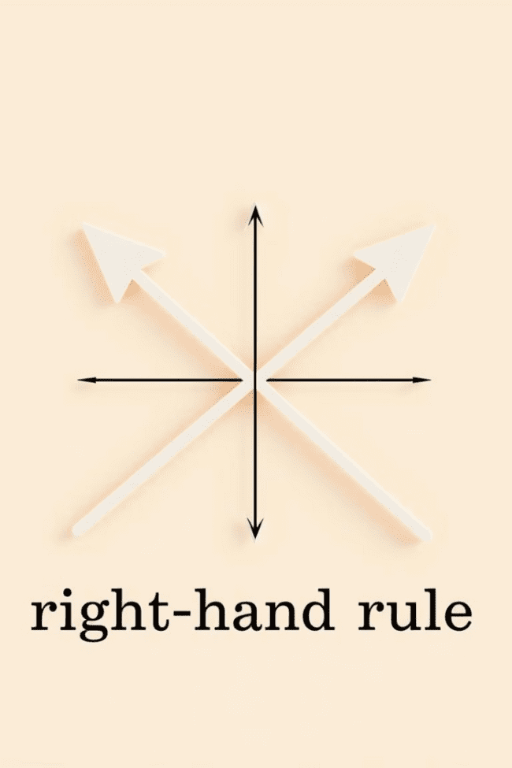



Cross Product
Definition
The cross product is a binary operation on two vectors in three-dimensional space. It produces a vector that is perpendicular to both of the original vectors.
Geometric Interpretation
The magnitude of the cross product represents the area of the parallelogram formed by the two original vectors, and its direction is determined by the right-hand rule.
Applications
Cross products have applications in physics, particularly in calculating torque, angular momentum, and magnetic fields. They are also used in computer graphics for computing surface normals.

Slide 6
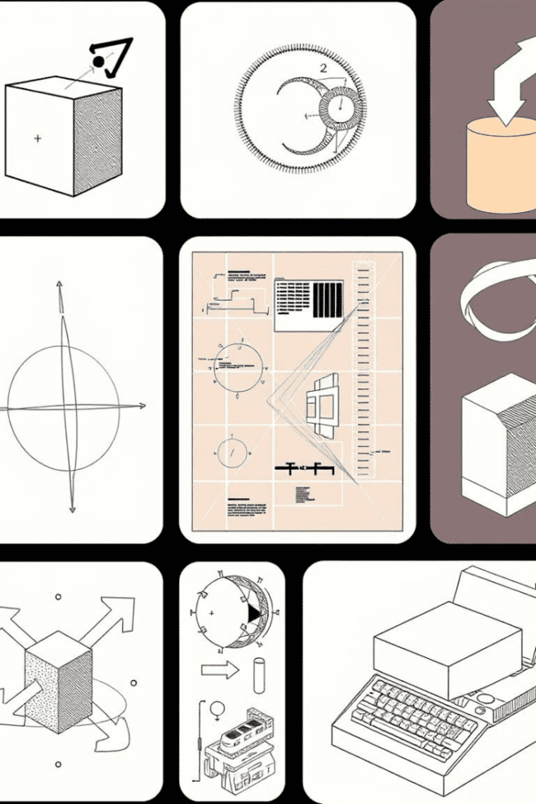
Applications of Vectors
1
Physics: Vectors are used to represent forces, velocities, accelerations, and displacements. This is essential for understanding how objects move and interact with each other.
2
Engineering: Vectors are used in structural analysis, fluid dynamics, and robotics to model and solve complex engineering problems. They are critical for designing and optimizing structures and systems.
3
Computer Graphics: Vectors are used in computer graphics to represent positions, directions, and colors. They are crucial for creating realistic 3D models and animations.

Slide 7
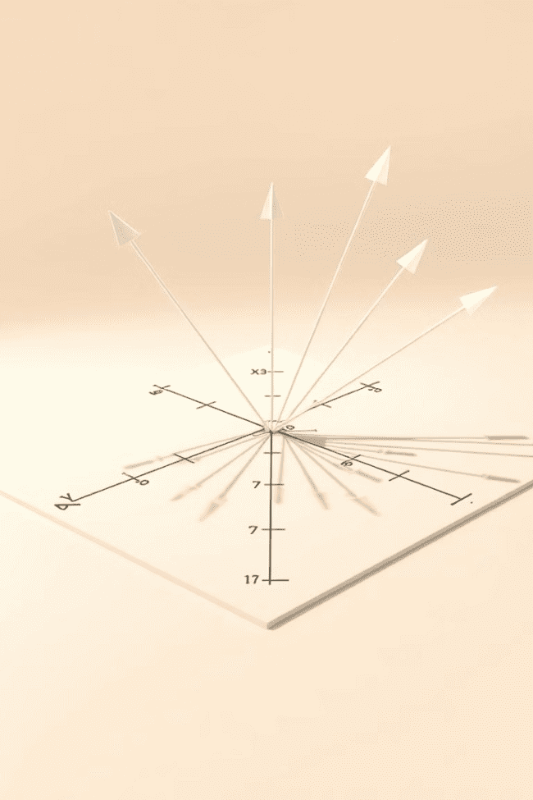
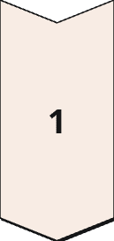
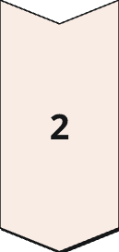
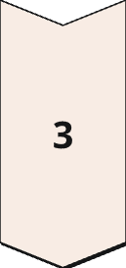
Coordinate Systems
Cartesian Coordinates
Vectors can be represented in Cartesian coordinates, where each component is defined relative to the X, Y, and Z axes. This system is widely used for its simplicity and ease of calculations.
Polar Coordinates
Polar coordinates are used to represent vectors in terms of their magnitude and angle relative to a reference axis. This system is particularly useful for representing vectors in circular or rotational motion.
Spherical Coordinates
Spherical coordinates represent vectors in three dimensions using their magnitude and two angles: the azimuth and elevation angles. This system is suitable for representing vectors in spherical or astronomical applications.

Slide 8


Conclusion and Key Takeaways
Vectors are essential tools for understanding and modeling various phenomena in mathematics, physics, engineering, and computer science. This presentation highlighted the basic concepts of vectors, their representations, operations, and diverse applications. By understanding vectors, we gain a deeper understanding of the fundamental principles governing the world around us.

