Slide 1
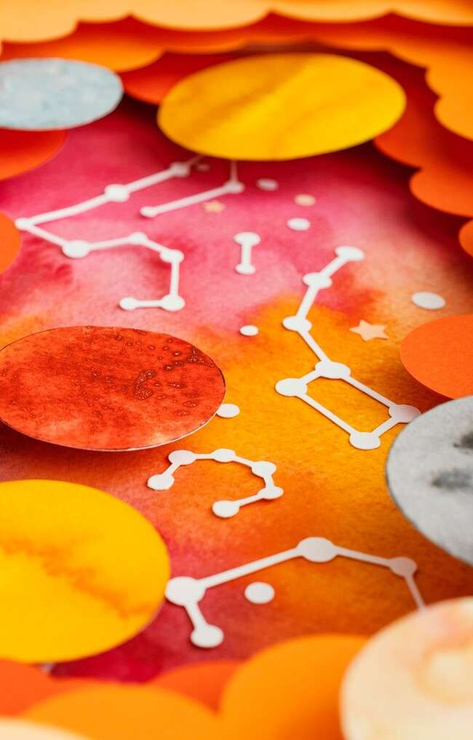
Intersecting Ideas: The Art and Science of Venn Diagrams

Slide 2
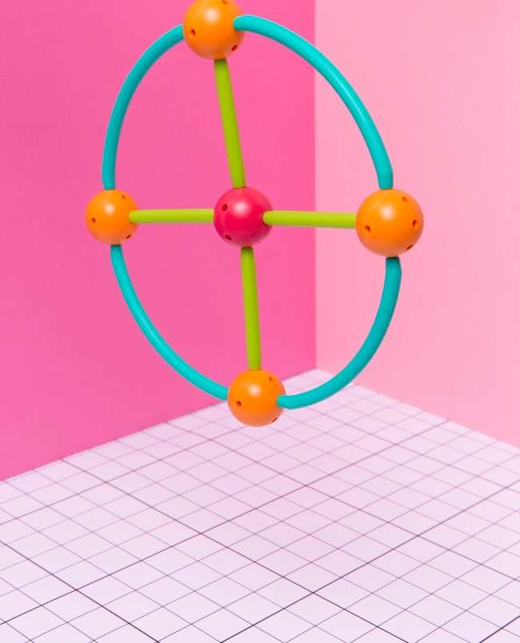


Intersecting Ideas
Welcome to the exploration of
! This presentation will delve into the and behind these powerful visual tools that help us understand relationships and intersections in various concepts. Get ready to discover how these diagrams can enhance creativity and clarity in
communication.

Slide 3
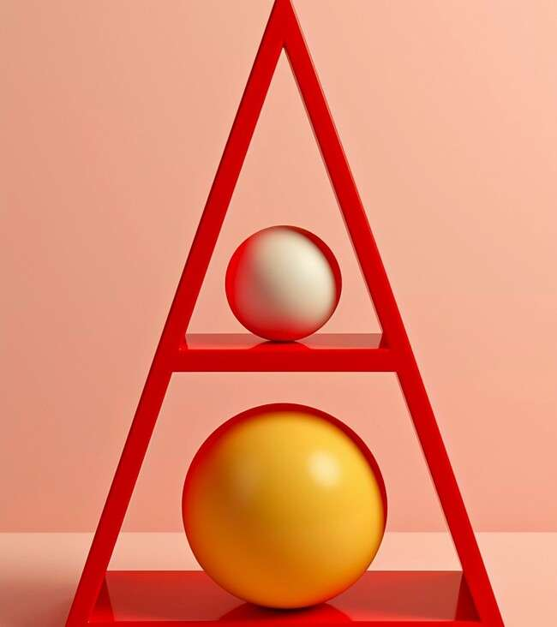





The Basics of Venn
Diagrams
A consists of
overlapping circles that illustrate the
between different sets.
Each circle represents a set, and the intersections show commonalities. This simple yet effective tool helps visualize complex ideas and is widely used in
, , and .

Slide 4
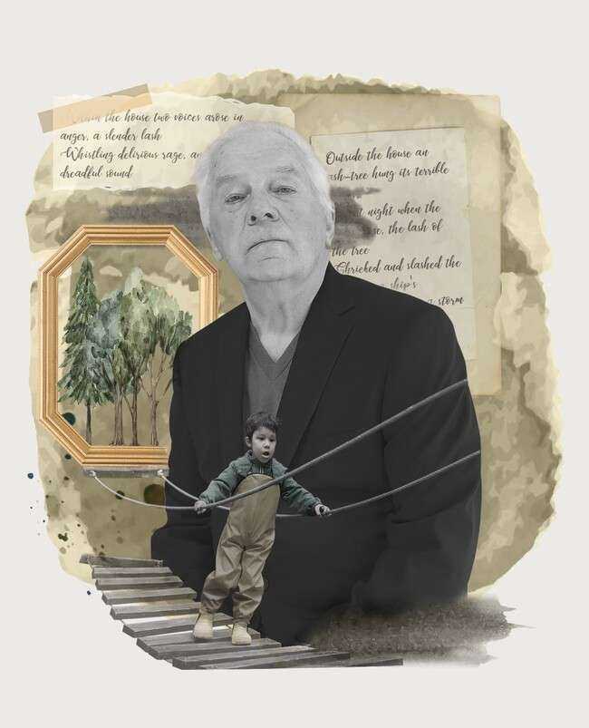





Historical Context
The concept of introduced by
was
in the 1880s.
Initially used in , they have evolved into a versatile tool for various ﬁelds, including , , and . Understanding their history adds depth to their signiﬁcance in problem-solving.

Slide 5







Applications in Education
In
, Venn diagrams facilitate and enhance
. Teachers use them to compare and contrast
, , or
. This visual aid encourages students to engage deeply with the material and fosters
collaborative learning.

Slide 6





Creative Uses in Art
Artists have creatively integrated
into their works, exploring themes of
and . By
visually representing overlapping ideas, artists provoke thought and
discussion about the human experience and the connections we share.
of

Slide 7
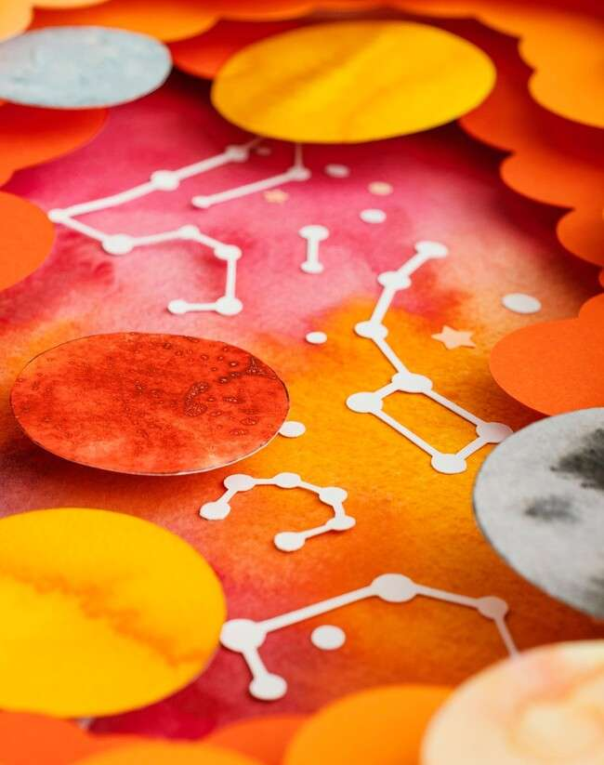


Science and Venn Diagrams
In , Venn diagrams are invaluable for illustrating among different biological species, chemical properties, or physical laws. They simplify complex data, making it easier to identify patterns and
correlations, crucial for effective
in research.

Slide 8
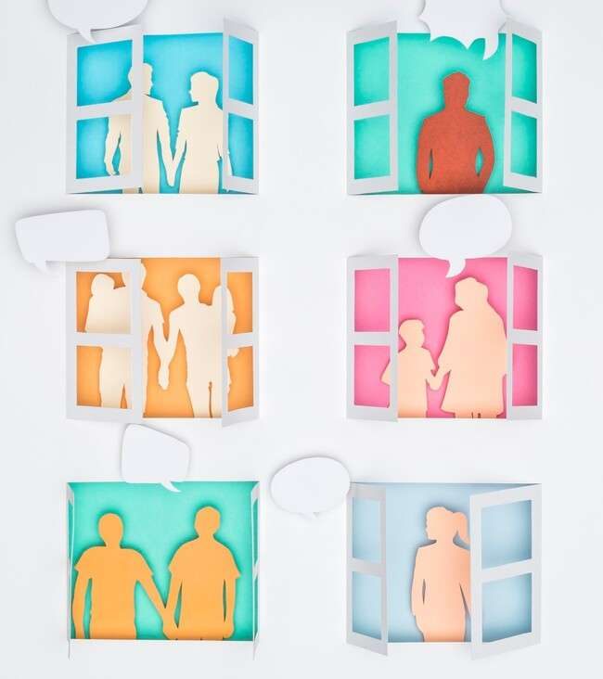


Designing Effective Diagrams
To create impactful
focus on clarity and simplicity. Use
for each circle and label them clearly. Ensure that the intersections are meaningful and reﬂect the true relationships between the sets. A well-designed diagram tells a compelling story.
,

Slide 9

Conclusion: The Power of Intersection
In conclusion,
gateways to understanding the
are not just tools; they are
of ideas.
By visualizing relationships, we can enhance our creativity, communication, and comprehension in various ﬁelds.
Embrace the art and science of Venn diagrams in your own work!

Slide 10
Thanks!
Do you have any questions? youremail@email.com
+91 620 000 838
www.yourwebsite.com @yourusername

