Slide 1

End Behavior of Functions
Understanding the end behavior of functions is crucial in mathematics, especially when dealing with advanced topics like calculus and differential equations. It provides insights into how functions behave as their input values approach positive or negative infinity. This presentation explores the concept of end behavior, delving into its significance and practical applications.
oi
by onyi ik

Slide 2
What is the End Behavior of a Function?
Definition
Importance
End behavior refers to how the graph of a function behaves as its input values (x) approach positive or negative infinity. It describes the long-term trend of the function, indicating whether it rises, falls, or approaches a specific value.
Understanding end behavior is essential for various mathematical applications, such as determining the behavior of functions near singularities, analyzing limits, and understanding the behavior of complex mathematical models.

Slide 3
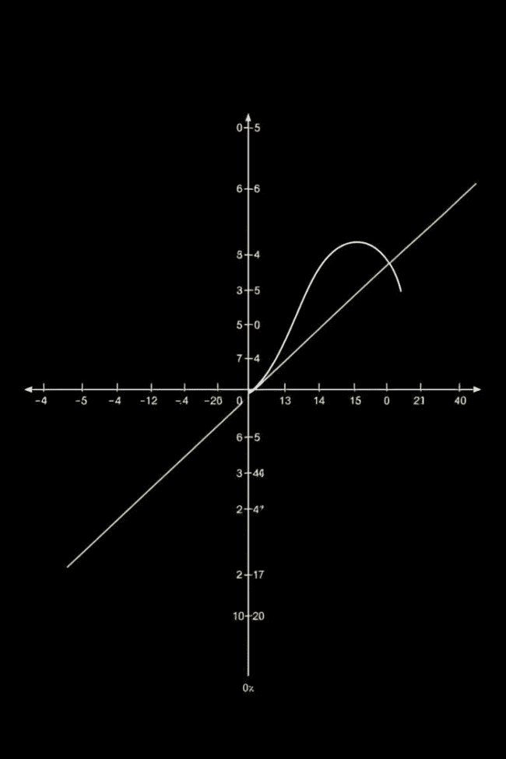
Asymptotic Behavior and Limits
1
Asymptotes
2
Limits
Asymptotes are lines that a function approaches as its input values approach infinity. They represent the limiting behavior of the function.
Limits are used to describe the end behavior of a function. They represent the value that a function approaches as its input values approach a specific value, including infinity.
3
Relationship
Asymptotic behavior and limits are closely related. Asymptotes are often used to visualize the limits of a function as its input values approach infinity.

Slide 4
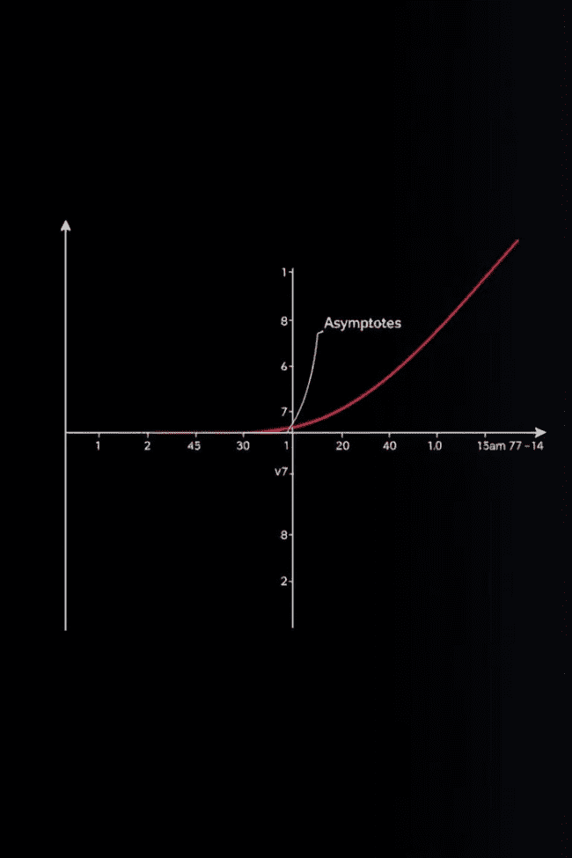



Graphing Asymptotic Behavior
Vertical Asymptotes
Occur when the function approaches infinity as its input values approach a specific value. These are usually caused by factors in the denominator of a rational function.
Horizontal Asymptotes
Occur when the function approaches a specific value as its input values approach infinity. These are usually caused by the degree of the numerator and denominator of a rational function.
Slant Asymptotes
Occur when the degree of the numerator is exactly one more than the degree of the denominator in a rational function. They represent a linear trend the function follows as it approaches infinity.

Slide 5



Vertical Asymptotes
Definition
1
Vertical asymptotes occur when the function approaches infinity as its input values approach a specific value.
Location
2
Vertical asymptotes are located at the values where the denominator of a rational function becomes zero.
Behavior
3
As the function gets closer to the vertical asymptote, its output values approach infinity or negative infinity, depending on the direction from which it approaches the asymptote.

Slide 6
Horizontal Asymptotes
Definition
1
Horizontal asymptotes occur when the function approaches a specific value as its input values approach positive or negative infinity.
Degree
2
The degree of the numerator and denominator of a rational function determines the existence and location of horizontal asymptotes.
Types
3
There are three types of horizontal asymptotes: y = 0, y = a, and no horizontal asymptote. The type depends on the degree of the numerator and denominator.

Slide 7
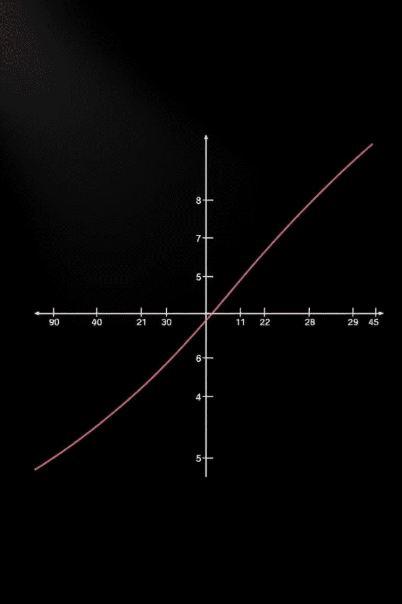
Slant Asymptotes
1
Degree Difference
Slant asymptotes occur when the degree of the numerator is exactly one more than the degree of the denominator in a rational function.
2
Equation
The equation of the slant asymptote can be found by performing long division on the rational function.
3
Behavior
As the function approaches infinity, its graph approaches the slant asymptote, following a linear trend.

Slide 8
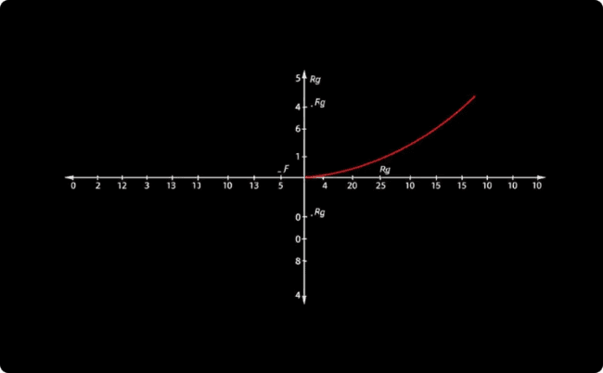
Exploring End Behavior with Rational Functions
Example
Consider the rational function f(x) = (x^2 + 1) / (x - 1). This function has a vertical asymptote at x = 1 and a horizontal asymptote at y = 1. As x approaches infinity, the function approaches 1.

Slide 9
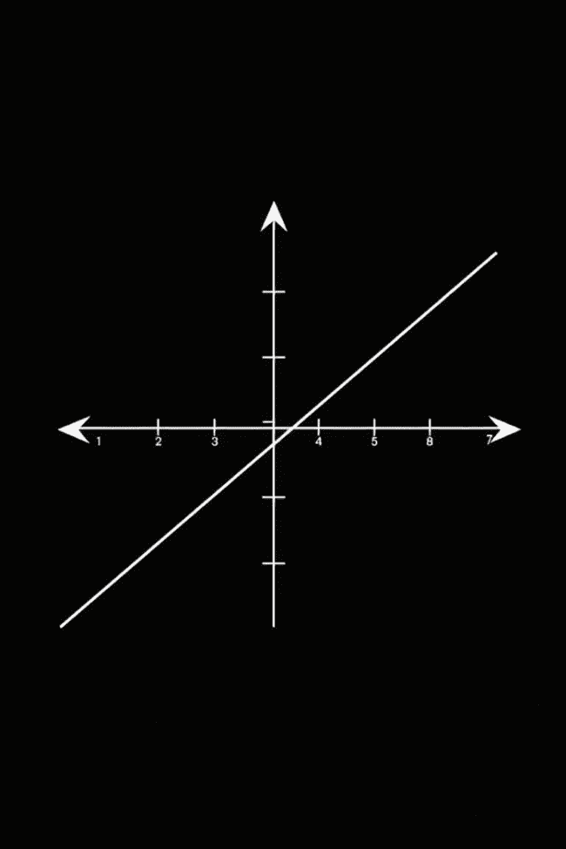



Applying End Behavior to Polynomial Functions
Degree
The degree of a polynomial function determines its end behavior.
Leading Coefficient
The sign of the leading coefficient determines whether the function rises or falls as x approaches infinity.
Behavior
For even degree polynomials, both ends of the graph point in the same direction, determined by the leading coefficient. For odd degree polynomials, the ends point in opposite directions.

Slide 10
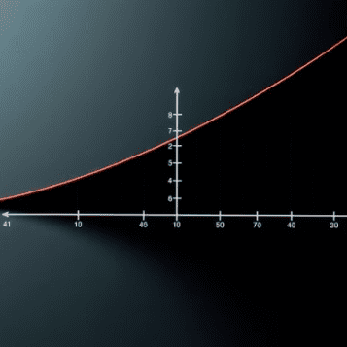

Analyzing Exponential and Logarithmic Functions

