Slide 1


Unveiling the Power of Proofs and Logic
Welcome to this exploration of proofs and logic, two fundamental concepts that underpin mathematics, computer science, and critical thinking. We'll delve into the nature of proofs, explore different types of proofs, and understand the building blocks of logic.
by ONYEDIKACHI ONWURAH

Slide 2

What is a Proof?
A Logical Argument
Mathematical Foundation
A proof is a logical argument that demonstrates the truth of a statement, known as a proposition, using a series of deductive steps. It builds a chain of reasoning from accepted truths, axioms, and previously proven theorems to establish the validity of the proposition.
Proofs are essential in mathematics for establishing the validity of theorems and for building a solid foundation for the subject. They provide a rigorous and objective method for verifying the correctness of mathematical statements.

Slide 3
Types of Proofs
Direct Proof
Indirect Proof
A direct proof starts with the given premises and uses logical deduction to arrive at the desired conclusion. It's like following a straight path from the starting point to the destination.
An indirect proof works by assuming the opposite of the statement to be true and then showing that this assumption leads to a contradiction. This contradiction proves that the original statement must be true.
Proof by Contradiction
Proof by Induction
Similar to an indirect proof, proof by contradiction assumes the opposite of the statement to be true. However, it demonstrates that this assumption leads to a contradiction within the system of axioms or previously proven theorems.
This method is used to prove statements about natural numbers. It involves showing that the statement is true for a base case and then proving that if it's true for an arbitrary case, it's also true for the next case. This establishes the truth for all natural numbers.

Slide 4
Direct Proof
Premise 1
1
Assume that the statement "If it is raining, then the ground is wet" is true.
Premise 2
2
Observe that it is raining.
Conclusion
3
Therefore, using the premises and logic, we can conclude that the ground is wet.

Slide 5



Indirect Proof
Assume the Opposite
1
Assume that the statement "All cats are black" is false.
Find a Contradiction
2
If the statement is false, it means there exists at least one cat that is not black. This contradicts the common knowledge that many cats are not black.
Conclude the Original
3
Since the assumption leads to a contradiction, the original statement must be true.

Slide 6
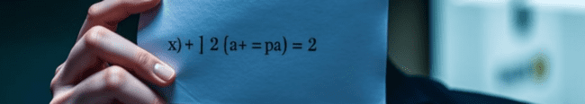



Proof by Contradiction
Assume the Opposite
Derive a Contradiction
Conclude the Original
Assume that the square root of 2 is a rational number, meaning it can be expressed as a fraction p/q where p and q are integers.
By manipulating the equation and applying algebraic steps, we can derive a contradiction, showing that if the square root of 2 is rational, it leads to a contradiction in the number system.
Since the assumption leads to a contradiction, we conclude that the original statement, the square root of 2 is irrational, must be true.

Slide 7

Proof by Induction
1
Base Case
Show that the statement holds true for the first case, often n=1. This establishes a foundation for the inductive process.
2
Inductive Hypothesis
Assume that the statement is true for an arbitrary case, denoted by k. This acts as a stepping stone to prove the next case.
3
Inductive Step
Show that if the statement is true for case k, it also holds true for case k+1. This establishes the recursive nature of the proof, extending the truth from one case to the next.

Slide 8
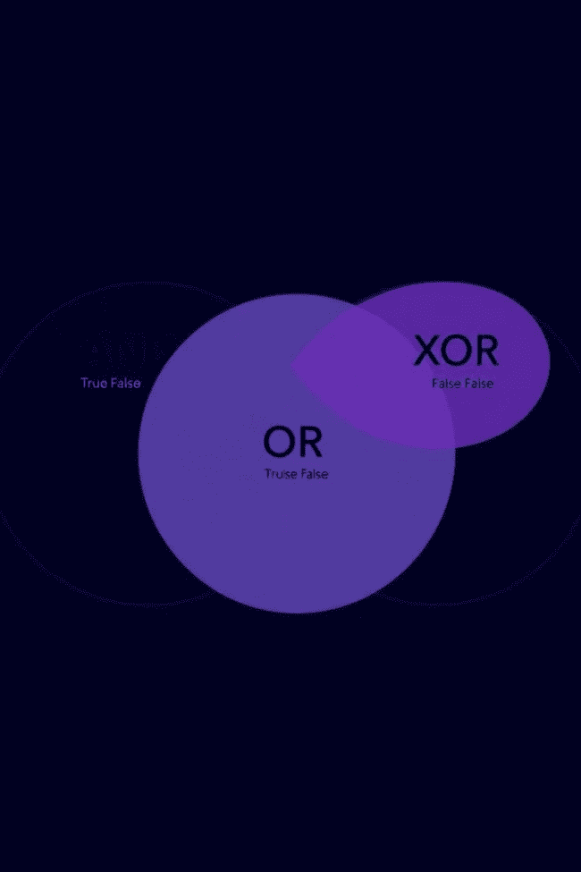




Logical Connectives
Conjunction (AND)
Disjunction (OR)
Two propositions are combined using "AND" (∧). The conjunction is true only when both propositions are true.
Two propositions are combined using "OR" (∨). The disjunction is true if at least one of the propositions is true.
Negation (NOT)
Implication (IMPLIES)
The negation of a proposition is its opposite. It's denoted by "¬" and reverses the truth value of the proposition.
An implication is a conditional statement, denoted by "⇒." It states that if the first proposition is true, then the second proposition must also be true.

Slide 9

Logical Fallacies
1
2
Ad Hominem
Appeal to Authority
Attacking the person making the argument instead of the argument itself.
Assuming something is true simply because a respected person said it.
3
4
False Dichotomy
Hasty Generalization
Presenting only two options as if they were the only possibilities when other options exist.
Drawing a broad conclusion based on insufficient evidence or a small sample size.

Slide 10
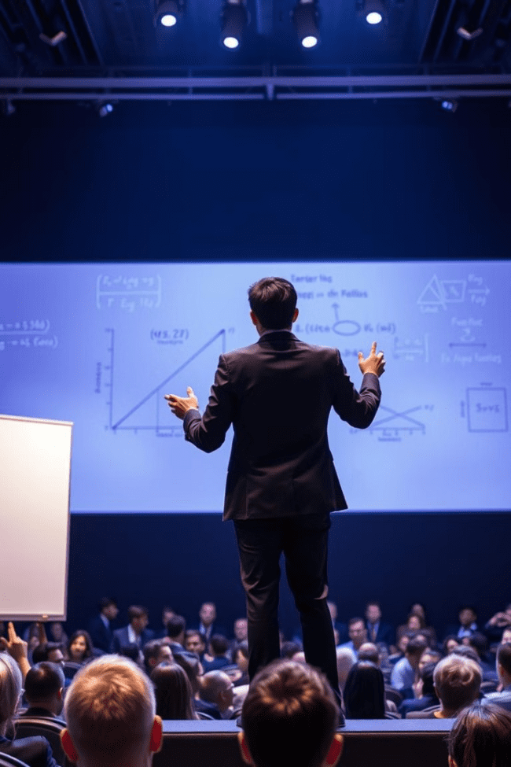
Conclusion and Key Takeaways
By understanding proofs and logic, we gain a powerful tool for critical thinking, problem-solving, and reasoning. We learn to evaluate arguments rigorously, identify fallacies, and build a solid foundation for knowledge in various fields. From mathematics to computer science, the principles of proofs and logic guide us in exploring and understanding the world around us.

