Slide 1

Unlocking the Angles: The Magic of the Law of Sines

Slide 2




Introduction to the Law of Sines
Welcome to the fascinating world of
! Today, we will explore the
, a powerful tool for solving
triangles. This mathematical concept not only helps in calculations but also reveals the of geometry in our lives. Let's unlock the angles together!

Slide 3



Understanding Triangles
Triangles are the of geometry. With three sides and three angles, they can take various forms.
The applies to all types of triangles, allowing us to ﬁnd unknown angles or sides using the ratios of their lengths. Let's dive deeper into these unique shapes.

Slide 4




The Law of Sines
Explained
The
states that the ratio of
a side length to the sine of its opposite angle is constant for all sides and angles in a triangle. This relationship
can be expressed as
, where a, b, and c are the sides, and A, B, and C are the angles.

Slide 5



Applications in Real Life
The isn't just theoretical; it has practical applications! From to architecture, this law helps in determining distances and angles in real-world scenarios. Understanding these applications can inspire creativity and innovation in various ﬁelds.

Slide 6
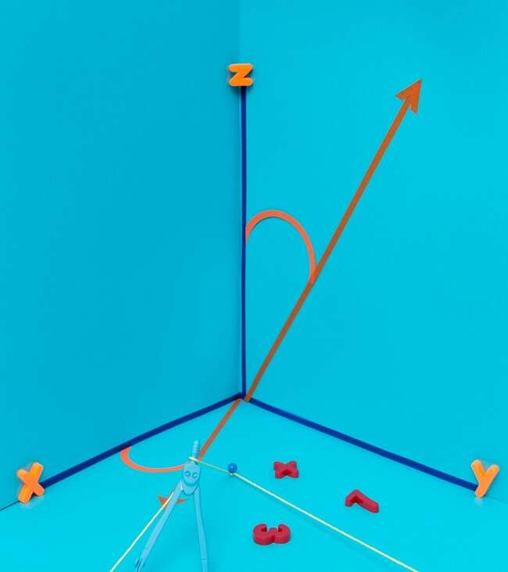

Solving Triangles with Ease
With the , solving triangles becomes a breeze!
Whether you know two angles and one side or two sides and a non- included angle, this law provides a straightforward method to ﬁnd missing parts. Let's explore some examples to see it in action!

Slide 7


Common Mistakes to Avoid
While using the , it's crucial to avoid common pitfalls. Mislabeling angles and sides or forgetting to use the correct sine values can lead to errors. Always double-check your work and ensure you’re applying the law correctly to achieve accurate results.

Slide 8





Exploring Further Concepts
The opens doors to many advanced topics, such as the
and
. By mastering this law, you’ll build a strong foundation for tackling more complex problems in trigonometry and geometry. Let's keep the curiosity alive!

Slide 9

Conclusion: The Magic Unlocked
In conclusion, the is a magical tool that allows us to unlock the secrets of triangles. By understanding its principles, we can solve problems creatively and apply these concepts in various ﬁelds. Keep exploring, and let the magic of mathematics inspire you!

Slide 10
Thanks!
Do you have any questions? youremail@email.com
+91 620 000 838
www.yourwebsite.com @yourusername

