Slide 1


Cool Kids Rule!
Math games for 1st Graders!!!!!!!
Word Problems
Click here for:
Number Problems

Slide 2

Number
Problems 1-11
Start!

Slide 3






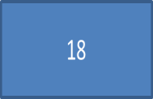
6+14=
21
20
19

Slide 4


Sorry That’s Wrong
Try Again!

Slide 5


Awesome!! That’s Right!!
Next Question!

Slide 6


8+6=
14
12
13
15

Slide 7


Sorry That’s Wrong
Try Again!

Slide 8

Math-tastic!! That’s Right!!
Next Question!

Slide 9

6+5=
10
9
11
12

Slide 10



Sorry That’s Wrong
Try Again!

Slide 11

Looking Good!! That’s Right!!
Next Question!

Slide 12



9+8=
16
18
19
17

Slide 13

Sorry That’s Wrong
Try Again!

Slide 14

Nice!! That’s Right!!
Next Question!

Slide 15




8+4=
16
12
14
13

Slide 16
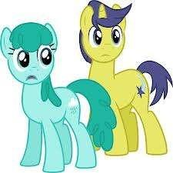
Sorry That’s Wrong
Try Again!

Slide 17

You got it!!!!
Next Question!

Slide 18


7+8=
13
15
14
16

Slide 19

Sorry That’s Wrong
Try Again!

Slide 20


You’re math-radical
Next Question!

Slide 21

7+12=
18
20
19
17

Slide 22
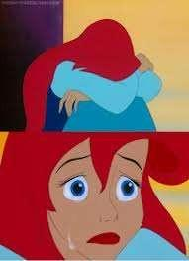
Sorry That’s Wrong
Try Again!

Slide 23

You’re math-radical
Next Question!

Slide 24


7+9=
16
17
15
18

Slide 25
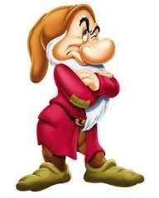
Sorry That’s Wrong
Try Again!

Slide 26
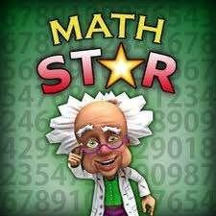
You’re a Math Star!
Next Question!

Slide 27

5+7=
12
13
14
11

Slide 28
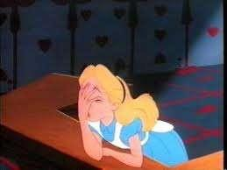
Sorry That’s Wrong
Try Again

Slide 29

You’re a Math Star!
Next Question!

Slide 30



13+5=
17
19
18
16

Slide 31

Sorry That’s Wrong
Try Again!

Slide 32
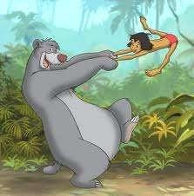
You’re on a Math Roll!
Next Question!

Slide 33




15+5=
22
21
19
20

Slide 34
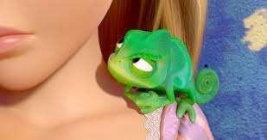
Sorry That’s Wrong
Try Again!

Slide 35
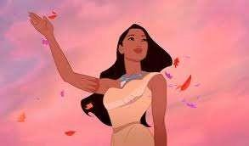
Your Done! Great Job!
You’re Done!

Slide 36
Word
Problems 1-20
Start!

Slide 37

Cookie Craving
Malaika and Kassa have 4 cookies, but Ms. Wiegman gives her 9 more to share with the class. How many do they have to share now?
4+9=
13
15
12
14

Slide 38
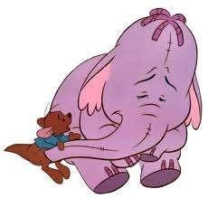
Sorry That’s Wrong
Try Again!

Slide 39
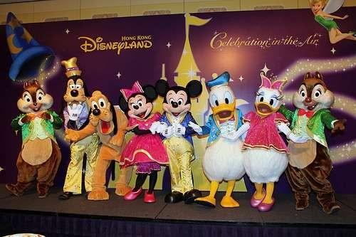
You’re Great!
Next Question!

Slide 40




Printing Pages
Patrick and Daniel need to print 13 pages and David needs to print 5. How many pages is it all together?
13+5=
17
18
19
16

Slide 41

Sorry That’s Wrong
Try Again!

Slide 42

You’ve got a cool talent!
Next Question!

Slide 43




A Toy Field Trip
Anna has 7 toys that she brought to school and Florine brought 6 toys. How many toys did they take together?
7+6=
11
12
14
13

Slide 44

Sorry That’s Wrong
Try Again!

Slide 45

You are a math Genius!
Next Question!

Slide 46





A Video Game
Challenge
Ms. Wiegman gives Henrique and Vorgai a special job to do. She wants them to get 8 math video games and 8 science video games. How many games are they supposed to get?
8+8=
17
14
16
15

Slide 47

Sorry That’s Wrong
Try Again!

Slide 48


You are on a math roll!
Next Question!

Slide 49


Candy Adding
Kolia, Eleanor, and Emerson have 14 pieces of candy. Then Ms. Wiegman gives them 3 more. How many pieces of candy do they
have now?
14+3=
16
17
15
18

Slide 50

Sorry That’s Wrong
Try Again!

Slide 51
You’re Done! Good Job!
You’re Done!

