Slide 1

Unleashing the Power of Vectors: Exploring the Magic of Cross Products

Slide 2





Introduction to Vectors
In this presentation, we will explore the of and the . Understanding these concepts can unlock new dimensions in ﬁelds like physics, engineering, and computer graphics. Get ready to dive into the
of vectors!

Slide 3




What are Vectors?
are quantities that have both and . They are
essential in representing physical
phenomena, such as force and velocity. By mastering vectors, we can better analyze and solve complex problems in
various disciplines.

Slide 4



Understanding Cross Products
The is a mathematical operation that takes two vectors and produces a third vector that is to both. This operation is crucial in calculating areas, torques, and understanding rotational dynamics in physics.

Slide 5
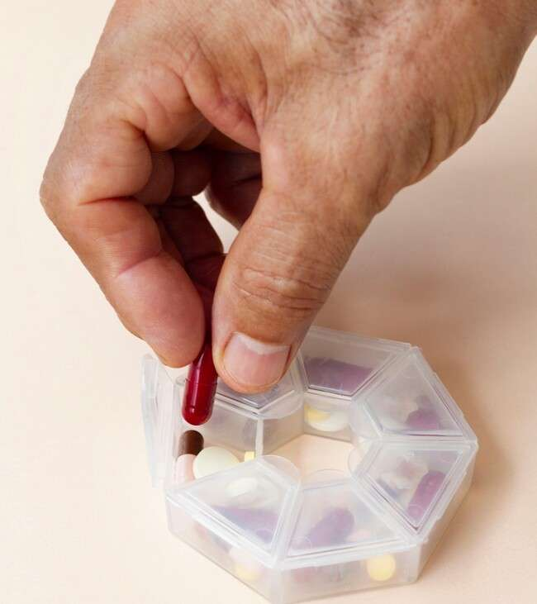


Calculating Cross
Products
To compute the
formula: θ
, use the
. Here, θ
is the angle between the vectors, and n is the unit vector perpendicular to the plane formed by A and B. Let's break it
down step by step!

Slide 6



Applications in Physics
Cross products play a vital role in
, especially in calculating the and angular momentum. By understanding these applications, we can better grasp concepts like rotation and equilibrium in various physical systems.

Slide 7




Cross Products in Computer Graphics
In
are used for ,
, cross products
, and
. They help in determining surface normals and creating realistic 3D environments, enhancing the visual experience for users.

Slide 8
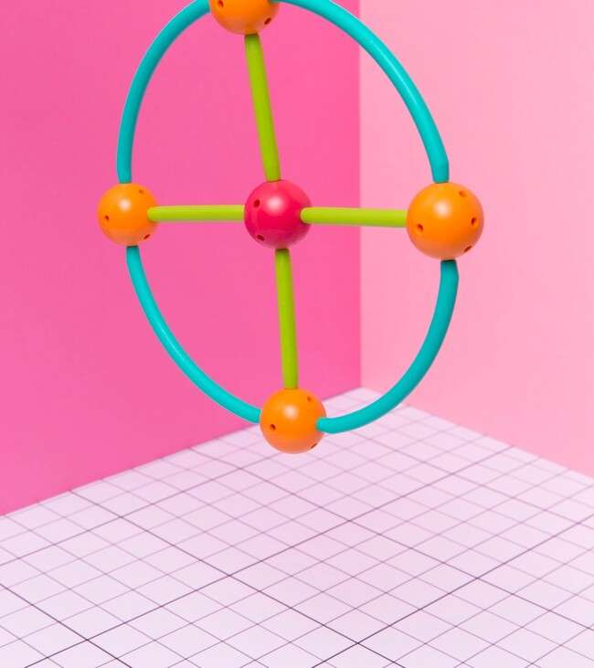

Creative Visualizations
Visualizing cross products can be a process! Using tools like 3D
models and animations, we can better
understand how vectors interact and the signiﬁcance of their relationships in
various applications.

Slide 9


Conclusion: Embrace the Power
By the power of vectors and understanding cross products, we can tackle complex problems and enhance our skills in various ﬁelds. Embrace the of vectors and let your creativity ﬂow in your projects!

Slide 10
Thanks!
Do you have any questions? youremail@email.com
+91 620 000 838
www.yourwebsite.com @yourusername

