Slide 1

Unlocking the Mysteries: Navigating the Labyrinth of Nonlinear Equations

Slide 2



Introduction to Nonlinear
Equations
are the unsung heroes of mathematics, presenting unique challenges and intriguing solutions. This presentation will guide you through the and
of these equations, unlocking the mysteries that lie within their intricate structures. Join us on this
adventurous journey!

Slide 3





What Are Nonlinear Equations?
In contrast to ,
involve variables raised to powers greater than one or involve products of variables.
They are essential in modeling real-world phenomena, from physics to economics, making them a area of study.

Slide 4




Real-World Applications
Nonlinear equations are everywhere! From
predicting
to understanding
, they help us make sense of
complex systems. By exploring these applications, we can appreciate the
of nonlinear equations in our daily lives.

Slide 5






Methods of Solving
Solving nonlinear equations can be a
task. Techniques like
,
,
play a crucial
and
role in ﬁnding solutions. Each method has its own strengths, making the exploration of these techniques both
and .

Slide 6







Challenges Faced
Despite their beauty, nonlinear equations present numerous
. Issues such as
,
, and in
calculations can make solving them a true test of ingenuity and creativity.

Slide 7
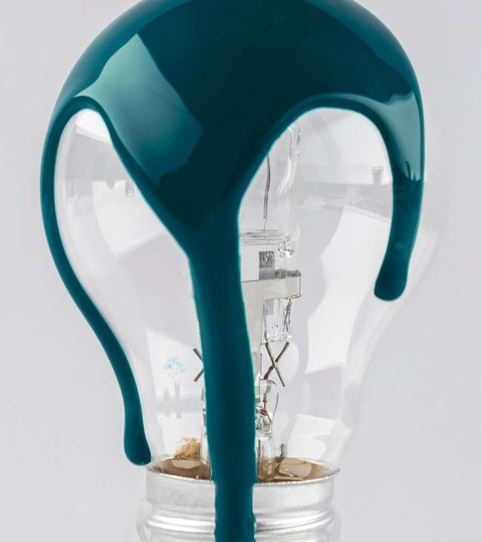


Innovative Approaches
Creativity is key when tackling nonlinear equations! Techniques such as , , and are paving the way
for new solutions. By thinking outside the box, we can unlock new pathways
to understanding.

Slide 8



Future of Nonlinear
Equations
As technology advances, the study of nonlinear equations is becoming
increasingly
and
. With the rise of
, we
are on the brink of groundbreaking discoveries that could revolutionize
various ﬁelds.

Slide 9



Conclusion: Embrace the Complexity
In conclusion, nonlinear equations are a to understanding the of the universe. By embracing their challenges and exploring innovative solutions, we can unlock their mysteries and apply them to real-world problems.
Let's continue this together!

Slide 10
Thanks!
Do you have any questions? youremail@email.com
+91 620 000 838
www.yourwebsite.com @yourusername

