Slide 1

Unlocking the Universe: Exploring the Domain and Range of Functions

Slide 2




Unlocking the Universe
to our exploration of the domain and range of functions! In this journey, we will uncover the
of how functions deﬁne relationships between variables and how they shape our understanding of the universe. Let's embark on this adventure together!

Slide 3



What are Functions?
A is a special relationship where each input is associated with exactly one output. Think of it as a
that transforms inputs into outputs, allowing us to model real-world phenomena.
Understanding functions is crucial for navigating the complexities of
mathematics.

Slide 4



Deﬁning Domain
refers to the set of all possible input values for a function. It determines the of the function's application. By identifying the domain, we can unlock the potential of the function and understand its limitations in the universe of mathematics.

Slide 5



Understanding Range
The is the set of all possible output values that a function can produce. By exploring the range, we gain insight into the of different inputs and how they inﬂuence the output. This is key to comprehending the behavior of functions.

Slide 6
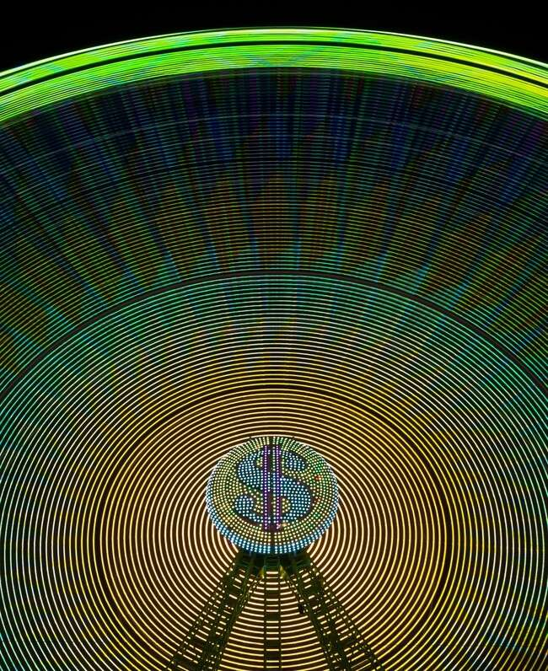




Real-World Applications
Functions play a vital role in various ﬁelds, from to economics.
Understanding domain and range helps
us model real-world situations, such as predicting , analyzing
, or even designing technology.
The applications are truly limitless!

Slide 7



Visualizing Functions
Graphs are powerful tools for visualizing functions. They help us identify the
and at a glance. By
plotting functions, we can observe their behavior, relationships, and how they interact with the universe around us.
Let's dive into some examples!

Slide 8



Challenges and Misconceptions
Many students face challenges when understanding domain and range. Common include
overlooking restrictions or assuming all inputs are valid. By addressing these challenges, we can enhance our mathematical and unlock the full potential of functions.

Slide 9


Conclusion: The Journey Ahead
In conclusion, understanding the and of functions is essential for unlocking the universe of mathematics. By mastering these concepts, we equip ourselves with the tools to explore, analyze, and innovate in various ﬁelds. Let's continue this journey of discovery!

Slide 10
Thanks!
Do you have any questions? youremail@email.com
+91 620 000 838
www.yourwebsite.com @yourusername

