Slide 1



Logarithms: Unlocking the Secrets of Exponential Growth
Welcome to our exploration of logarithms, a powerful tool in mathematics with wide-ranging applications. Throughout this presentation, we'll unveil the mysteries behind these functions, their historical significance, and their real-world impact. We'll also delve into their properties, applications, and how they solve complex equations. Prepare to unlock a new understanding of exponential growth and the fascinating world of logarithms.
by ONYEDIKACHI ONWURAH

Slide 2
What are Logarithms?
Inverse of Exponents
Key Components
Logarithms are the inverse of exponents. They answer the question: "What power must we raise a base to in order to get a certain number?" For example, log2 8 = 3, meaning 2 raised to the power of 3 equals 8.
Logarithms consist of a base, a number, and a result. The base is the number being raised to a power, the number is the result of the exponentiation, and the result is the power required to reach the number.

Slide 3

The History and Importance of Logarithms
John Napier
Revolutionized Astronomy
Logarithms were first invented by John Napier in the early 17th century as a way to simplify complex calculations involving multiplication and division.
Their invention revolutionized fields like astronomy, allowing scientists to perform astronomical calculations with greater accuracy and efficiency.
Foundation for Modern Mathematics
Logarithms laid the foundation for modern calculus and other branches of mathematics, making them a fundamental concept in the advancement of science and technology.

Slide 4




Logarithmic Functions and their Properties
1
Function Definition
2
Domain and Range
3
Asymptotes
4
Properties
A logarithmic function is expressed as logb(x) = y, where b is the base, x is the number, and y is the power. The domain of a logarithmic function is all positive real numbers, and its range is all real numbers. Logarithmic functions have a vertical asymptote at x = 0. They also exhibit several important properties, including the product rule, the quotient rule, and the power rule.

Slide 5
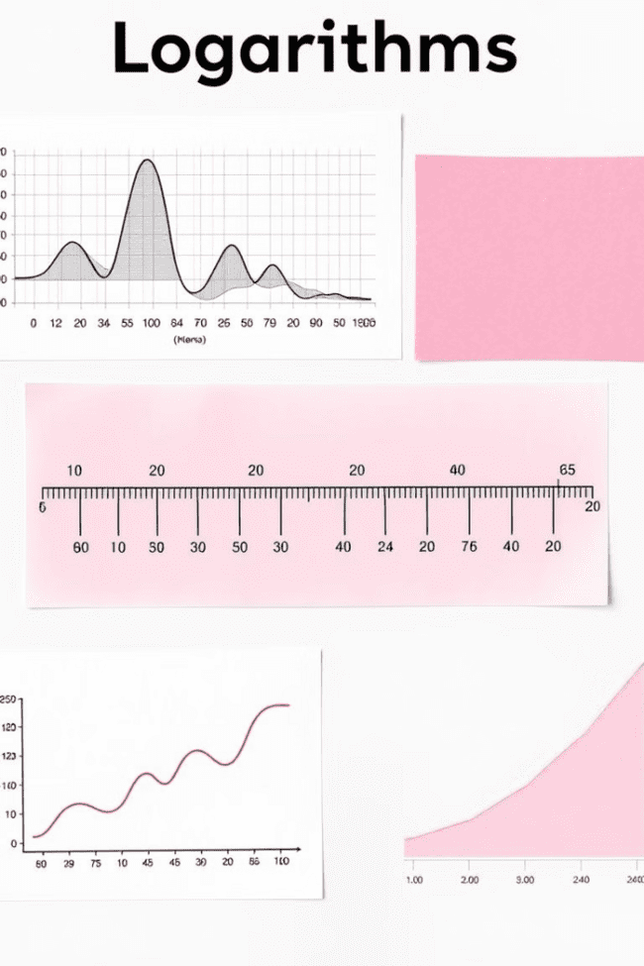



Applications of Logarithms in the Real World
Earthquakes
The Richter scale, used to measure the intensity of earthquakes, is based on a logarithmic scale.
Chemistry
The pH scale, measuring acidity and alkalinity, utilizes a logarithmic scale for quantifying hydrogen ion concentration.
Finance
Logarithms are crucial in financial modeling and analysis, helping to understand compound interest and exponential growth in investments.

Slide 6
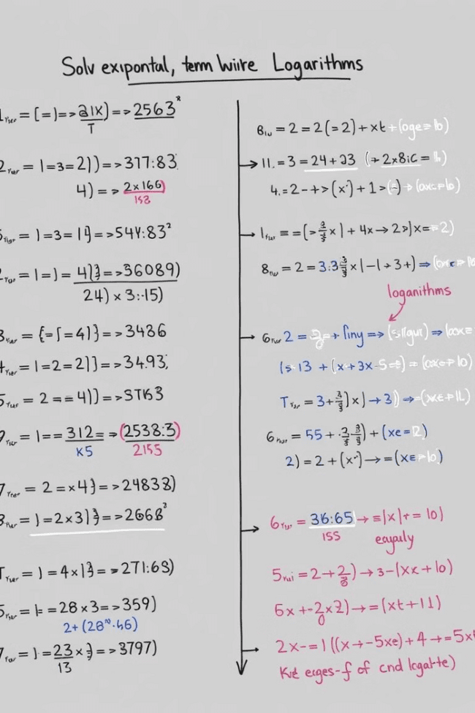



Solving Exponential Equations Using Logarithms
Isolate the Exponential Term
The first step involves isolating the exponential term on one side of the equation.
Apply Logarithms
Apply the appropriate logarithm to both sides of the equation, using the same base as the exponential term.
Solve for the Variable
Utilize logarithmic properties to simplify the equation and solve for the variable.

Slide 7
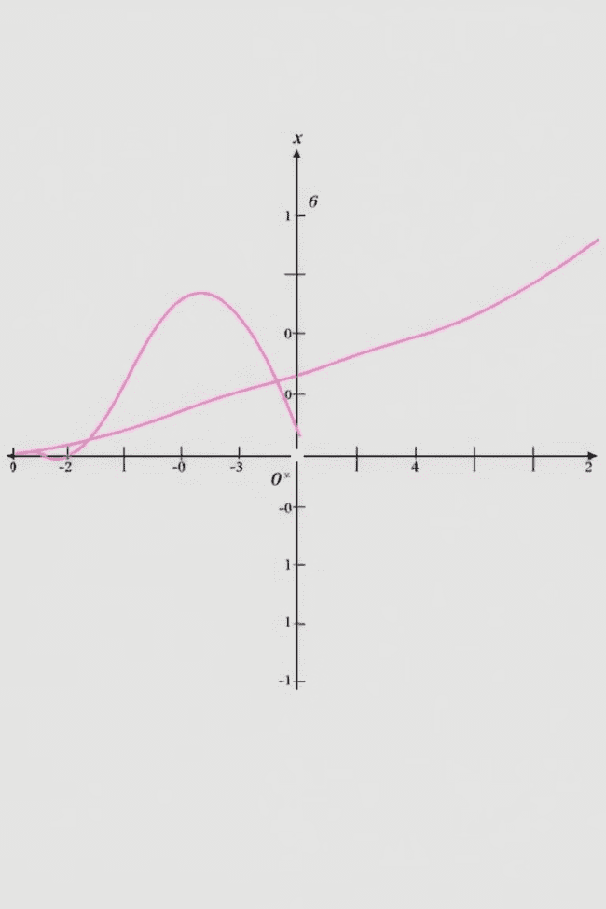
Natural Logarithms and their Significance
e
Euler's Number
The natural logarithm is a special type of logarithm with a base of Euler's number, denoted by the letter "e," which is approximately 2.718.
ln
ln(x)
The natural logarithm is commonly denoted as ln(x).
1
Applications
Natural logarithms have numerous applications in calculus, physics, and engineering, particularly in areas involving continuous growth and decay.

Slide 8
Logarithms in Calculus and Advanced Mathematics
Derivatives
1
Calculus utilizes logarithms to find the derivatives of exponential functions and to simplify complex integral expressions.
Integrals
2
Logarithms are employed in solving certain types of integrals, particularly those involving rational functions and exponential expressions.
Advanced Applications
3
Logarithms find application in various branches of advanced mathematics, including differential equations, Fourier analysis, and complex analysis.

