Slide 1

Unveiling the Magic: The Dot Product and Its Hidden Dimensions

Slide 2







Introduction to Dot Product
Welcome to the world of
This presentation will explore its
!
and uncover the
. Prepare to behind this
mathematical operation and how it reveals hidden dimensions in
.

Slide 3
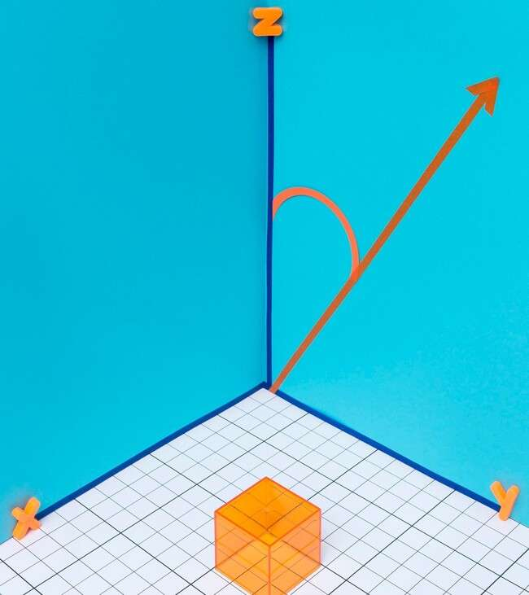







What is the Dot Product?
The operation in
combines two
is a fundamental
. It
to produce a
single value. This scalar provides insight into the
between the vectors, revealing their and
.

Slide 4






Geometric Interpretation
In geometric terms, the can be interpreted as the product of the of two vectors and the of the angle between them. This relationship highlights how
affects the result, making it a powerful tool in .

Slide 5



Applications in Physics
The applications in calculating
ﬁnds numerous
, such as done by a force. By
projecting force vectors onto displacement vectors, we can determine how much of the force contributes to movement, showcasing its practical signiﬁcance.

Slide 6




Dot Product in Computer Graphics
In , the
is essential for calculations and determining how
light interacts with surfaces. It helps in creating realistic scenes by calculating angles of incidence and reﬂection, enhancing our visual experiences.

Slide 7






Hidden Dimensions
Revealed
The
doesn't just operate in
two dimensions; it extends into
as well. This ability to reveal
relationships in multi-dimensional spaces allows us to understand complex data structures, making it
invaluable in ﬁelds like
.

Slide 8





Common Misconceptions
Many misunderstand the
as merely a mathematical tool. However, it embodies deeper concepts such as ,
, and .
Understanding these nuances can transform how we approach problems in various disciplines.

Slide 9





Conclusion: The Power of Dot Product
In conclusion, the calculation; it unveils the
is more than a simple of relationships between
vectors. Its applications span across
,
,
and , making it a vital concept in understanding our world.

Slide 10
Thanks!
Do you have any questions? youremail@email.com
+91 620 421 838
www.yourwebsite.com @yourusername

