Slide 1

Unraveling the Mysteries: The Enchanting Roots of Complex Numbers

Slide 2
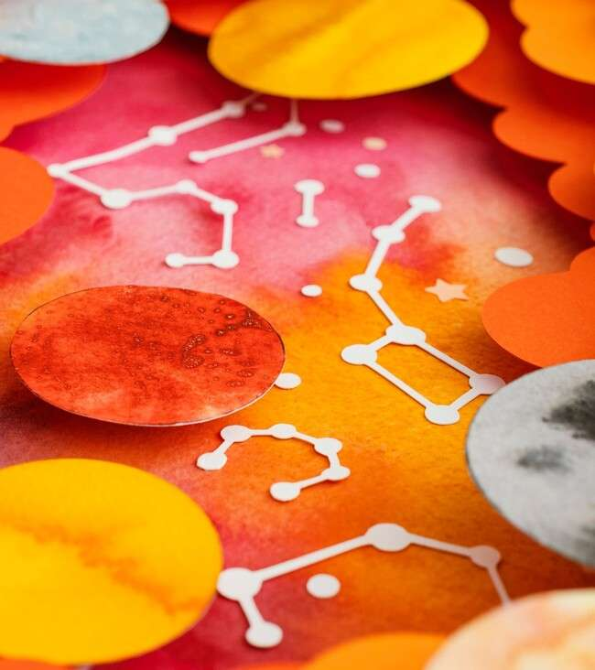


Introduction to Complex
Numbers
are fascinating mathematical constructs that combine real and imaginary components. This presentation aims to explore their
, historical signiﬁcance, and their role in various ﬁelds, from engineering to quantum physics. Join us as we unravel the
mysteries behind these intriguing
numbers!

Slide 3
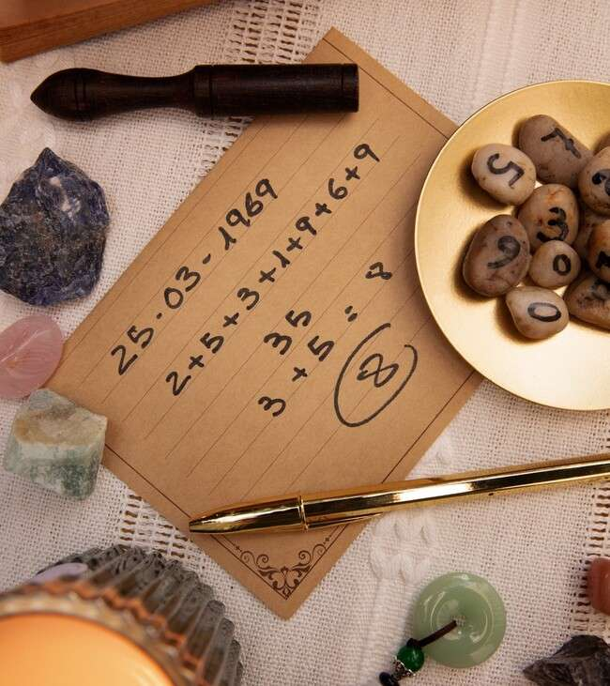





Historical Origins
The journey of
begins in the with mathematicians like Gerolamo Cardano. They emerged from the need to solve equations that had no real solutions, leading to the birth of the 'i'. This slide delves into their
and evolution over
time.

Slide 4
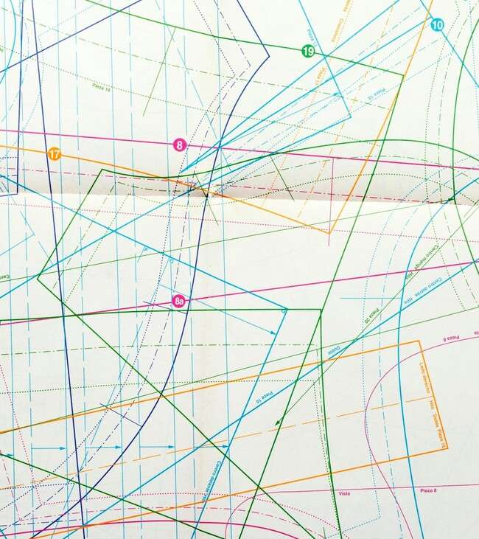




Understanding the
Components
A complex number is expressed as
, where 'a' is the real part and 'bi' is the imaginary part. The and
intersect to form the
, providing a visual representation of these numbers. This slide illustrates their structure and signiﬁcance in mathematics.

Slide 5



Applications in Engineering
Complex numbers play a critical role in
, particularly in electrical engineering and signal processing.
They simplify the analysis of
and help model waveforms. This slide highlights how complex numbers enhance our understanding of real- world systems and their applications.

Slide 6
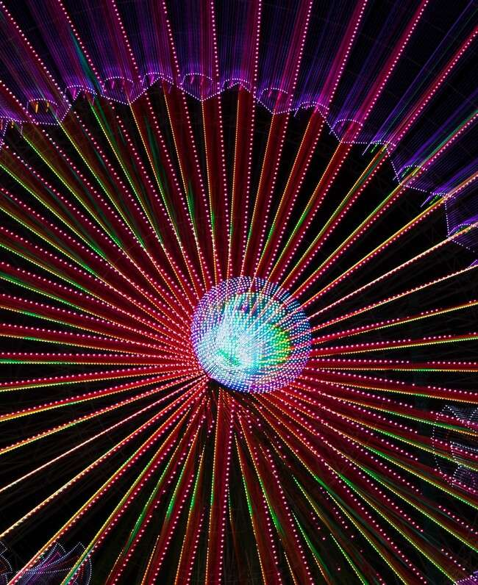


Complex Numbers in Physics
In , complex numbers are essential for describing wave functions and probabilities. They allow physicists to capture the
and matter. This slide discusses their pivotal role in shaping modern physics and how they help explain the universe's mysteries.

Slide 7



The Beauty of Fractals
Complex numbers are the foundation
of many
. The
, for example,
showcases the beauty that arises from simple mathematical rules applied to complex numbers. This slide explores the connection between complex numbers and the mesmerizing world
of fractals.

Slide 8



Art and Complex Numbers
Artists and mathematicians alike have found inspiration in complex
numbers. From
to
, their unique
properties allow for stunning visual representations. This slide highlights the intersection of art and mathematics, showcasing creativity through complex numbers.

Slide 9




Conclusion: The Enchantment Continues
The exploration of complex numbers reveals their and importance across various ﬁelds. Their
and beauty continue to inspire both scientists and artists. As we conclude, let us appreciate the they unravel and the endless possibilities they offer in our understanding of the universe.

Slide 10
Thanks!
Do you have any questions? youremail@email.com
+91 620 421 838
www.yourwebsite.com @yourusername

