Slide 1

Inverse Functions
Inverse functions are a fundamental concept in mathematics that play a crucial role in various areas of science and engineering. They are a way to "reverse" the operation of a function, allowing us to find the input that produced a given output.
OI
by ONYEDIKA IK

Slide 2
What are Inverse Functions?
Understanding the Concept
Example
Imagine a function as a machine that takes an input, processes it, and produces an output. An inverse function is like a reverse machine that takes the output of the original function and returns the original input. They undo each other's operations.
If a function doubles a number, its inverse function would halve it. If a function squares a number, its inverse function would find the square root. The inverse function reverses the process.

Slide 3
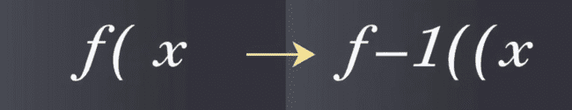
The Definition of an Inverse Function
Formally, a function f(x) has an inverse function, denoted as f^-1(x), if and only if for every output y in the range of f(x), there is a unique input x in the domain of f(x) such that f(x) = y. This means that every output of the original function corresponds to exactly one input in the inverse function.

Slide 4
Graphing Inverse Functions
Symmetry
Coordinate Swap
Inverse functions have a special relationship on a graph: they are reflections of each other across the line y = x. This symmetry is a visual representation of how they reverse the operation of each other.
If (a, b) is a point on the graph of f(x), then (b, a) will be a point on the graph of f^-1(x). This further illustrates the inverse relationship between the input and output of the original function and its inverse.

Slide 5
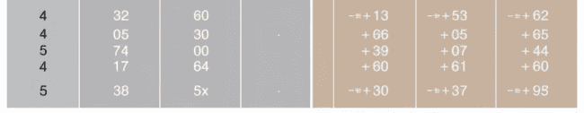
Algebraic Properties of Inverse Functions
1
Composition Property
2
Domain and Range Swap
3
Inverse of Inverse
The composition of a function and its inverse always results in the identity function: f(f^-1(x)) = x and f^-1(f(x)) = x. This property is a fundamental aspect of inverse functions.
The domain of f(x) is the range of f^-1(x), and the range of f(x) is the domain of f^-1(x). The input and output values of the original function and its inverse are effectively swapped.
The inverse of the inverse function is the original function: (f^-1)^-1(x) = f(x). This property reinforces the reversible nature of inverse functions.

Slide 6
Finding the Inverse of a Function
Step 1: Replace f(x) with y
1
Rewrite the function equation using "y" instead of "f(x)" to make the next steps more intuitive.
Step 2: Swap x and y
2
Interchange the variables "x" and "y" in the equation to reflect the inverse relationship.
Step 3: Solve for y
3
Isolate "y" in the equation to express the inverse function explicitly. This involves algebraic manipulation and possibly rearranging terms.
Step 4: Replace y with f^-1(x)
4
Substitute "f^-1(x)" in place of "y" to represent the inverse function in standard notation.

Slide 7
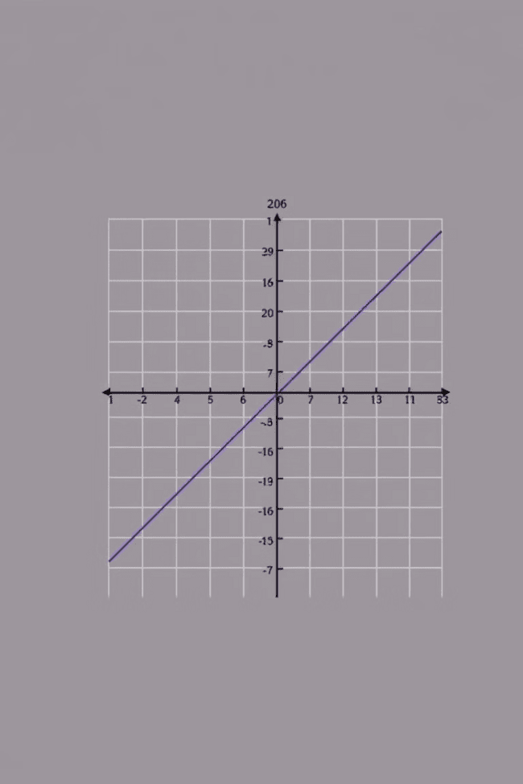


The Horizontal Line Test
Passing the Test
Failing the Test
A function has an inverse if and only if no horizontal line intersects its graph more than once. This test ensures that every output of the original function corresponds to a unique input in the inverse function.
If a horizontal line intersects the graph of a function more than once, the function does not have an inverse. This indicates that multiple inputs map to the same output, violating the definition of an inverse function.

Slide 8



Inverse Functions and their Domains
Restricted Domain
Sometimes, we need to restrict the domain of a function to ensure it has an inverse. This is often done for functions like square root or trigonometric functions that are not one-to-one over their entire domain.
1
One-to-One
2
By restricting the domain, we create a new function that is one-to-one, meaning that each output corresponds to exactly one input, making an inverse function possible.
Inverse Exists
3
Once the domain is restricted, we can find the inverse of the function, which will have a domain and range that correspond to the restricted domain and range of the original function.

Slide 9
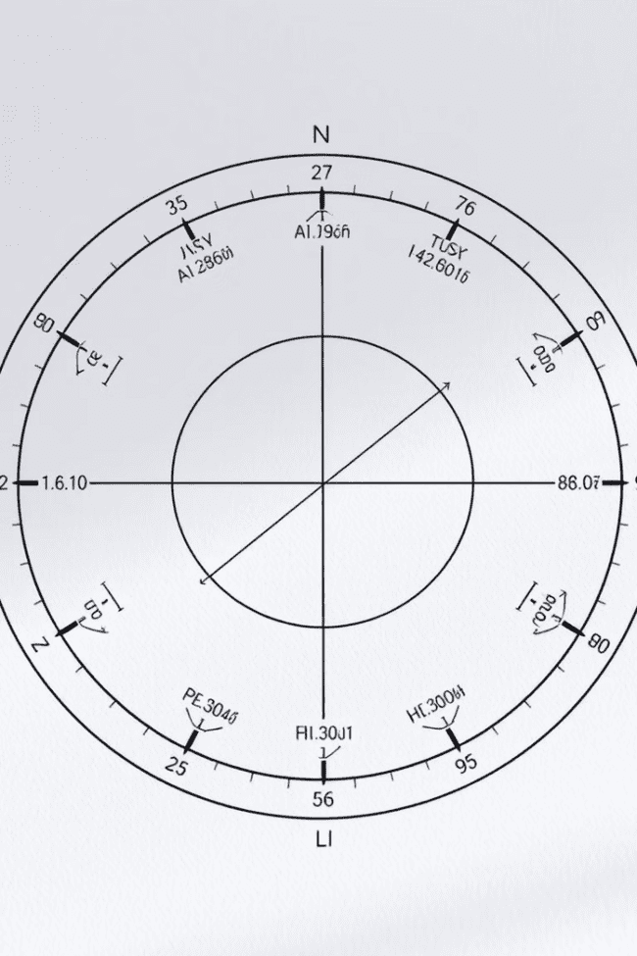
Inverse Trigonometric Functions
1
Sine
The inverse sine function, denoted as arcsin(x) or sin^-1(x), returns the angle whose sine is x. The domain of arcsin(x) is [-1, 1], and its range is [-π/2, π/2].
2
Cosine
The inverse cosine function, denoted as arccos(x) or cos^-1(x), returns the angle whose cosine is x. The domain of arccos(x) is [-1, 1], and its range is [0, π].
3
Tangent
The inverse tangent function, denoted as arctan(x) or tan^-1(x), returns the angle whose tangent is x. The domain of arctan(x) is (-∞, ∞), and its range is (-π/2, π/2).

Slide 10
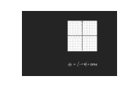
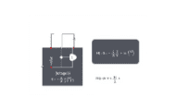
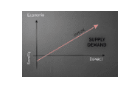
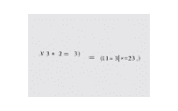
Applications of Inverse Functions

