Slide 1

Solving Quadratic Equations
This presentation will guide you through the fundamentals of solving quadratic equations, from understanding their basic structure to exploring their applications in various fields. We'll cover multiple methods for solving these equations, delve into their graphical representations, and explore the concept of imaginary and complex solutions.
RO
by Rejoice Onwurah

Slide 2
What are Quadratic Equations?
Definition
Key Features
A quadratic equation is a polynomial equation with a highest degree of 2, meaning the highest power of the variable is 2. They are often written in the standard form ax^2 + bx + c = 0, where a, b, and c are constants.
Quadratic equations exhibit a parabolic curve when graphed, with the shape determined by the coefficient 'a'. Their solutions, known as roots, represent the points where the curve intersects the x-axis.

Slide 3
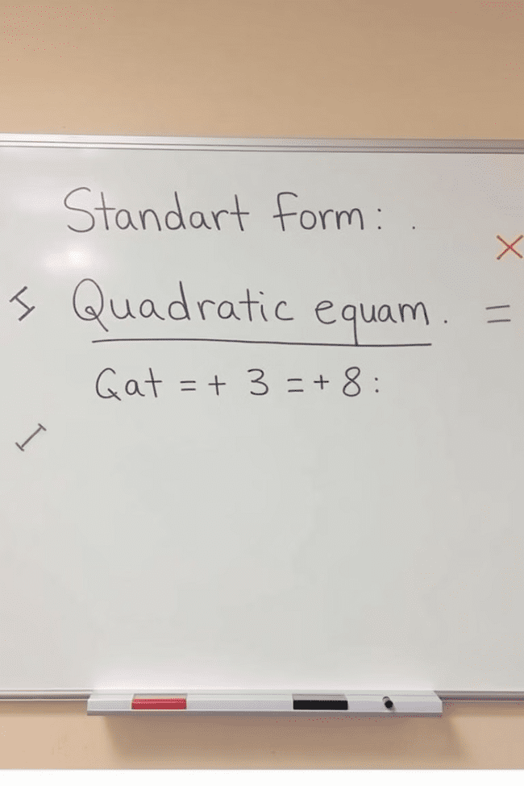
Standard Form of a Quadratic Equation
1
ax^2 + bx + c = 0
2
Example
The standard form reveals the coefficients of the quadratic term (a), the linear term (b), and the constant term (c). Understanding these coefficients is crucial for solving the equation.
The equation 2x^2 - 5x + 3 = 0 is in standard form, with a = 2, b = -5, and c = 3.

Slide 4
Solving Quadratic Equations by Factoring
Factorization
Example
This method involves breaking down the quadratic expression into two linear factors. The solutions are then found by setting each factor equal to zero and solving for x.
To solve x^2 - 5x + 6 = 0, we factor it as (x - 2)(x - 3) = 0. Setting each factor to zero gives us x = 2 and x = 3.

Slide 5



Solving Quadratic Equations by Completing the Square
Rearrange
1
Move the constant term to the right side of the equation.
Complete the Square
2
Take half of the coefficient of the x term, square it, and add it to both sides of the equation.
Factor and Solve
3
Factor the left side as a perfect square trinomial, take the square root of both sides, and solve for x.

Slide 6



Solving Quadratic Equations using the Quadratic Formula
Formula
Example
The quadratic formula provides a direct solution for x, regardless of the complexity of the equation. It's derived by completing the square, but can be applied directly.
To solve 3x^2 + 2x - 1 = 0, we plug a = 3, b = 2, and c = -1 into the formula: x = (-b ± √(b^2 - 4ac)) / 2a.

Slide 7
Graphing Quadratic Equations
Parabola
1
Quadratic equations always produce a parabolic curve when graphed. The vertex of the parabola represents the minimum or maximum point of the curve.
X-intercepts
2
The solutions of the equation, or roots, correspond to the points where the parabola intersects the x-axis, known as the x-intercepts.
Y-intercept
3
The y-intercept represents the point where the parabola intersects the y-axis. It's determined by setting x = 0 in the equation.

Slide 8
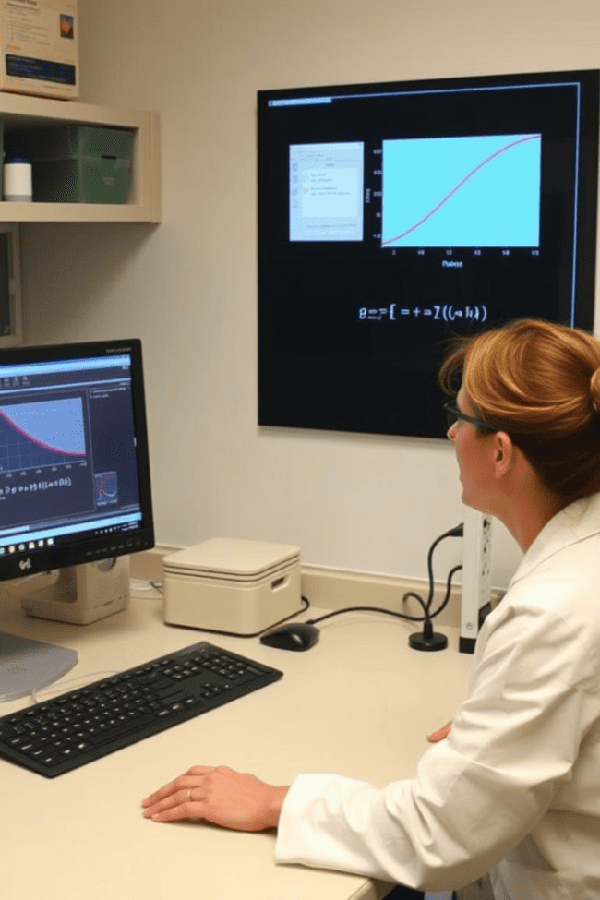
Applications of Quadratic Equations
1
Physics
Quadratic equations are used to model projectile motion, describing the trajectory of objects launched into the air.
2
Engineering
They are employed in designing structures, calculating forces, and analyzing the behavior of materials under stress.
3
Finance
Quadratic equations are used in financial modeling, such as calculating compound interest and analyzing investment returns.

Slide 9
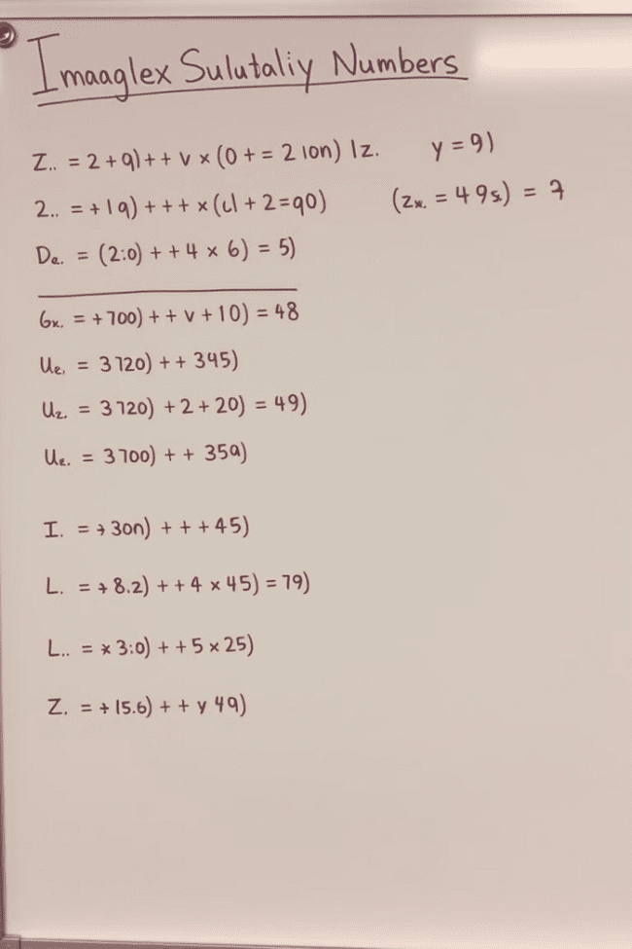
Imaginary and Complex Solutions
Discriminant
Imaginary Unit
The discriminant, b^2 - 4ac, determines the nature of the solutions. If it's negative, the equation has complex solutions involving imaginary numbers.
The imaginary unit 'i' is defined as √-1. Complex numbers are expressed in the form a + bi, where a and b are real numbers.
Applications
Complex numbers are essential in various fields like electrical engineering, signal processing, and quantum mechanics.

Slide 10

Practice Problems and Recap
This presentation has introduced you to the world of quadratic equations. Remember the standard form, explore the different solving methods, and practice using them. You can find numerous practice problems online and in textbooks to solidify your understanding. If you encounter difficulties, don't hesitate to seek help from your teacher or a tutor. The more you practice, the better you'll become at solving these equations.

